Slide 1

The State of Solar in NY

Slide 2
NEW YORK
3rd most populous state
19 million residents
13th largest economy in the world
2nd in per capita energy consumption efficiency
350,000 engineers & scientists

Slide 3
Demand and Growth
Where is the best place to put your savings?
Energy efficient products
Creating demand
Media attention

Slide 4
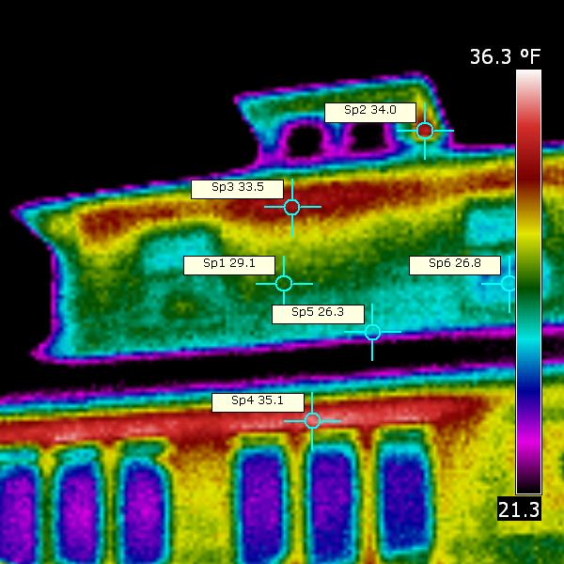

Slide 5
OLD BUILDINGS
Insulation confusion:
Attic vs. Living space
Fluffy paper
Closed cell foam
Open cell foam
No insulation
Not air tight
Wind steals heat
Thermal bridging

Slide 6
BUILDING CODES
Goals
Barriers
Triple Building Codes NOW
R-22 walls
R-50 under roof
R – 9 windows and doors
Blower door test
Contractors have issues
Oversight of specs
Buyers want more sq. ft.
View vs. Solar Gain

Slide 7
STREAMLINE PERMITTING
Permitting adds an average of $2500.00 to the cost of a solar installation.
Every town is different.
New technology issues/barriers…

Slide 8
LANDLORDS
How will owners of commercial and residential buildings change energy usage?
“My rent will go up!”

Slide 9
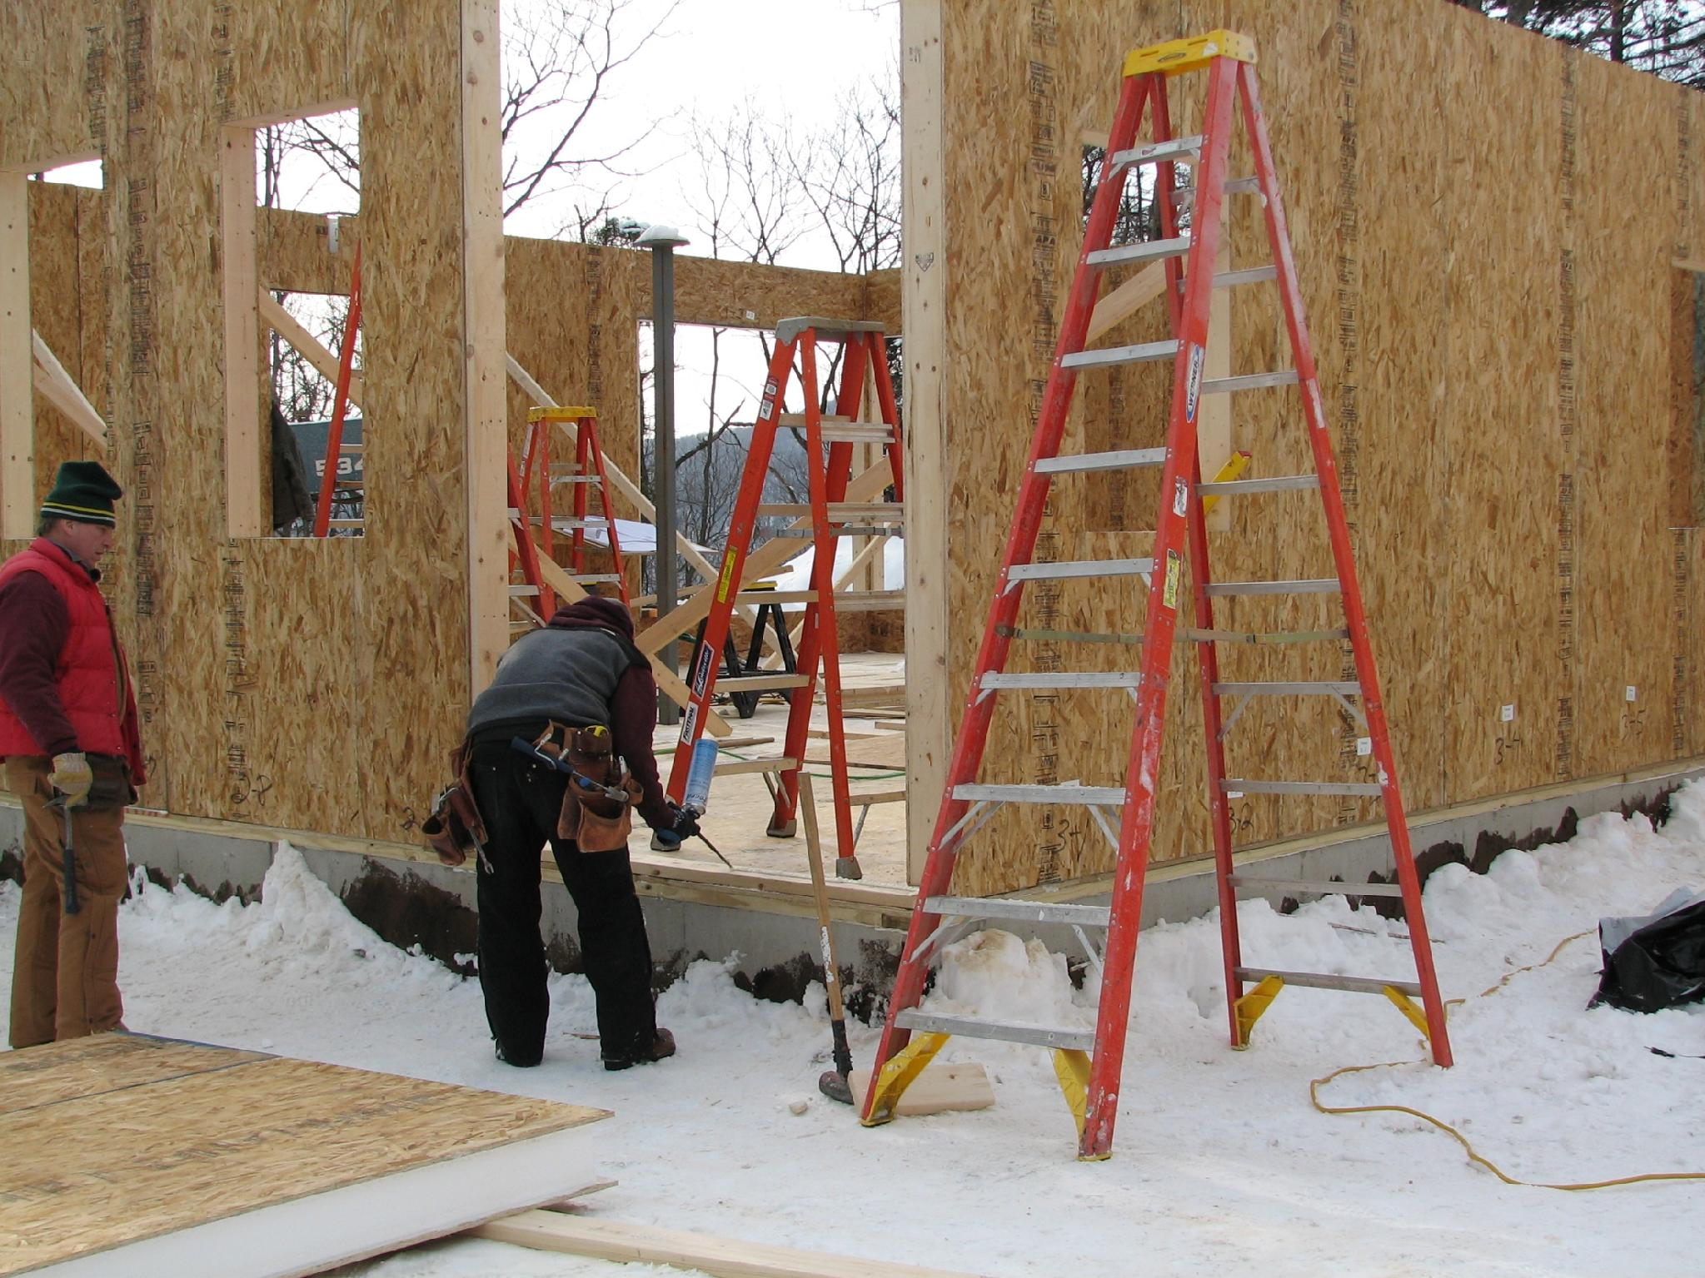

Slide 10
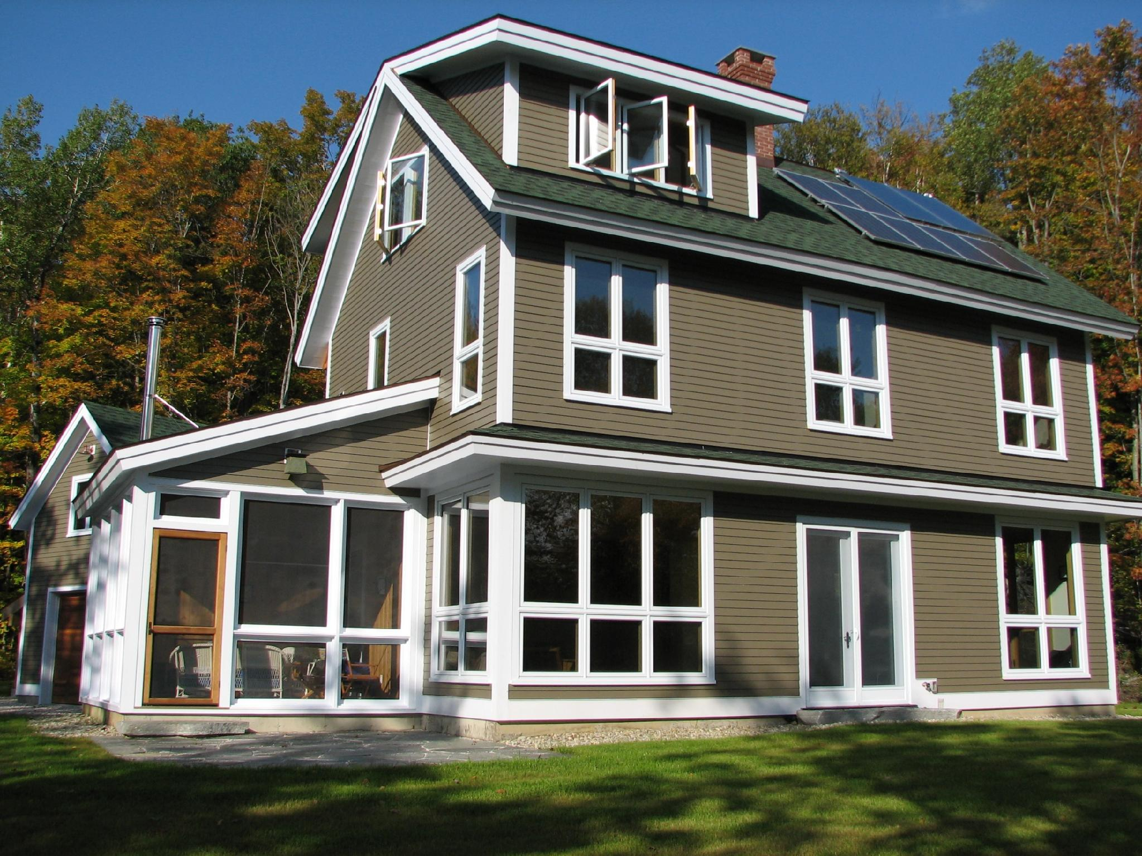

Slide 11
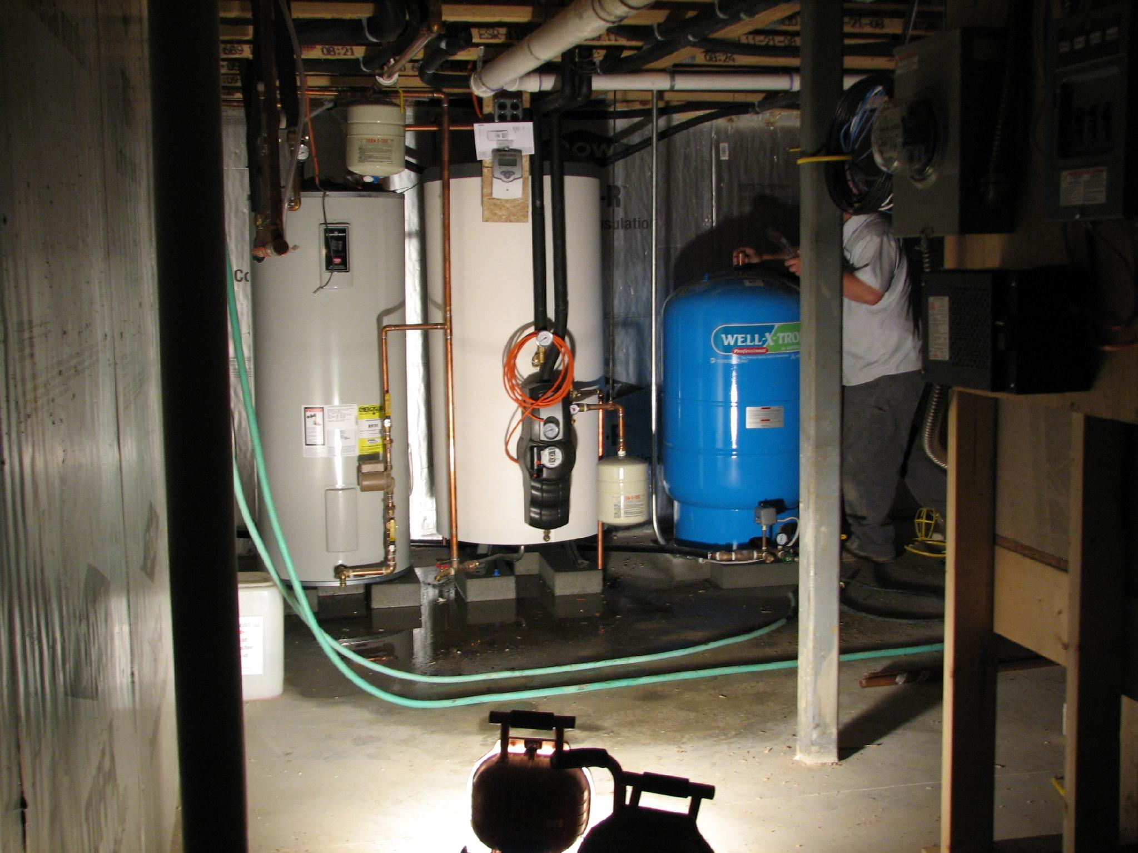

Slide 12
INEXPENSIVE + FAST PAYBACK
Solar Hot Water
includes
ENERGY STORAGE

Slide 13
Solar Hot Water
positive
negative
Simple
Free energy
Night time storage
Long life
Change
Upfront cost
Might move away
Cloudy days

Slide 14
Solar Cooker
positive
negative
Conversation piece
Free fuel
Portable
Multiple units
Can’t burn food
No sun, no heat
Daytime
Not a grill
Effort

Slide 15
Solar Heat
Overlooked
Inexpensive
Easy tie in
Remarkable savings

Slide 16
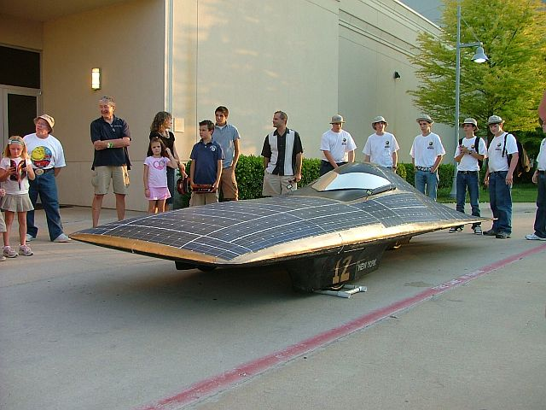
Transportation

Slide 17
AIR TO AIR HEAT PUMPS
COOL
HEAT
MINI SPLIT
COMMON IN EUROPE, ASIA

Slide 18
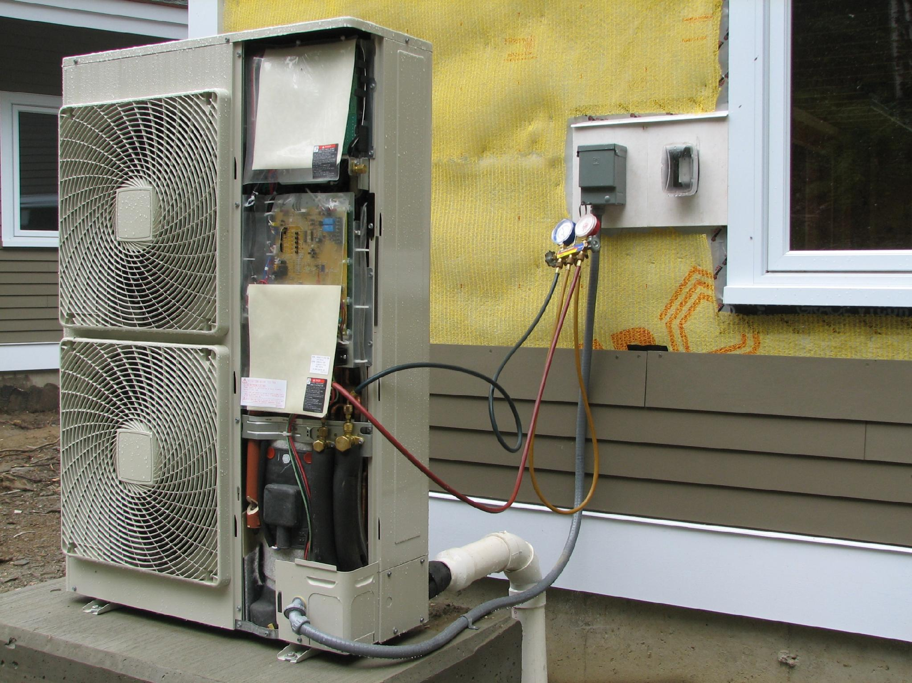

Slide 19
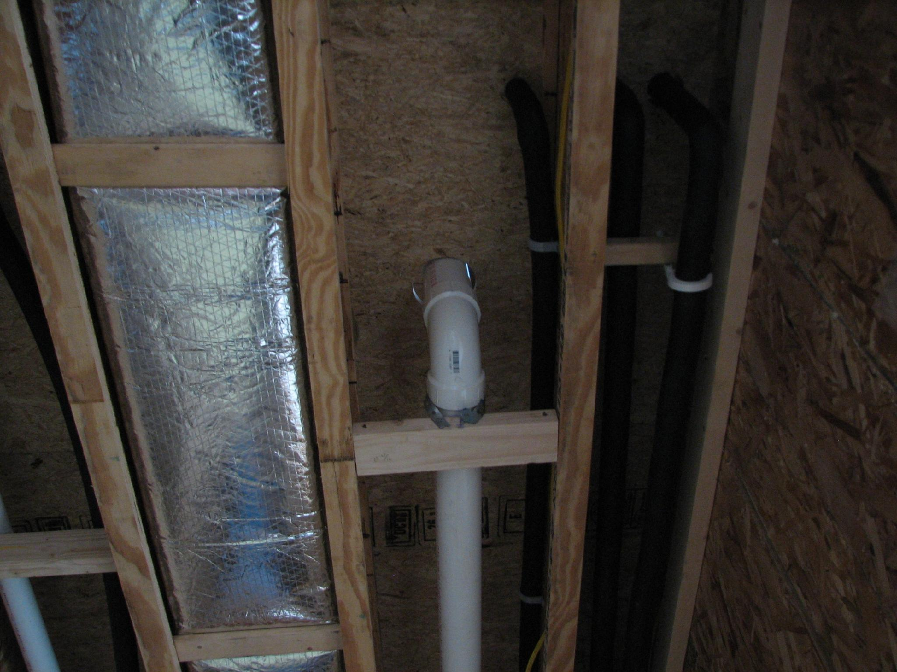

Slide 20
PHOTOVOLTAICS – 1.45 KW
Well pump
Solar hot water pump
Outlets
Wash
Flush
Recharge

Slide 21
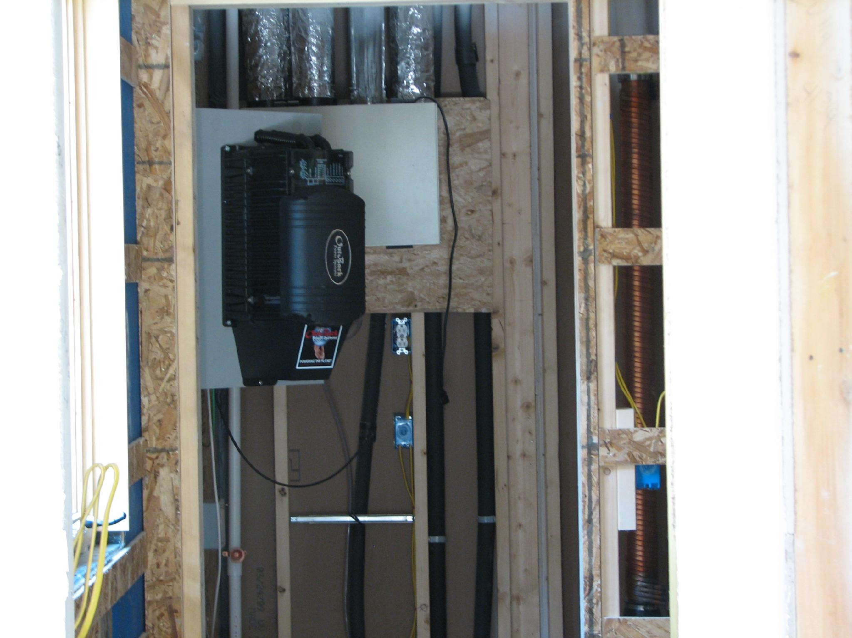

Slide 22
ENERGY SECURITY
Efficient Ratepayer/Taxpayer
  Keeps dollars local +
      Healthy environment =
        Positive ROI

