Slide 1

myRESEARCH IRB Instructions to Submit CR Information When Using an External IRB

Slide 2
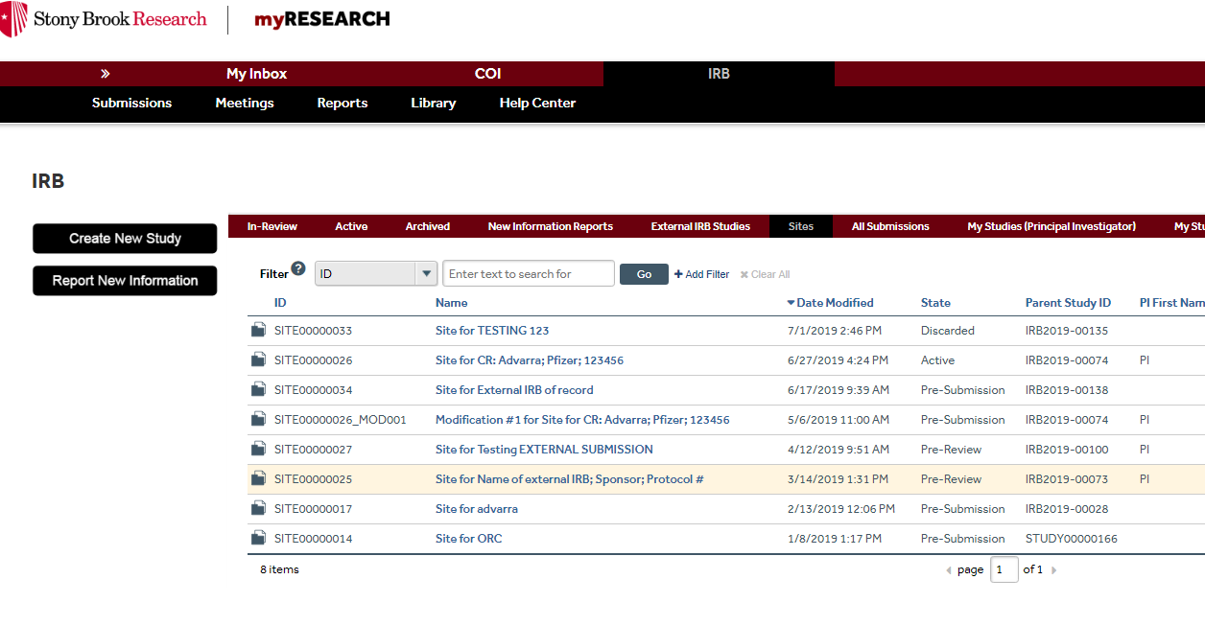
Click on Active study

Slide 3
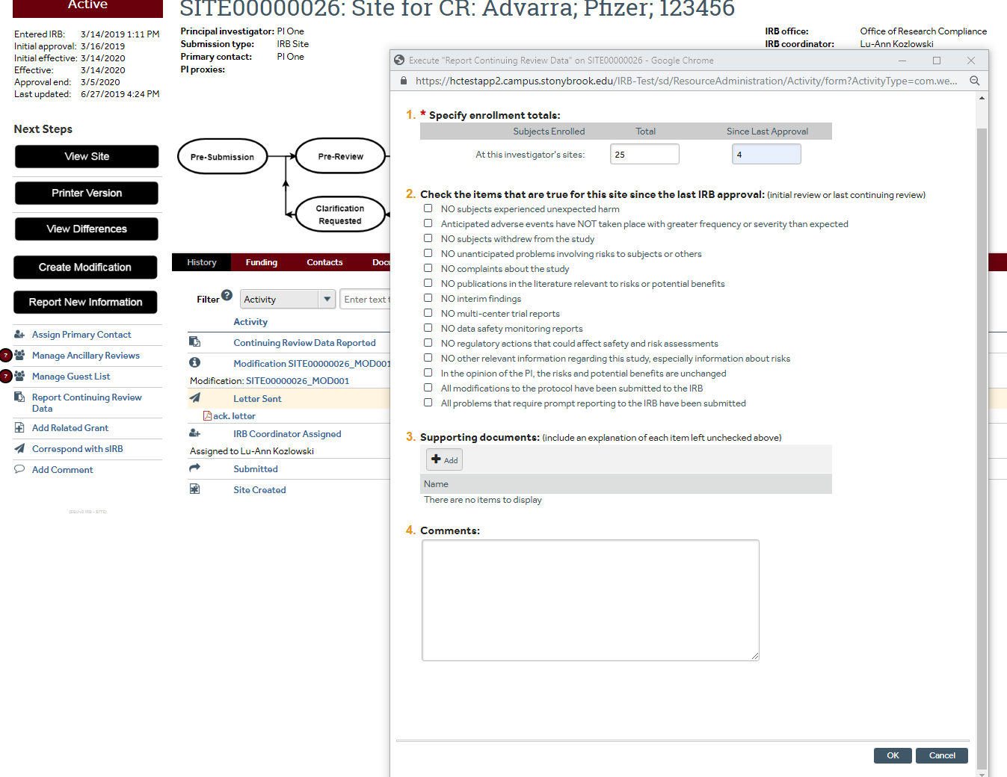
Click “report continuing review data” and then complete questions in pop up screen
Click ok when finished

Slide 4
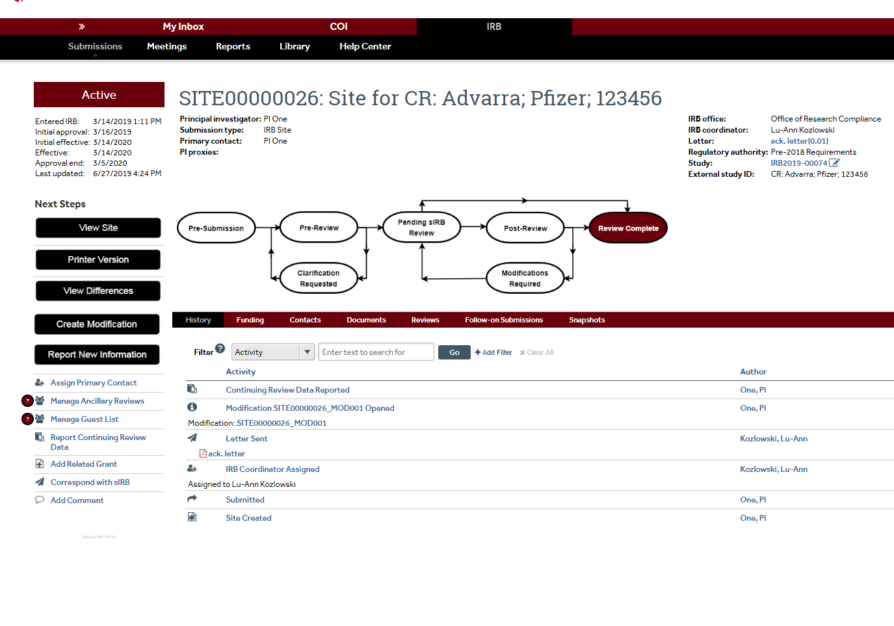
Click: CREATE MODIFICATION

Slide 5
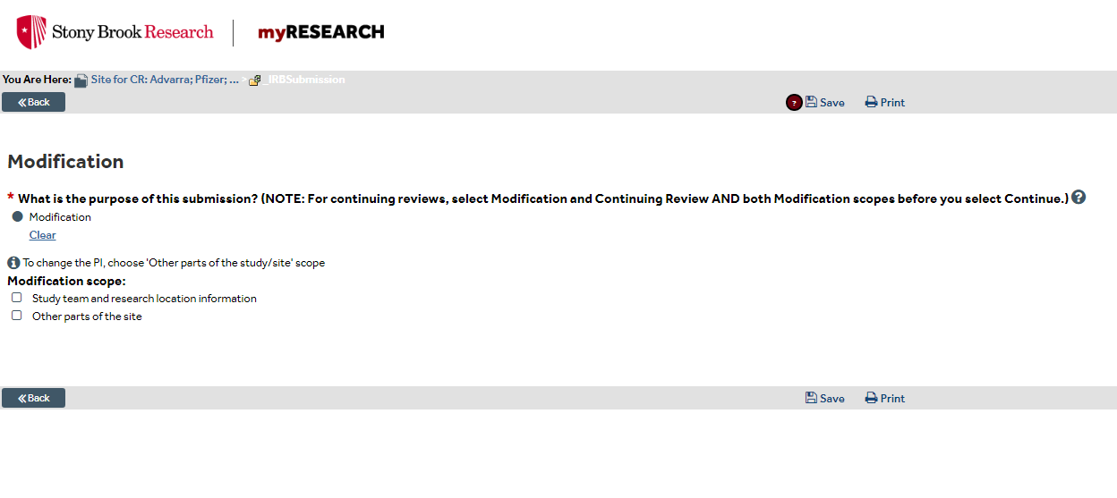
Click Modification and then choose the appropriate scope below, then continue

Slide 6
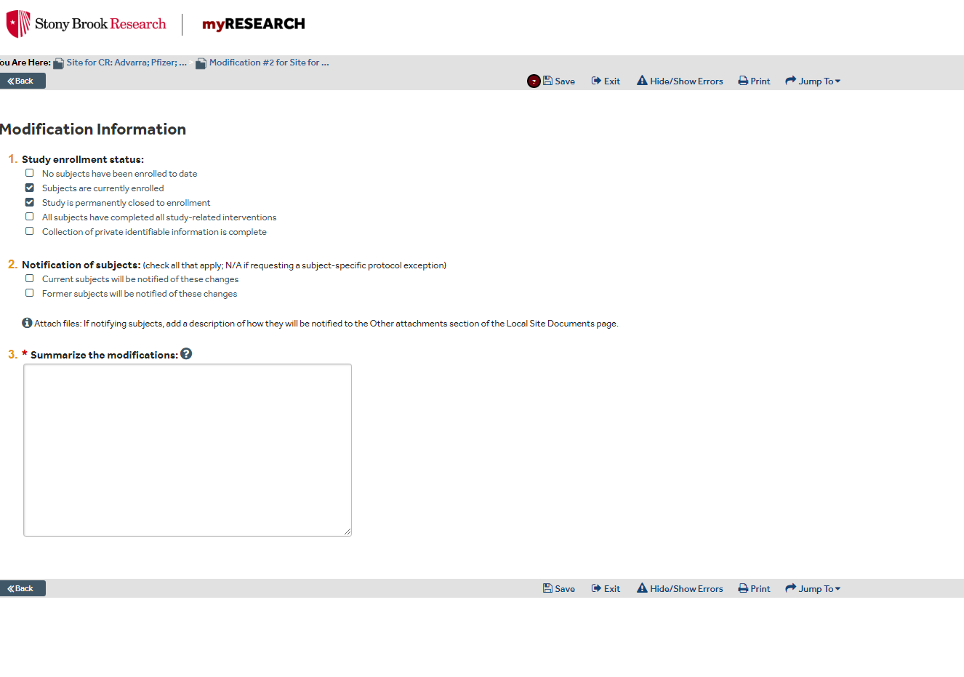
Choose appropriate status of study
Check if modification requires subject notification. Leave blank if N/A
EX:
Minor Amendment:
1. Change in personnel – addition of Jane Doe
Provide Summary of modification – This acts as cover memo
Then CONTINUE
OR
1. Continuing Review Submission

Slide 7
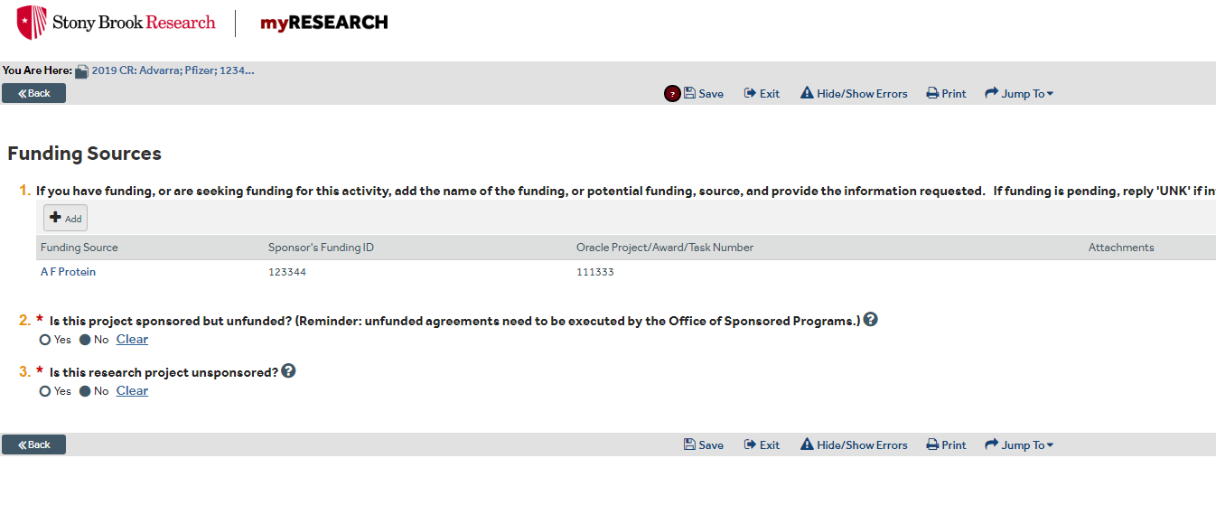
Update Funding if Applicable

Slide 8
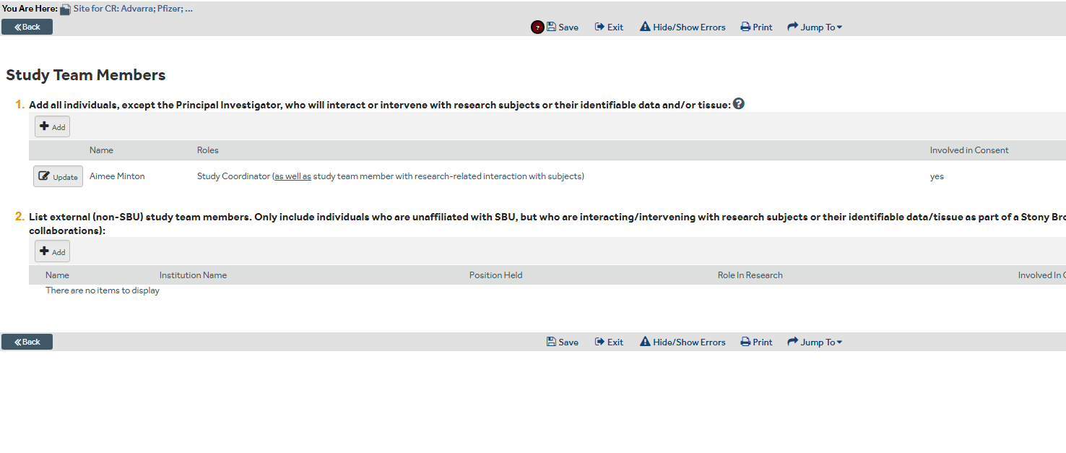
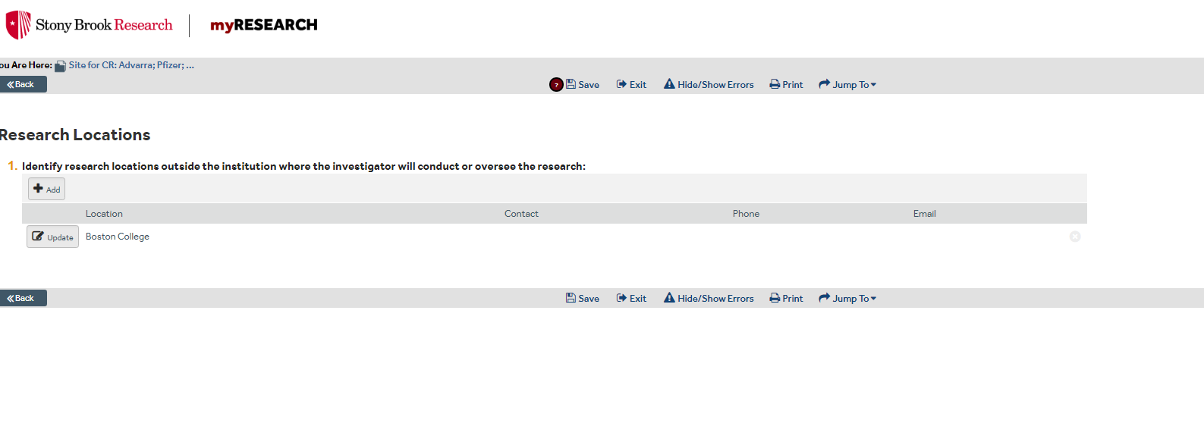
Update and add personnel/locations if applicable
*These pages only pop up if study team option was chosen on first page

Slide 9
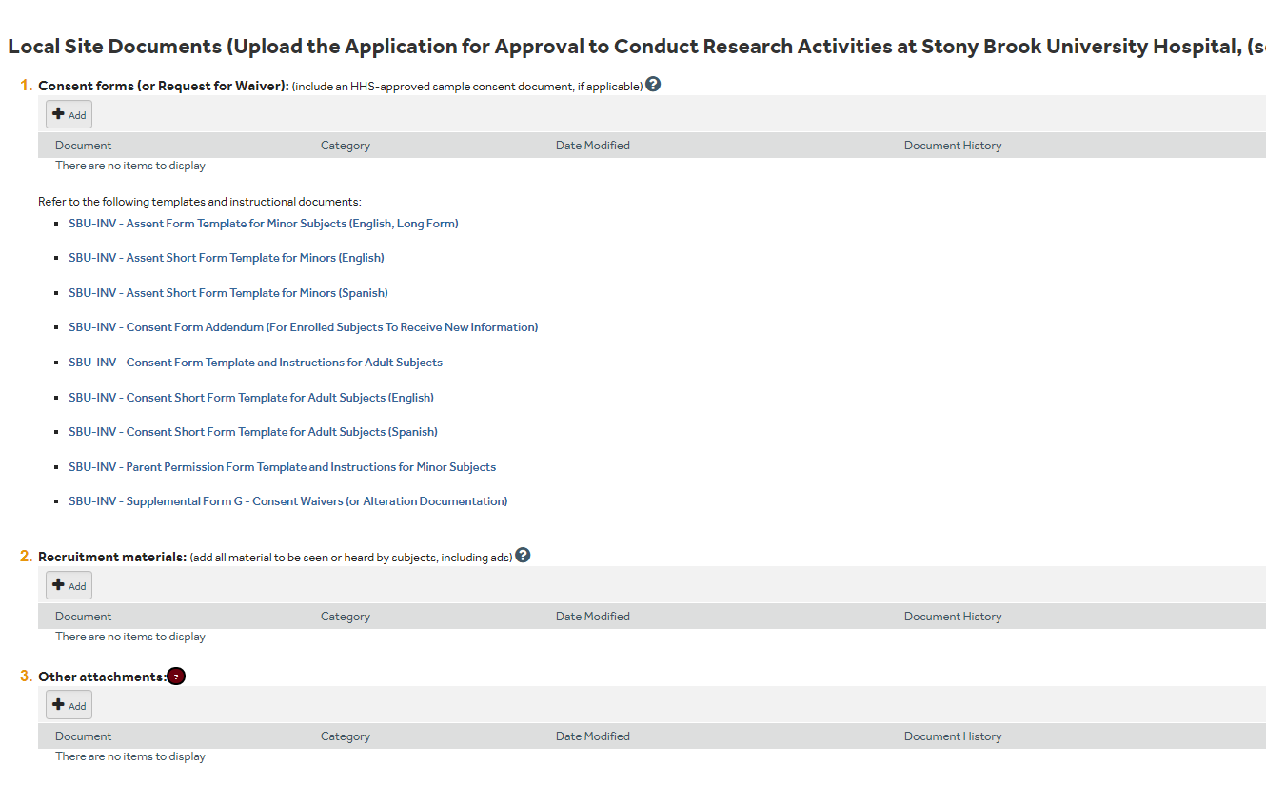
Add updated site specific Consent Forms
Add updated site recruitment materials
Add “other” updated site specific Forms
i.e. redacted consent form and I/E checklist if enrolled since last approval

Slide 10
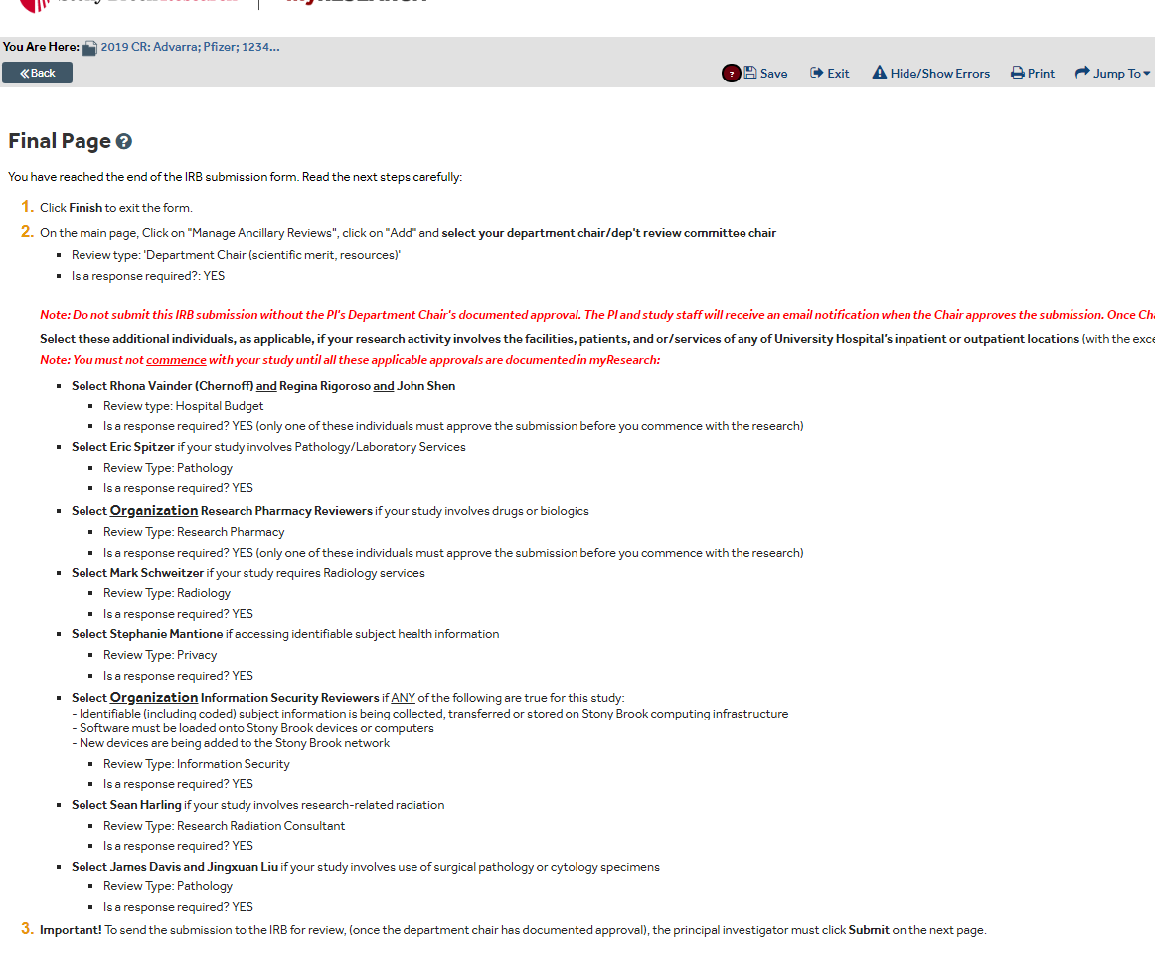
Make note of any ancillary reviews required for submission – this will be managed on the next page
Click FINISH

Slide 11
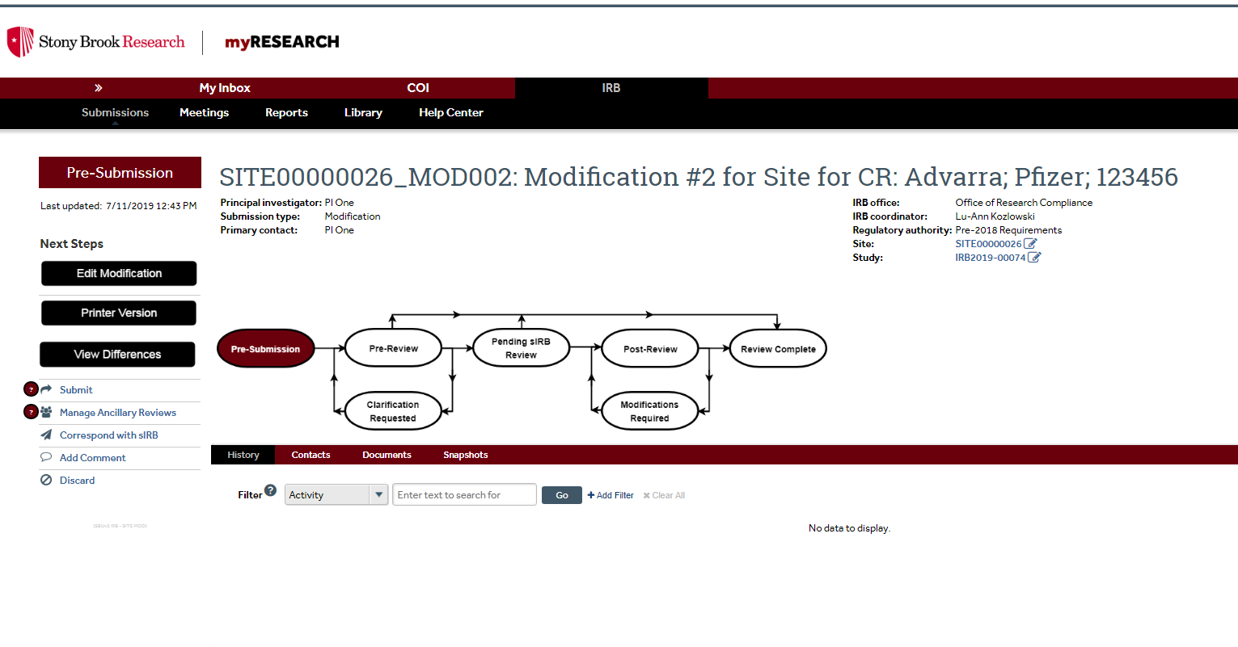
Click blue study link to upload current reviewing IRB documents into the “study”
i.e. current approval letter, updated protocol, updated master documents (not site specific)

Slide 12
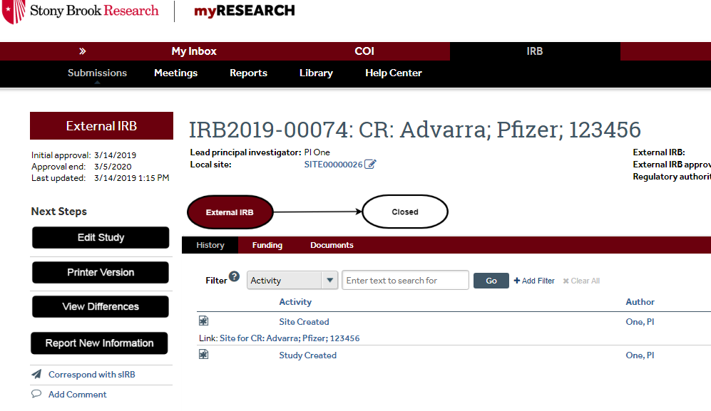
Click to EDIT STUDY

Slide 13
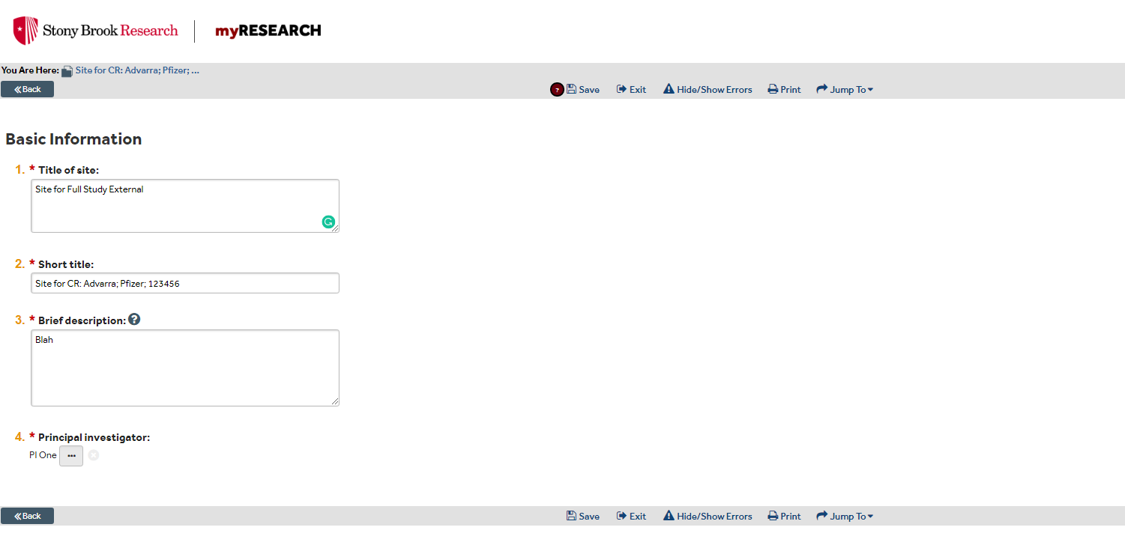
Include any changes to these fields if applicable and then Add Year to pre-fix of short title
Ex: “2019 CR: Advarra; Pfizer: 123456”
Continue..

Slide 14
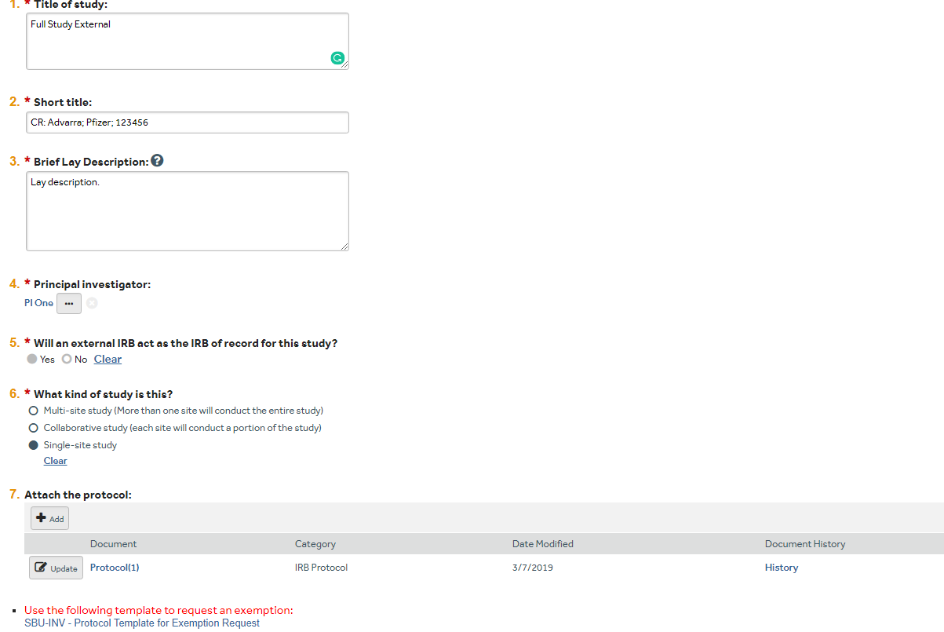
Label and add updated version of protocol then continue

Slide 15
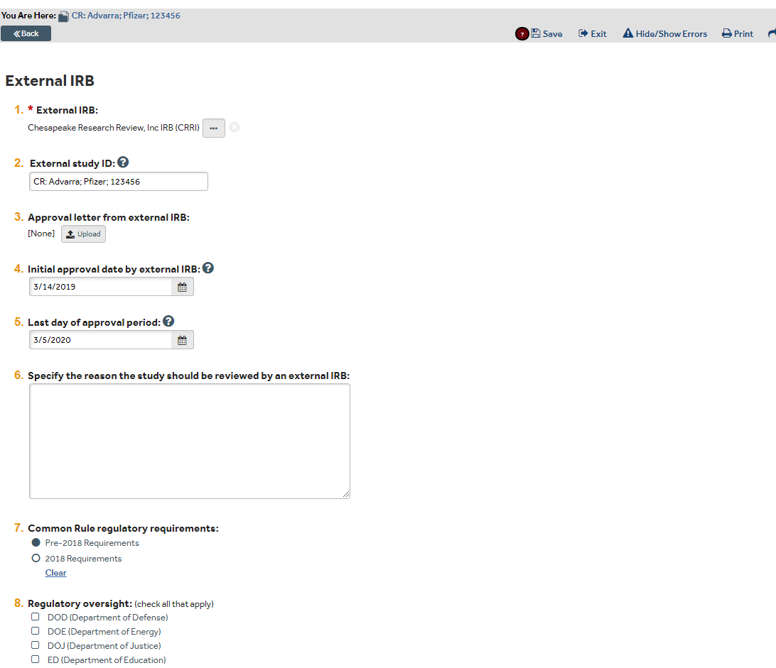
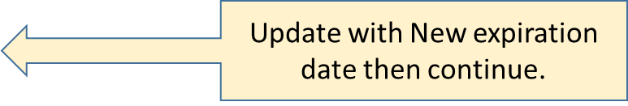
Add renewal approval letter

Slide 16
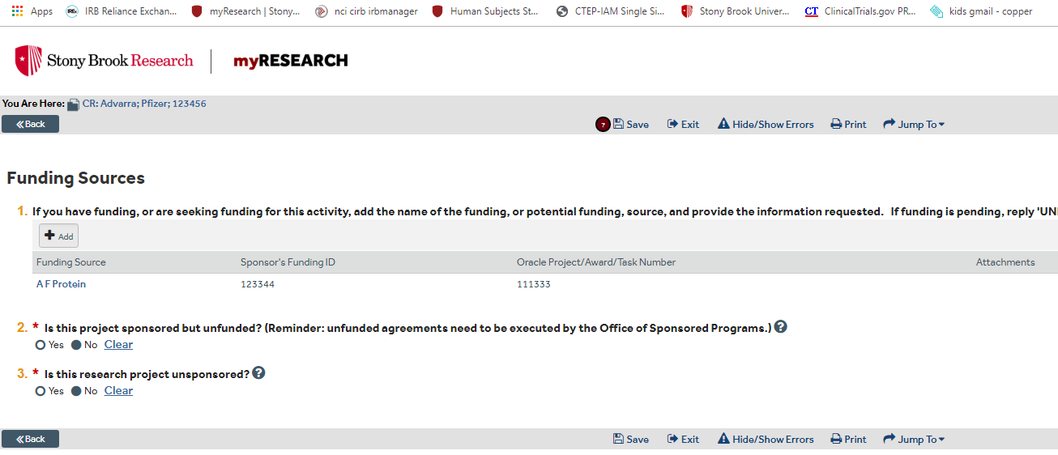
Add or edit funding information if applicable then continue.

Slide 17
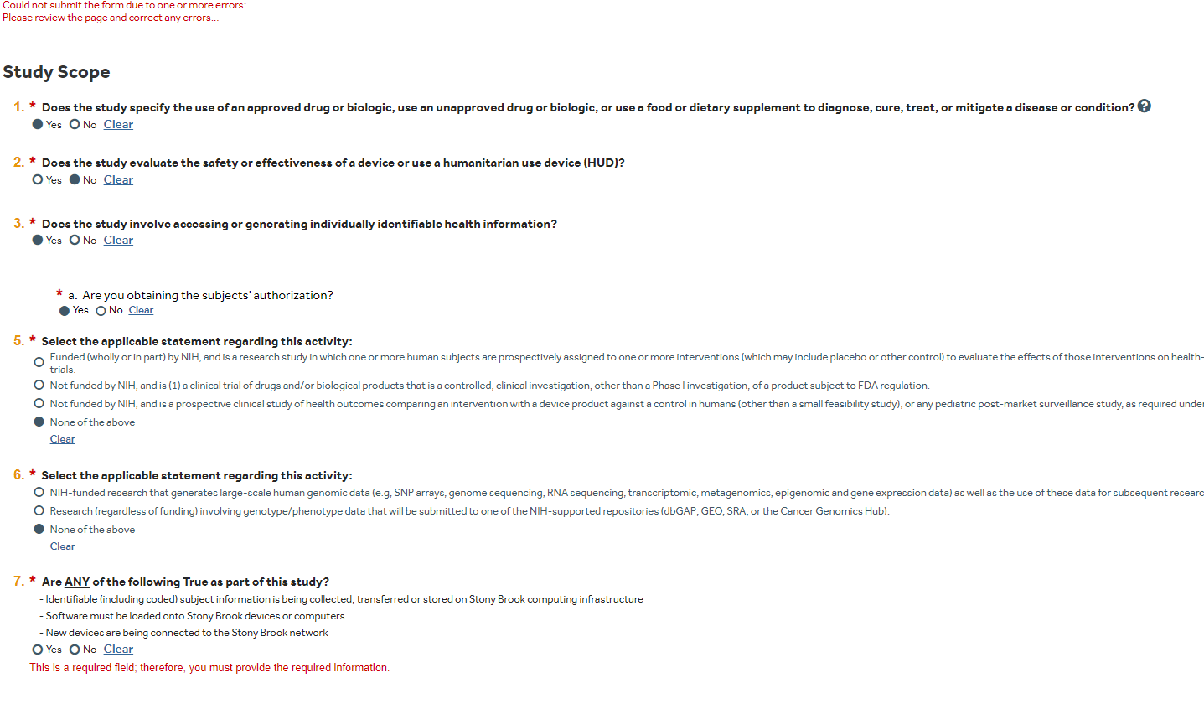
Only edit information if applicable (may need to provide answer to new question #7 & #8 Then continue…

Slide 18
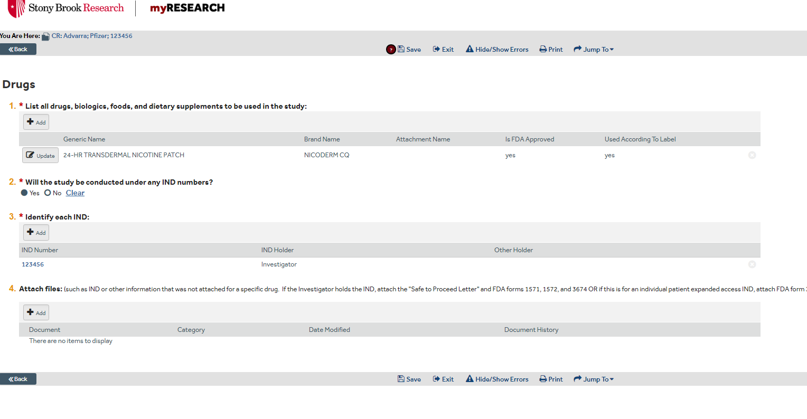
Update drug information or other study specific fields if applicable, then continue to next page and click FINISH

Slide 19
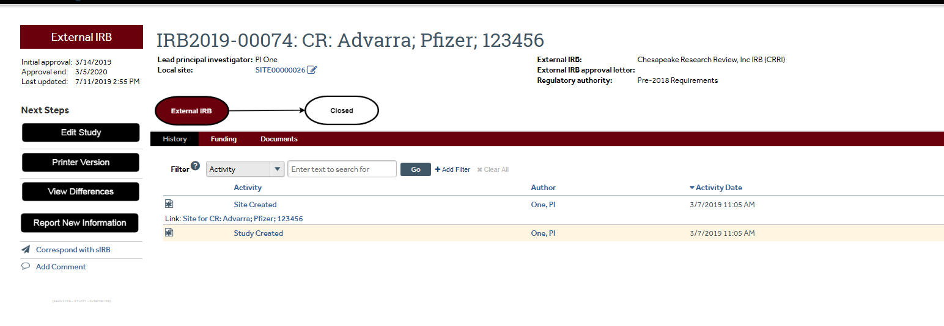
CLICK blue local site link to return to site information

Slide 20
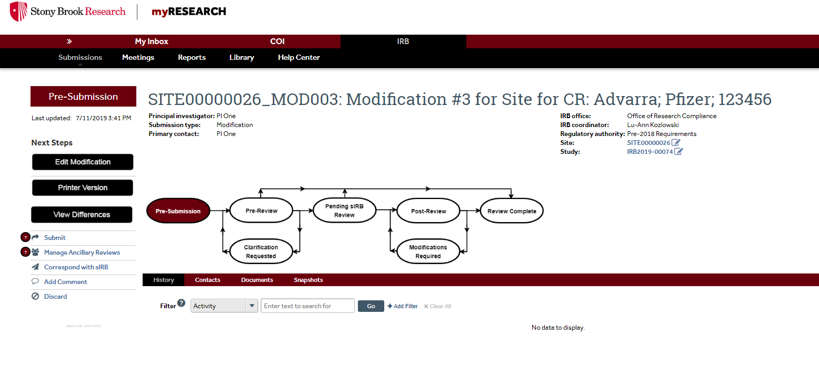
Manage Ancillary Reviews. Once Chair signature obtained, PI must “submit” the study

