Slide 1
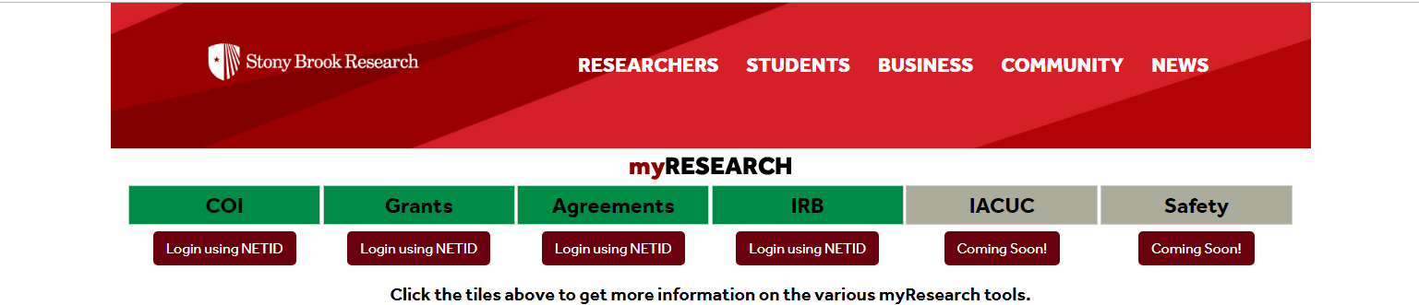
External IRB Submission Process in myRESEARCH
Advarra and NCI-CIRB are currently in the system
Other sites may be requested by emailing ovpr_myresearchirb@stonybrook.edu
External IRB Continuing Renewal Submissions must be submitted as a NEW STUDY in myRESEARCH
Lu-Ann Kozlowski
v.3.7.19

Slide 2
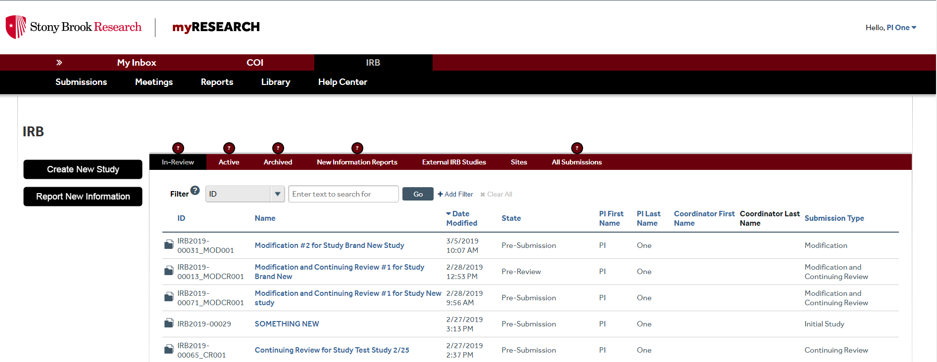
Step 1 page 1: CREATE NEW STUDY

Slide 3
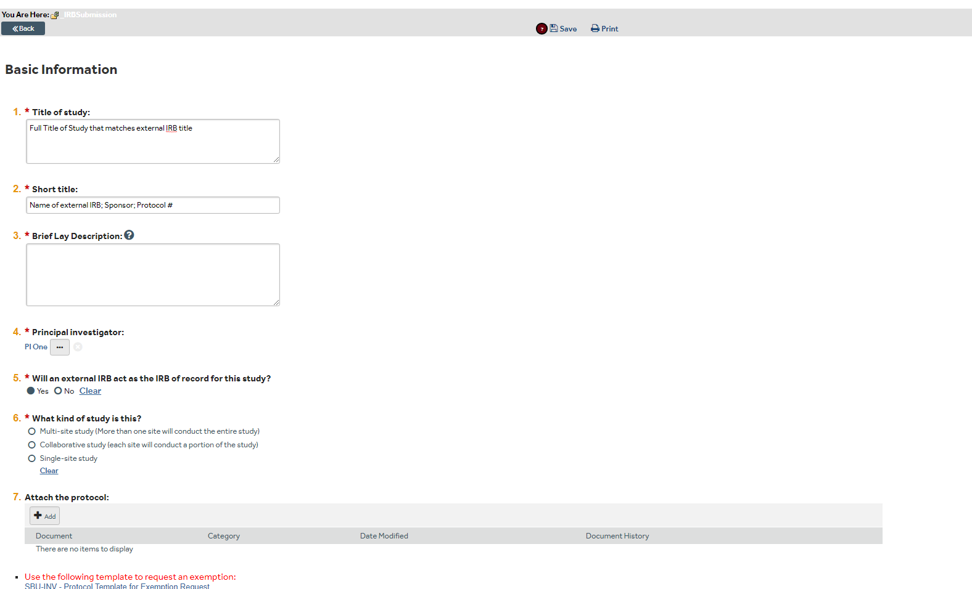





Step 1 Page 2: External IRB Information
Full title should Match external IRB title
Ex: Advarra; Friendly Pharmaceuticals; 7V34986
***If this is a continuing review include CR and IRBNet# before external IRB name
EX: CR#134756: Advarra; Friendly Pharmaceuticals; 7V34986
Must YES for external IRB
Add external study protocol -

Slide 4
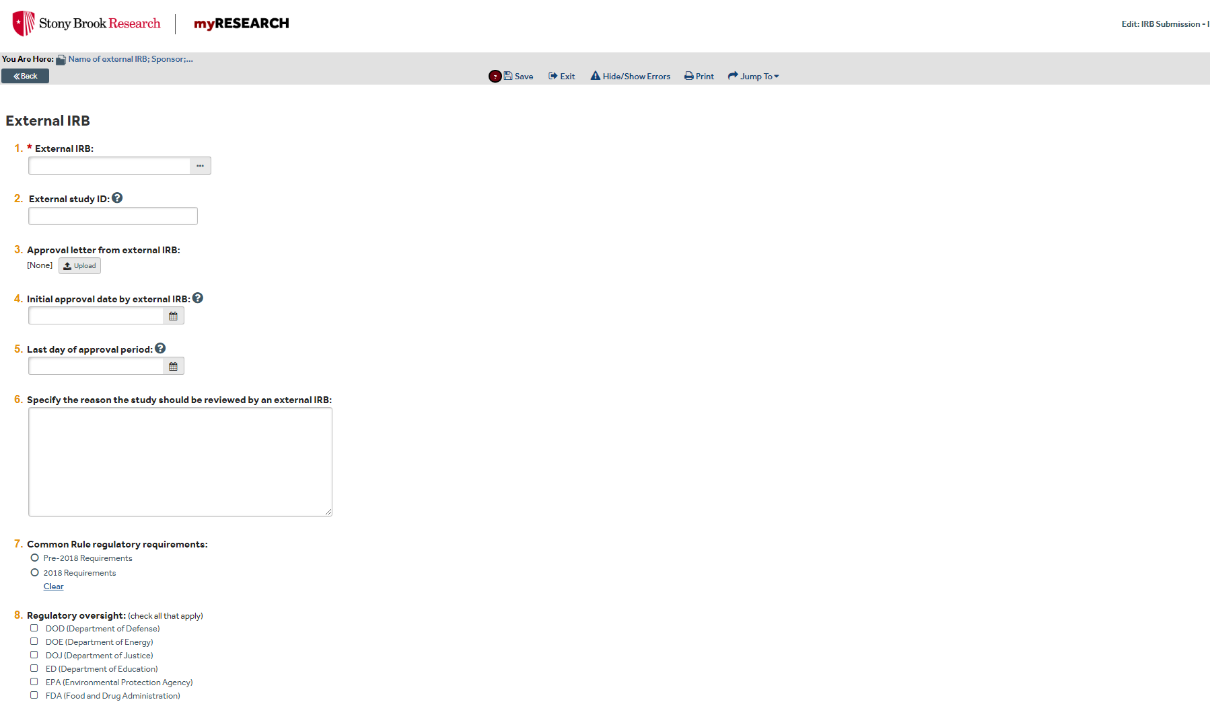



Step 1 Page 3: Complete Basic Information
Use drop down menu to add the IRB of record. If the IRB does not appear, email ovpr_myresearchirb@stonybrook.edu to request site addition.
Currently available sites: Advarra, NCI (adult), NCI (pediatric)
Same as Short Title
FDA regulated research Pre-2018 requirements
Non FDA regulated research 2018 requirements
Answer questions 3-12 as applicable

Slide 5
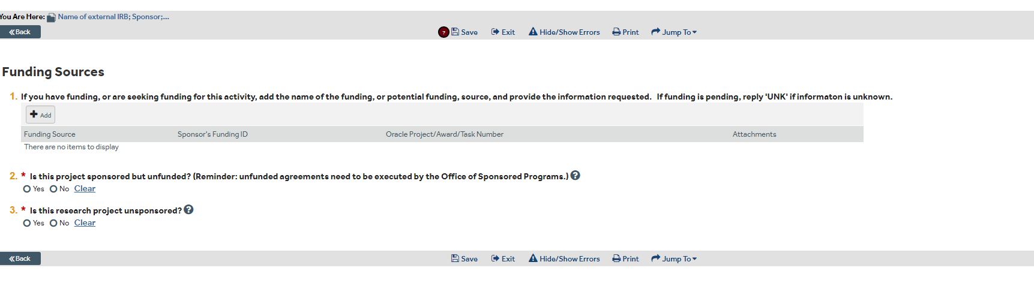

Step 1 Page 4: Funding Information
Add Applicable Funding Information: If choose unsponsored option, more inquiry fields will open

Slide 6

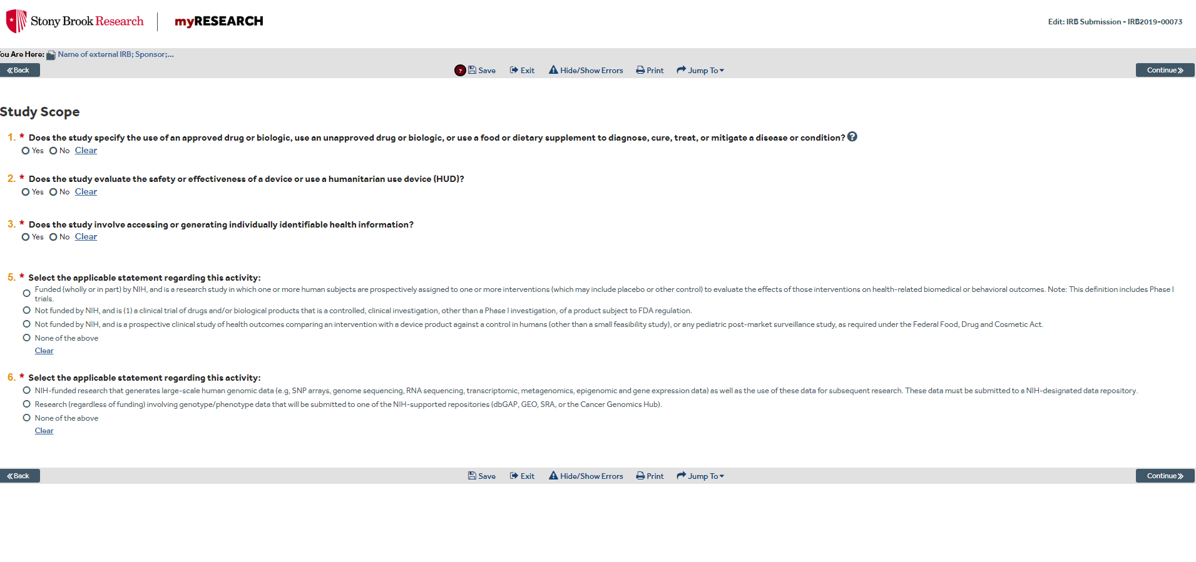
Step 1 Page 5: Study Scope
All study scope questions MUST be answered. More inquiries may appear based on answer given

Slide 7
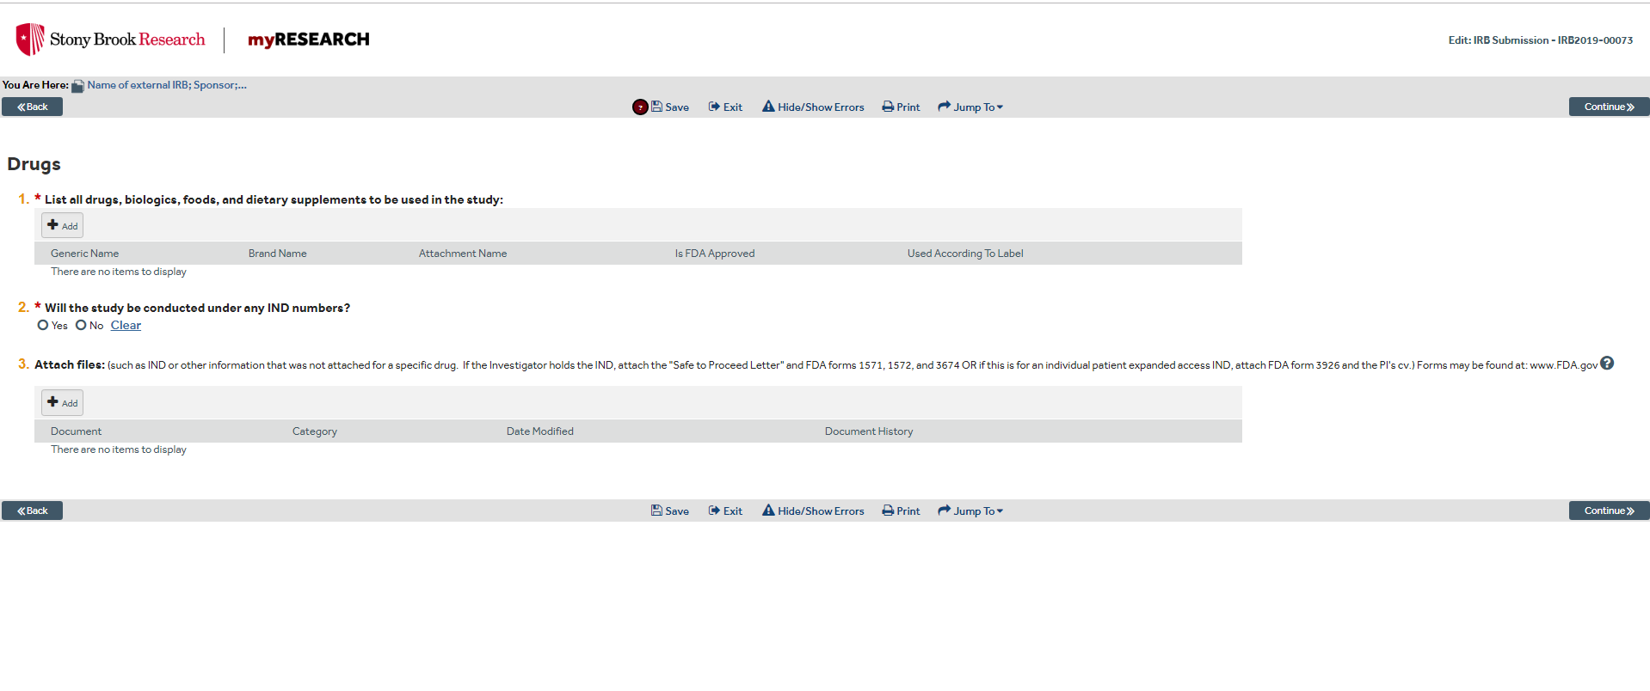


Step 1 Page 6: Drug Information
#1. Click ‘add’ for pop up window to add all study items
#2. Window will pop up to add IND information (number and holder)
#3. Only attach listed forms if the INVESTIGATOR holds the IND

Slide 8
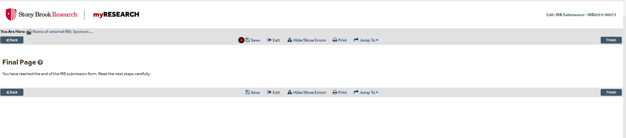

Step 1 Page 7: Final Page
Click FINISH and move on to STEP 2

Slide 9
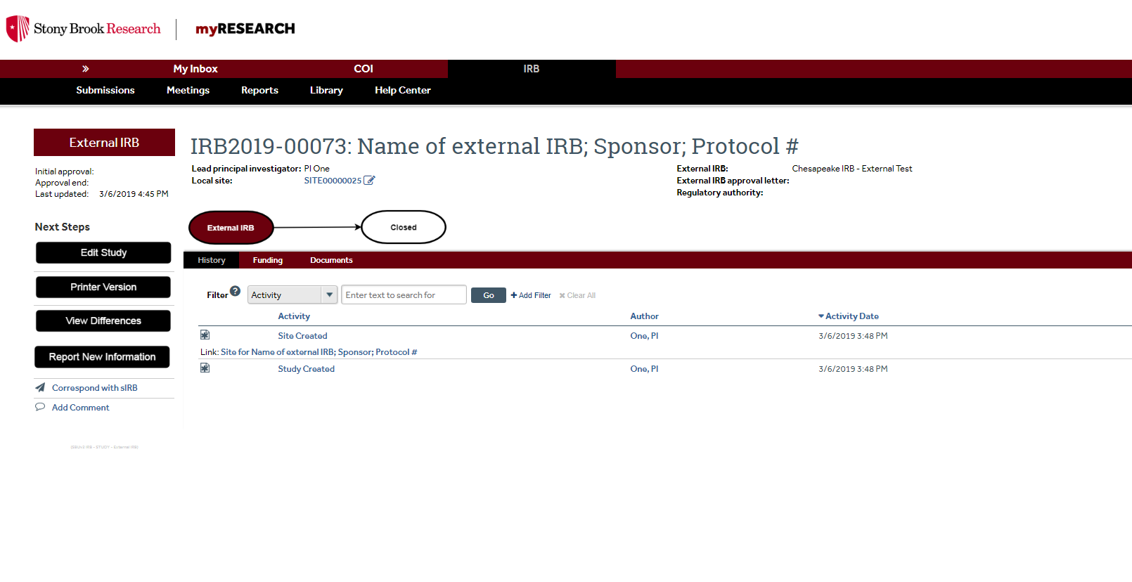

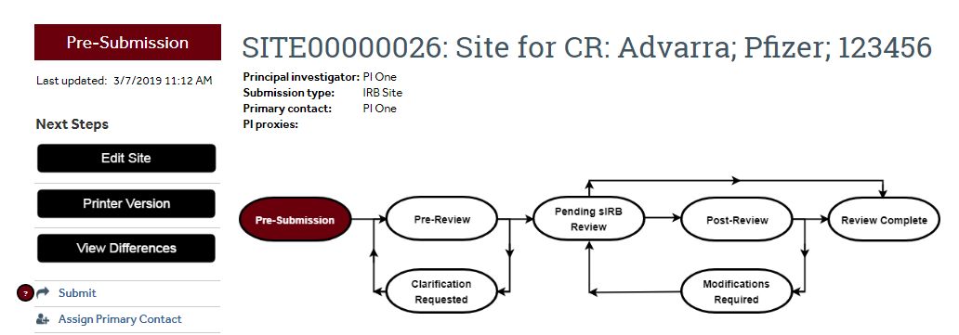
Step 2 Page 1: Add Local Site Information
**MUST click to add local site information or will be unable to submit
EDIT site

Slide 10
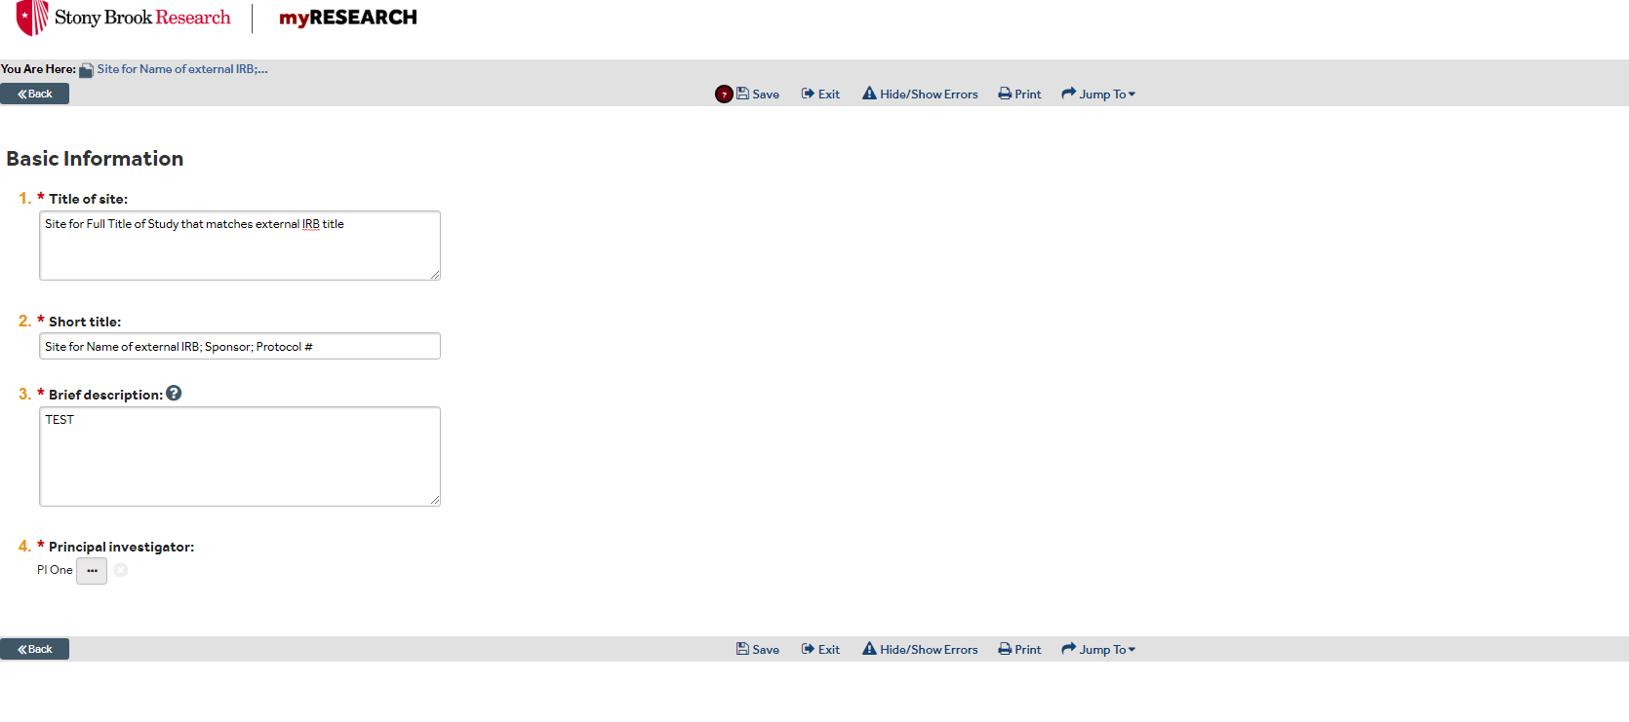
Step 2 Page 2: Basic Information
This is duplicate of study information, Titles will auto populate from previous screen

Slide 11
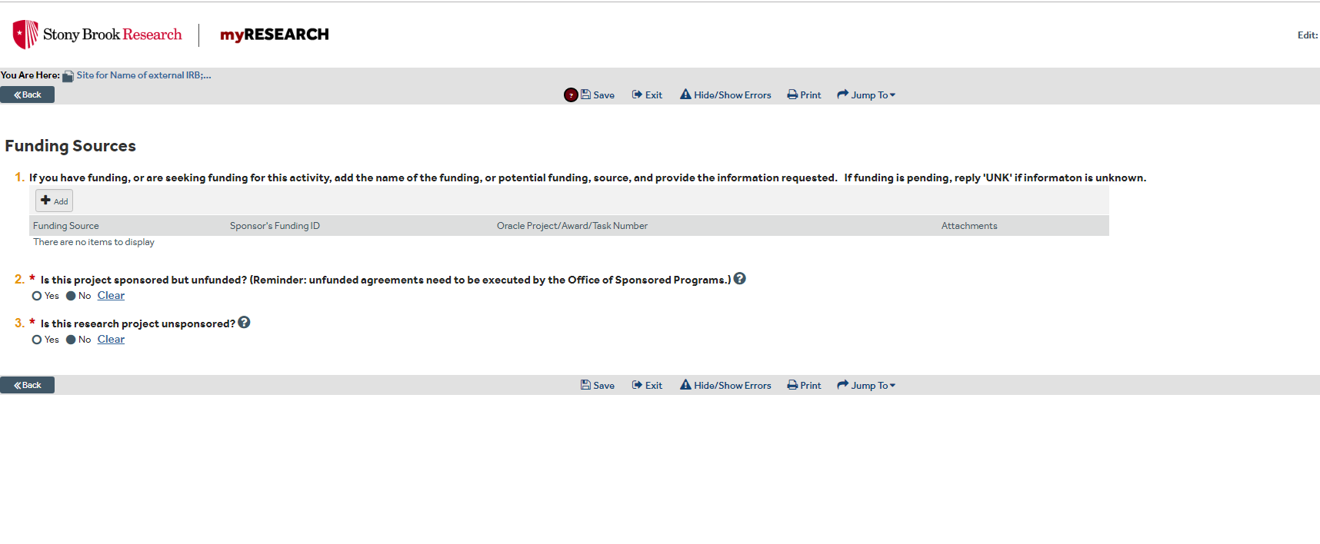
Step 2 Page 3: Funding
Duplicate page. Must be completed

Slide 12
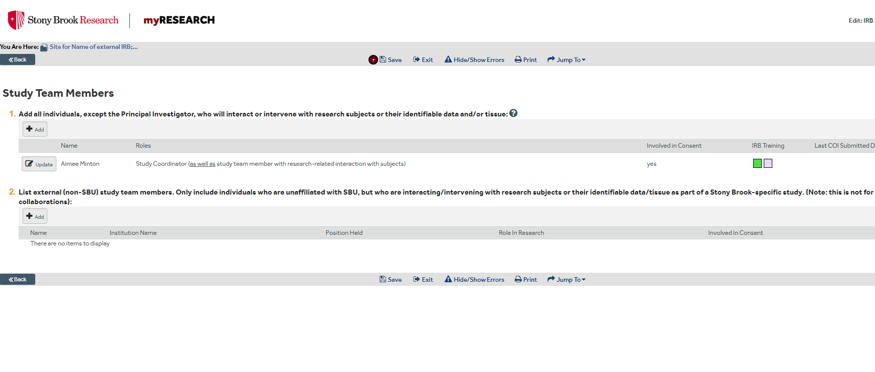
Step 2 Page 4: Add the Study Team
Hover to see which training was completed and expiration dates to verify all training requirements have been met.
Click to add study team members and define their role.

Slide 13
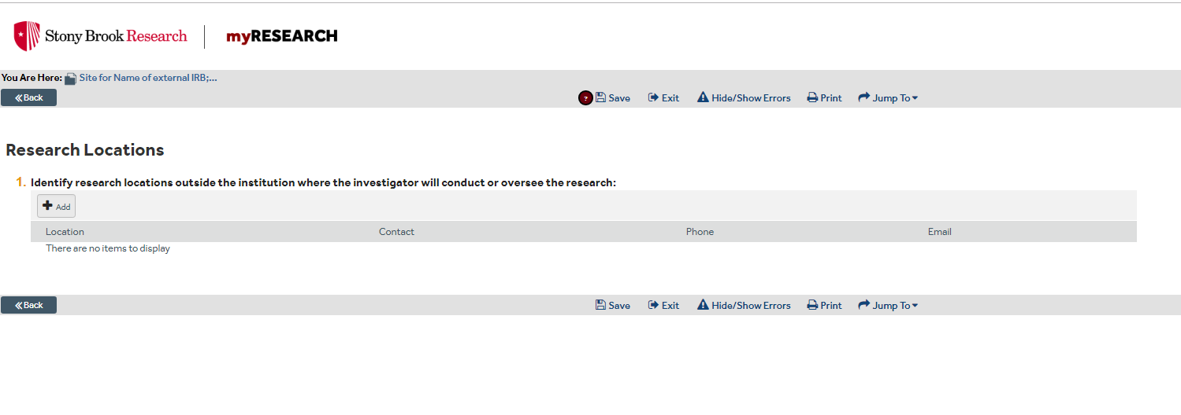
Step 2 Page 5: List all NON SBU Research Locations

Slide 14
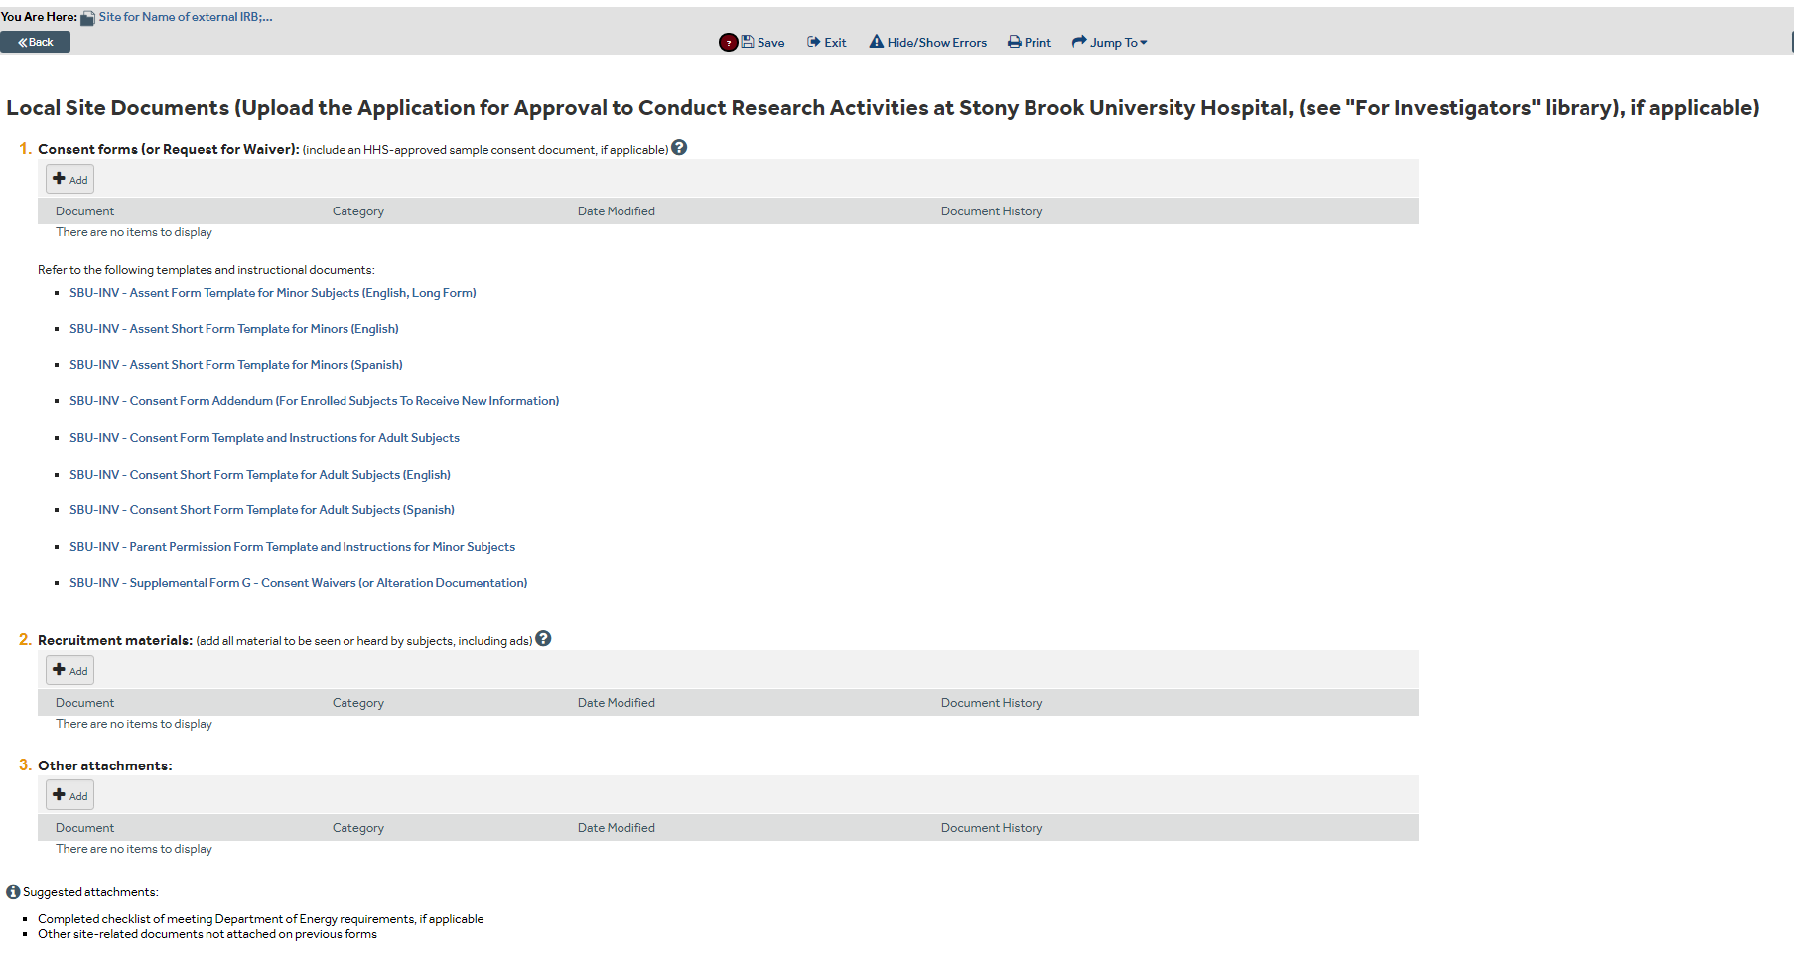
Step 2 Page 6: Add Stony Brook Documents
Consents, recruitment materials, I/E Checklist, etc.

Slide 15
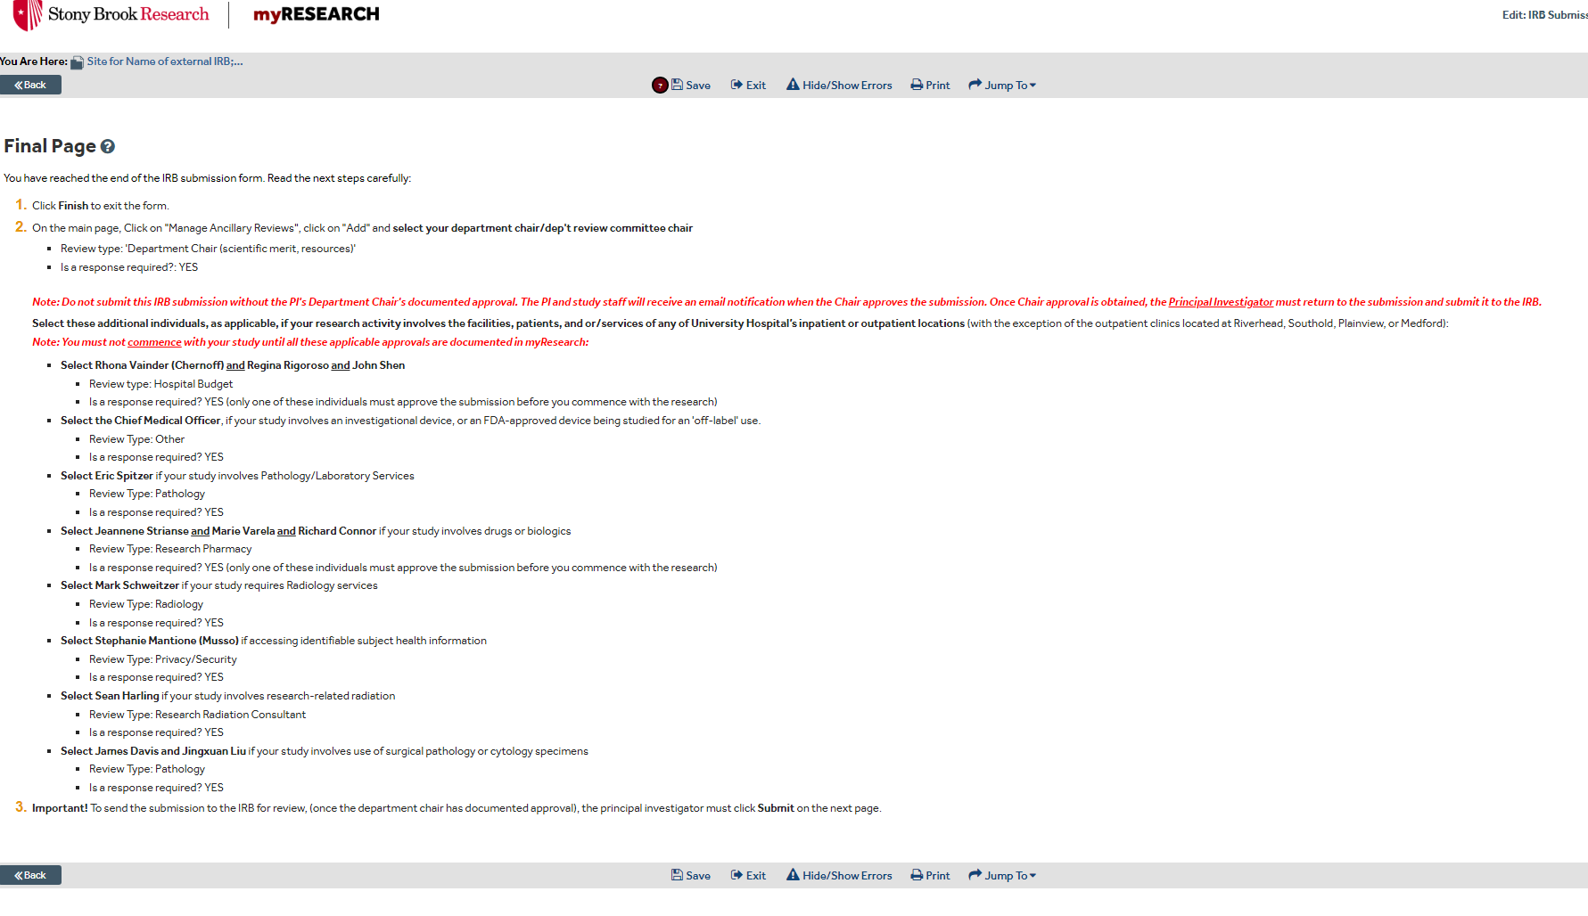

Step 2 Page 7: FINAL PAGE - Ancillary Reviews
Determine Required Ancillary Reviews that apply to the project and request on next two screens.

Slide 16
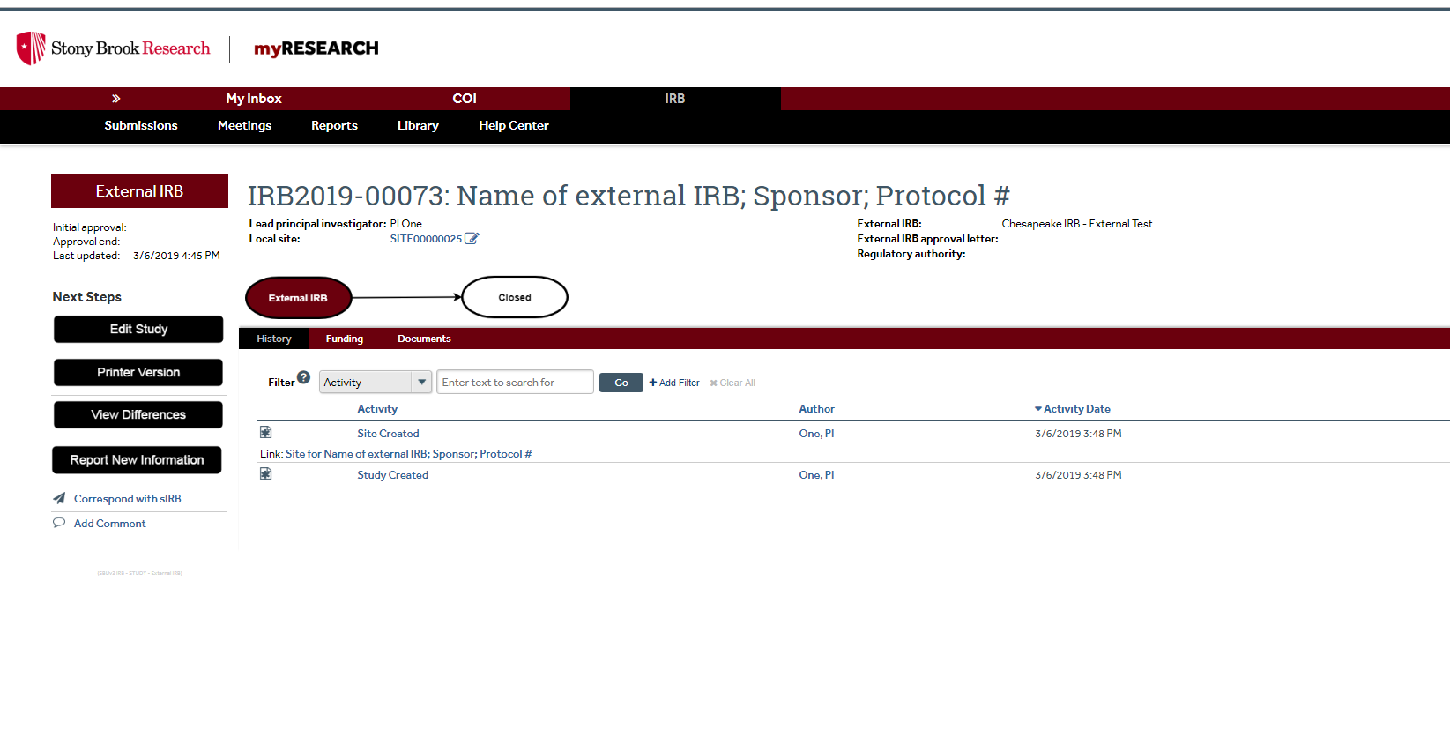
Step 2 Page 8: Navigate to Ancillary Review and Submission Page
**If not automatically routed to manage ancillary review/submission page, MUST click on Link.

Slide 17
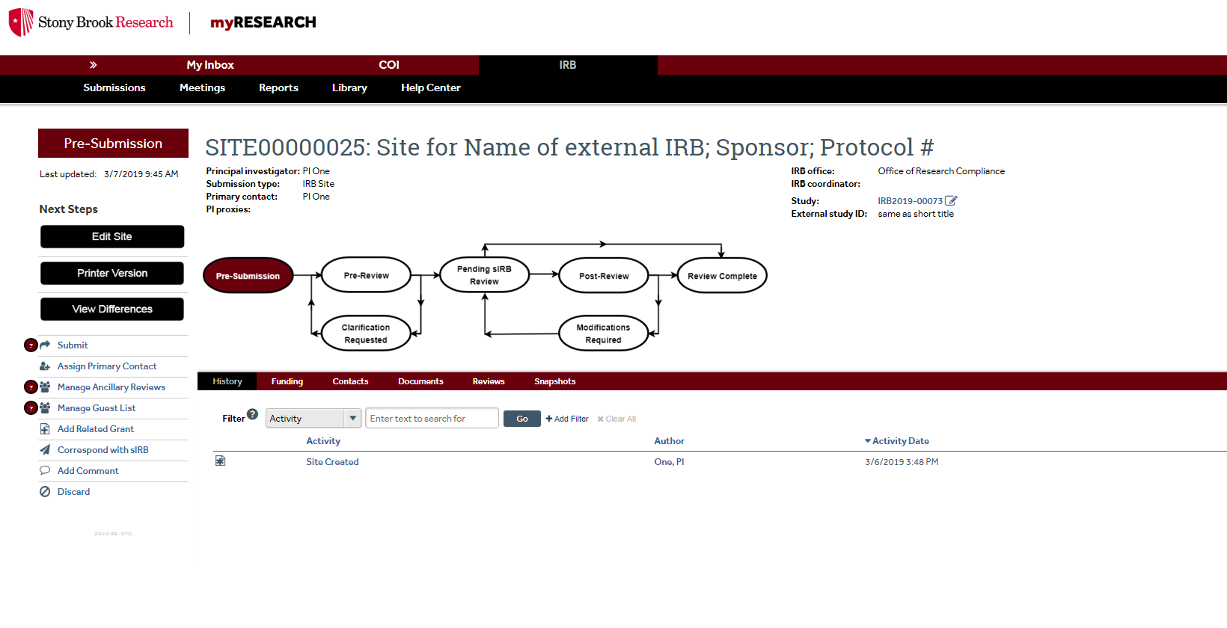

Step 2 Page 9: Manage Ancillary Reviews and Submit Project
STEP 2: Once Department Chair has approved the package, Submit to the IRB
STEP 1: Add all necessary ancillary reviews.

Slide 18
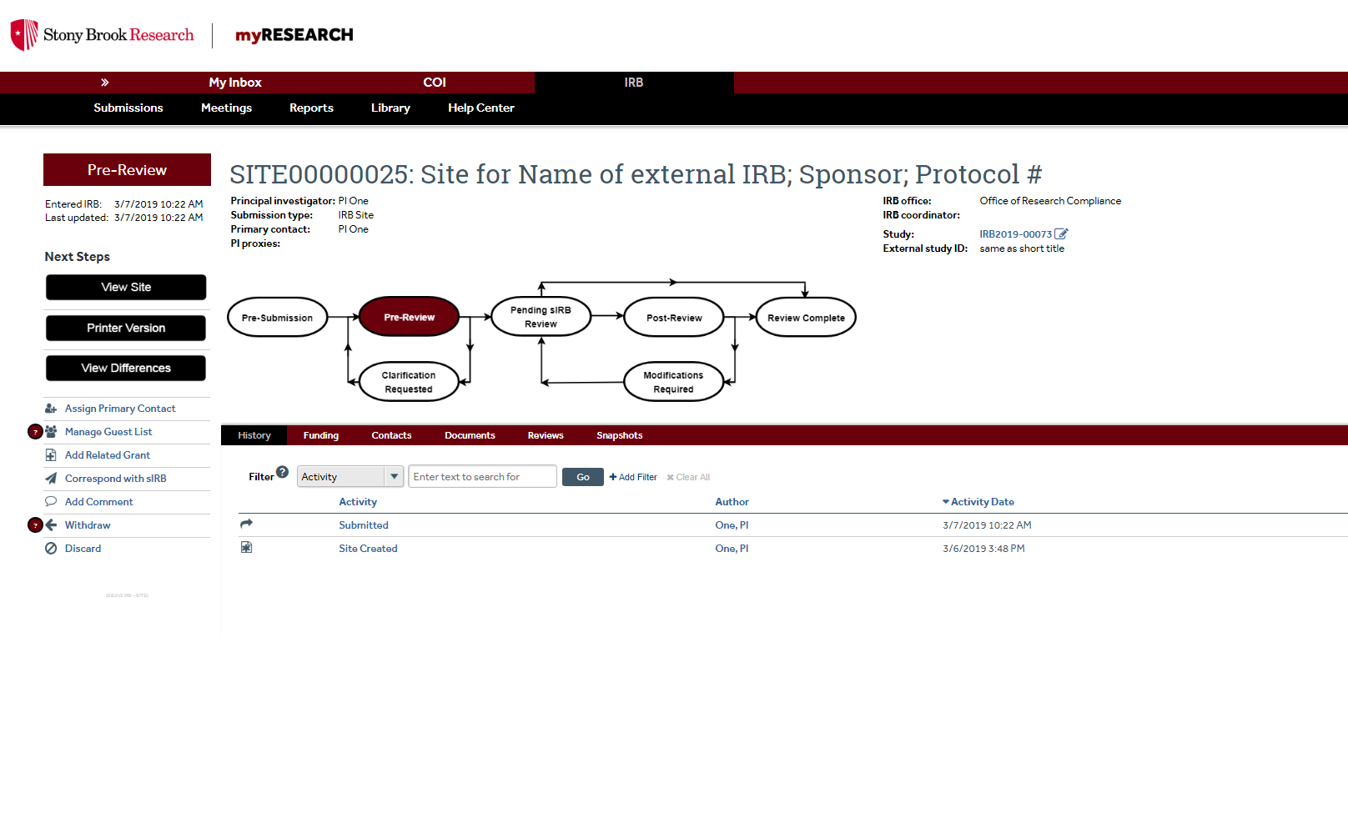

Step 2 Page 10: Success! Study has been submitted to the IRB
If Pre-Review box is highlighted study has been successfully submitted to the IRB

