Slide 1
Monte Carlo Simulation of Bell Inequalities
Justin Willson

Slide 2
EPR Paper (1935)
Einstein, Podolsky, and Rosen believed theory of quantum mechanics was incomplete
In the paper, they describe a thought experiment about entanglement
States cannot be described independently, and if one is measured, the other becomes known instantly
Therefore if quantum mechanics is true it violates the principle of locality
Believed statistical distributions of hidden variables predetermined this information

Slide 3
Bell and CHSH Paper (1969)
In between, Bell derived an inequality that proved quantum mechanics and the principle of locality were incompatible
Clauser, Horne, Shimony, and Holt generalized his inequality and described an experiment to test it for the first time

Slide 4
CHSH Inequality

Slide 5
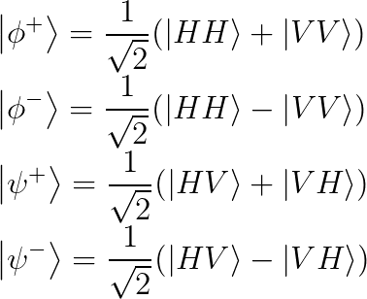
Bell States
Entangled photons are created through Spontaneous Parametric Down Conversion
Photons pass through a BBO crystal and a small probability split into two photons
Type I - resulting photons have the same polarization
Type II - resulting photons have orthogonal polarizations

Slide 6
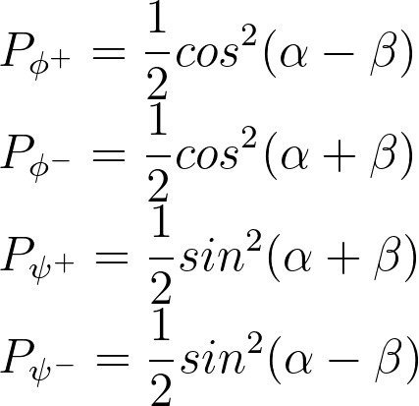
Probability of Coincidence Detection
These expressions can be derived in multiple ways, either using density matrix formalism (as in the simulation) or using an inner product
The simulation tests these expressions by making a plot of probability vs. beta
One angle is kept constant while the other is changed incrementally from 0 to 2*pi

Slide 7
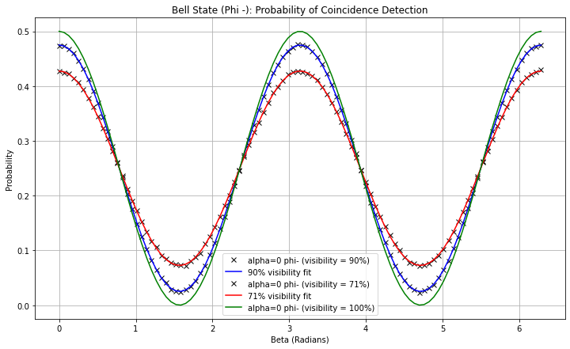
Probability of Coincidence Detection
V1 = 0.90764, V2 = 0.71533

Slide 8
CHSH Inequality Bell States

Slide 9
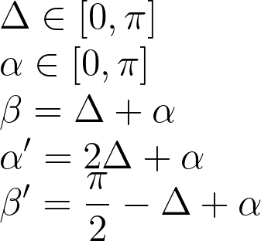
Maximum Violation Angle Formulas

Slide 10
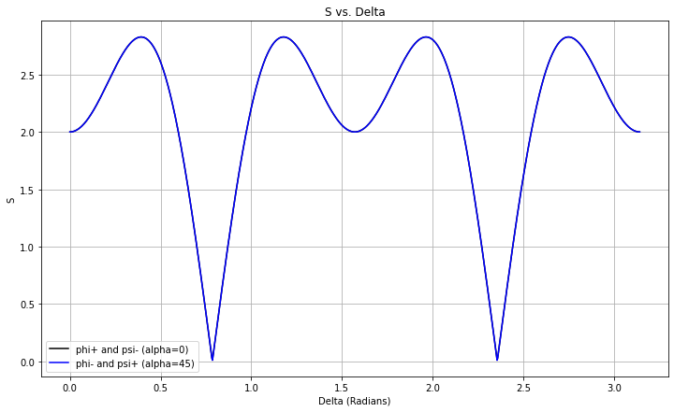
S vs. Plot

Slide 11
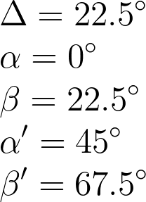
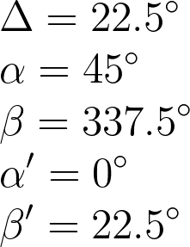
Maximum Violation Angles

Slide 12
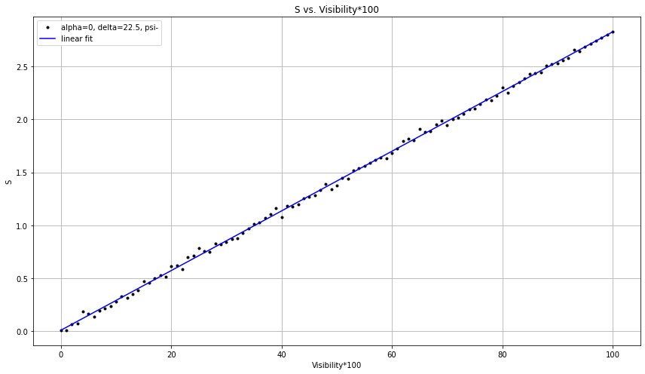
Visibility Needed for Violation
Linear fit parameters:
Visibility needed for violation:

Slide 13
Comparing Quantum and Classical States
A purely classical state will never violate the CHSH Inequality
In a classical state, for example a mixed state, there is no entanglement
This is true even if there are statistically the same number of horizontally polarized or vertically polarized photons as a bell state
Only entangled states, and therefore quantum states, violate the inequality
Classical states produce a maximum value of S=2 while quantum states have a maximum value of S=2.82

Slide 14
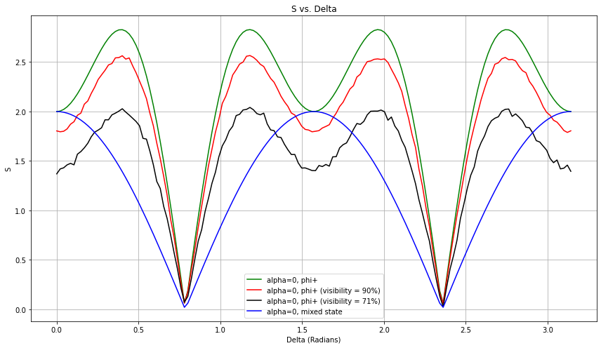
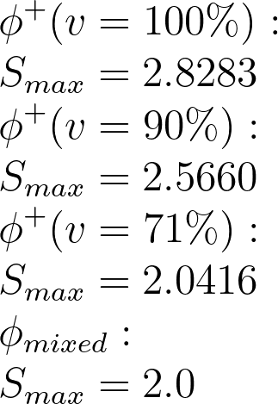
Comparing a Quantum and Classical States

Slide 15
References
J.F. Clauser, M.A. Horne, A. Shimony, and R.A. Holt. “Proposed Experiment to Test Local Hidden-Variable Theories”, Physical Review Letters, Vol. 23, No. 15, 1969, pp. 880-884.
A. Einstein, B. Podolsky, and N. Rosen. “Can Quantum-Mechanical Description of Reality Really be Considered Complete?”, Physical Review, Vol. 47, 1935, pp. 777-780.
L.P. Martins, A.J. Almeida, P.S. Andre, and A.N. Pinto. “Photon-Pair States and Violation of CHSH Inequality”, Microwave and Optical Technology Letters, Vol. 54, No. 11, 2012, pp. 2454-2461.
Stony Brook University, Violation of Bell’s Inequality Lab Manual, 2016.

