Slide 1

SPEED SCIENCE 2026
Session two

Slide 2

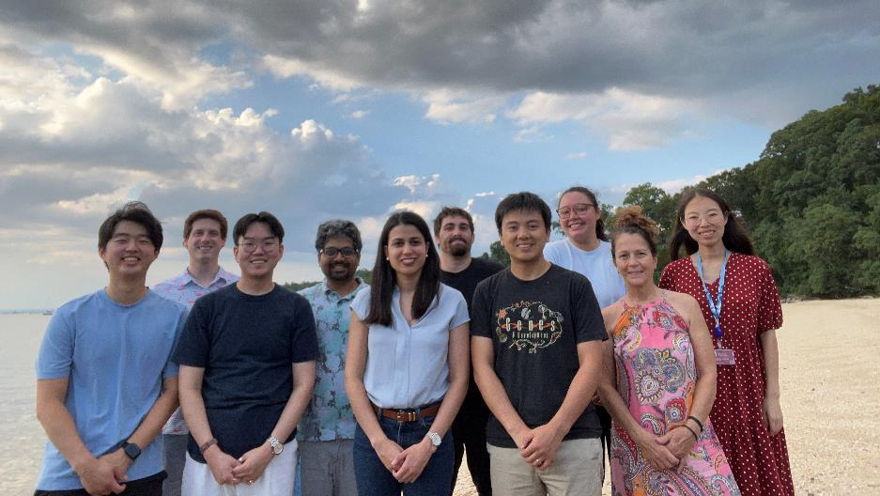
Brian Oh
at CSHL
- Born and raised on Long Island
- Graduated from Columbia University with a BA in Biochemistry in 2020
Spent 3 years at the Hospital for Special Surgery & Weill Cornell Medicine
studying inflammatory bone destruction
- Entered the MSTP at Stony Brook in 2023

Slide 3
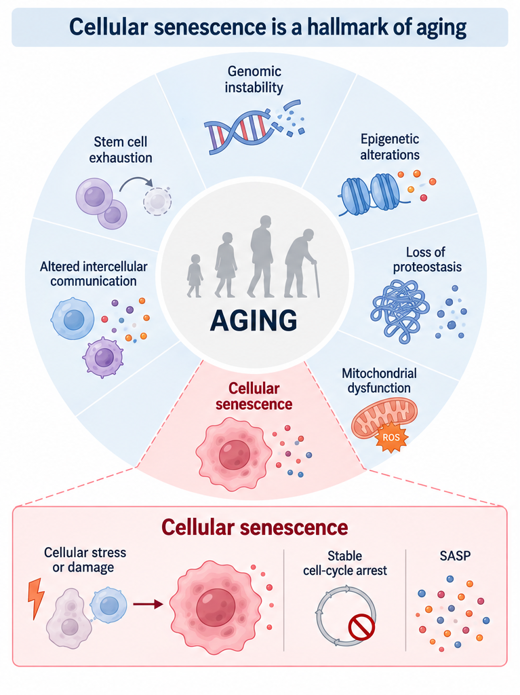
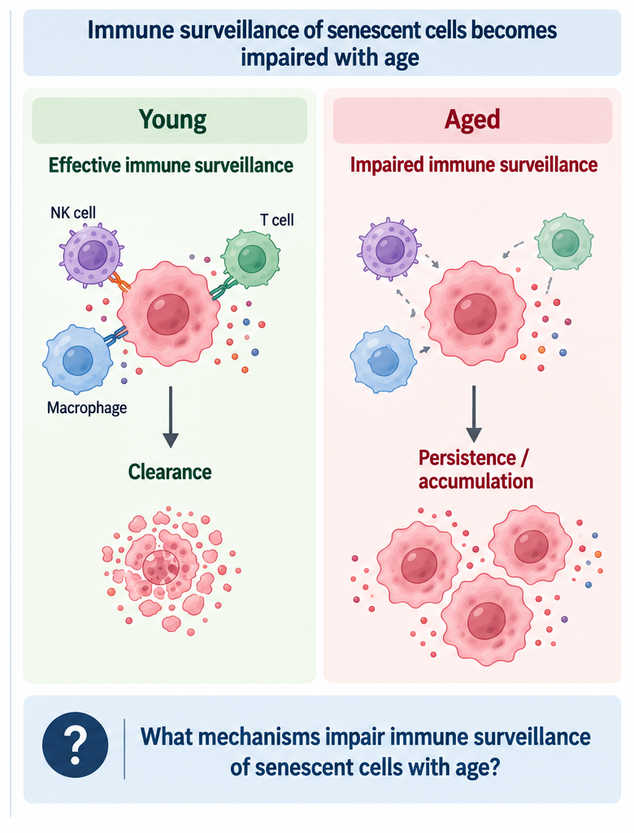

Slide 4


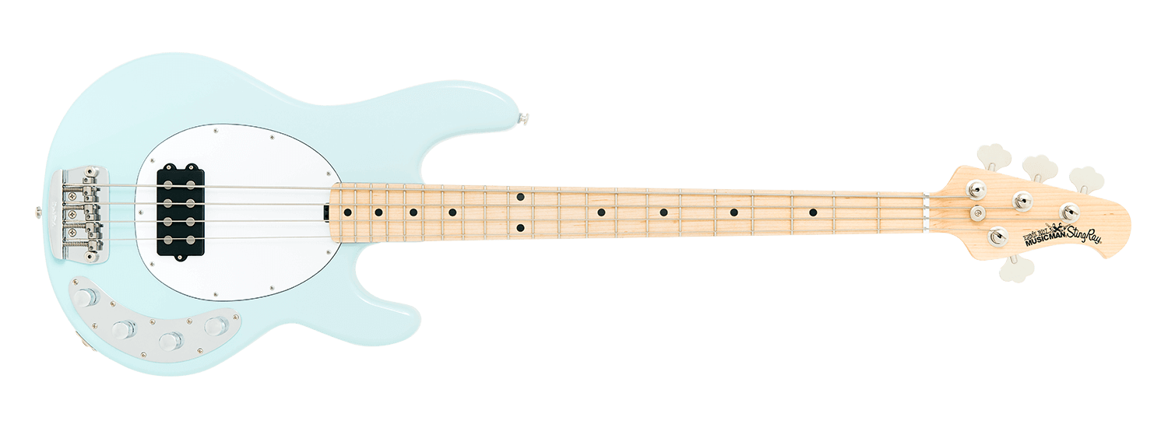
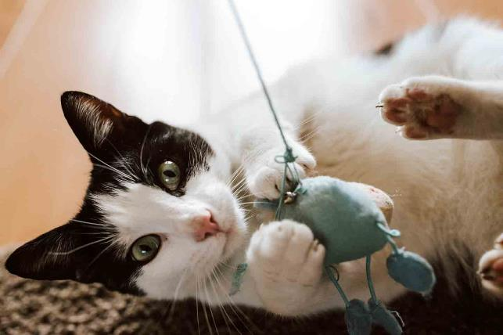
Outside of the lab

Slide 5
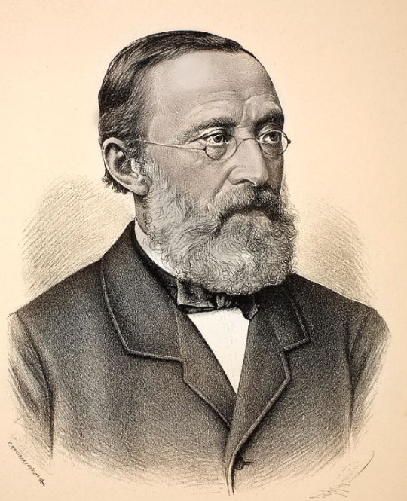
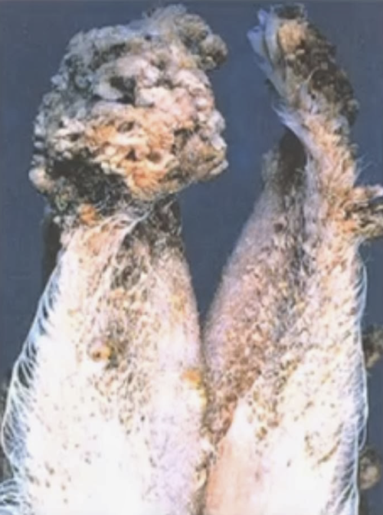
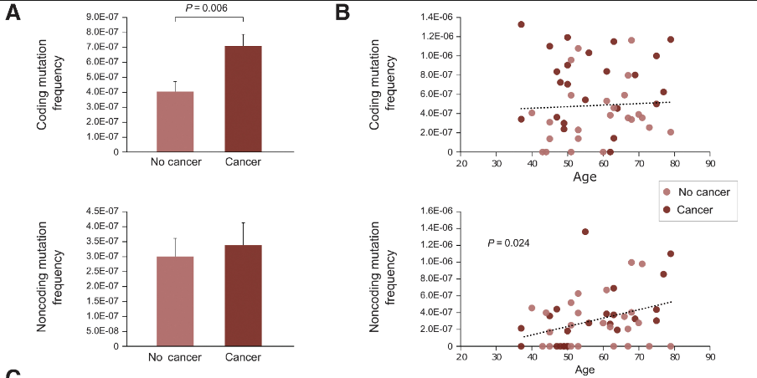
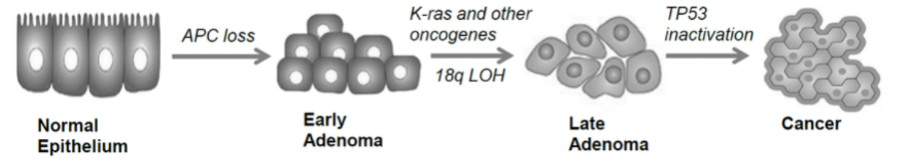


“Chronic Irritation Theory” 1863
Yamagiwa and Ichikawa
1915
In-depth Tissue Sequencing Studies
2010s-Present
Alex Cicala
Peter Westcott Lab, CSHL

Slide 6
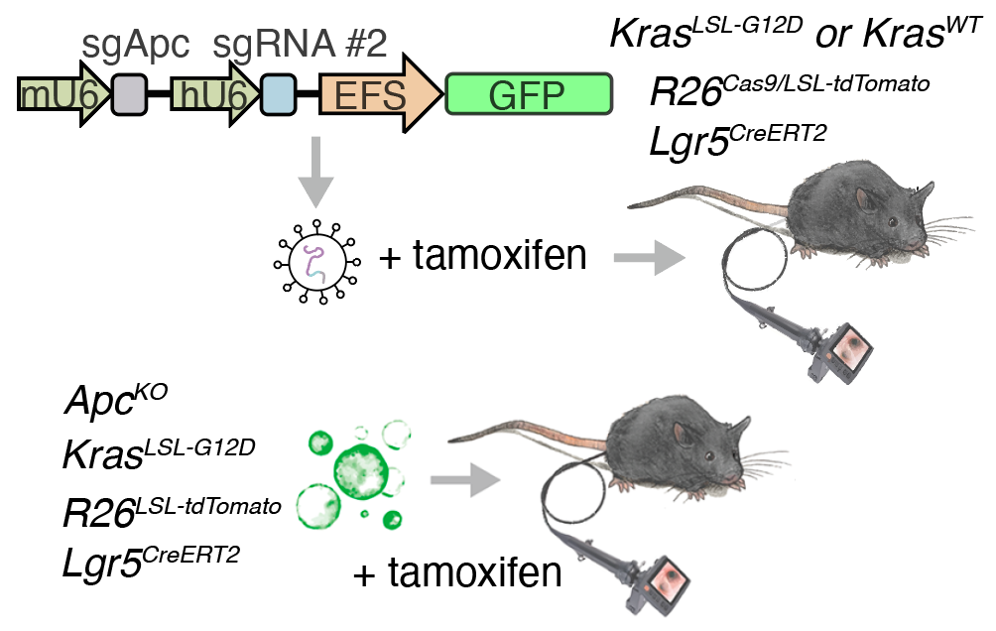
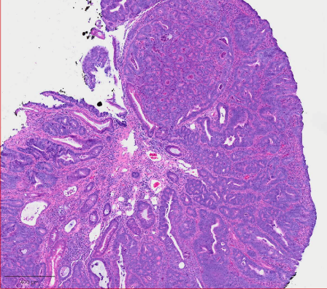
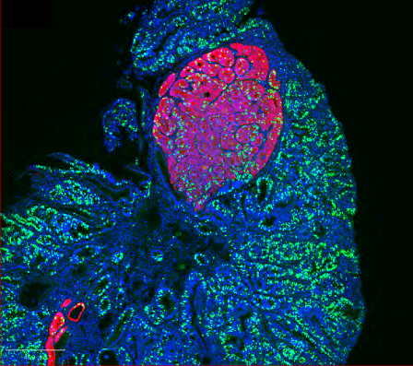
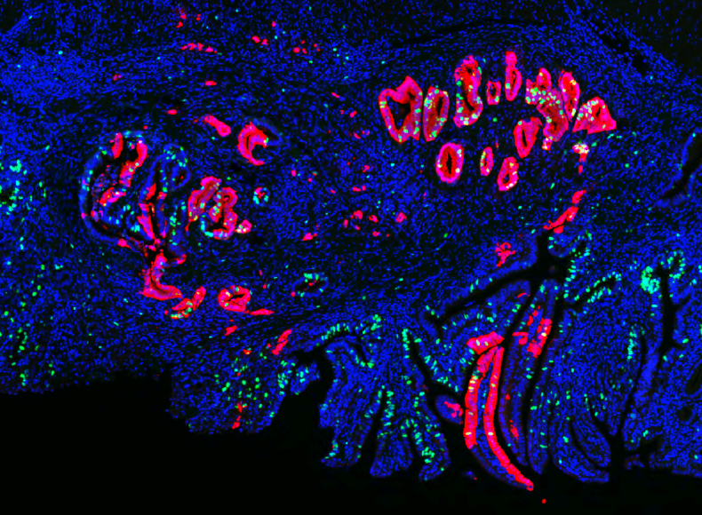
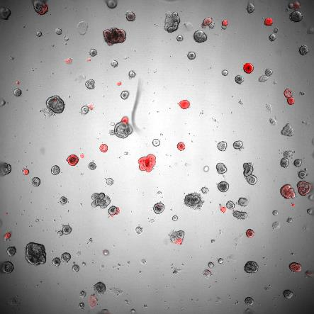
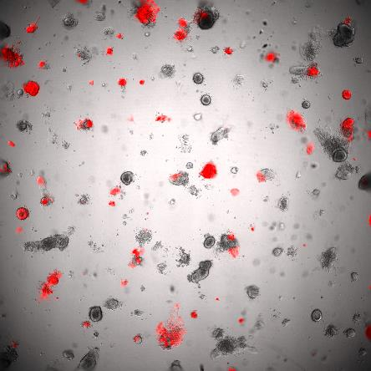
DAPI, RFP, EDU
PBS
1 ng/mL IFNγ
DAPI, RFP, EDU

Slide 7
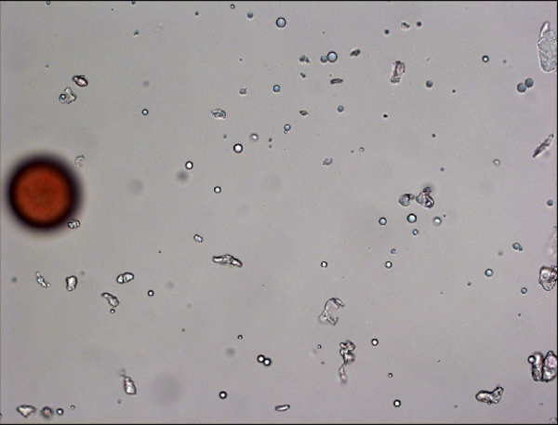

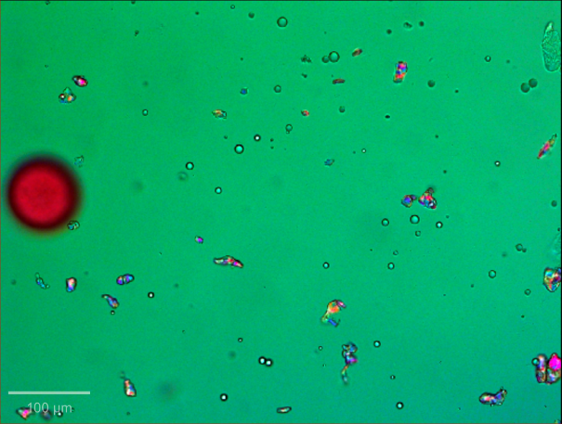
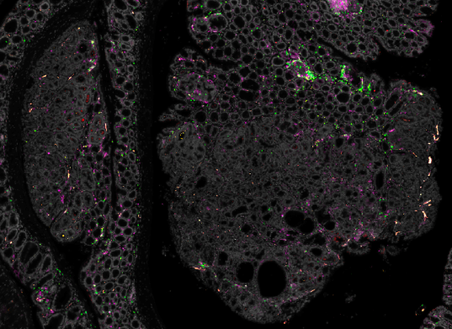
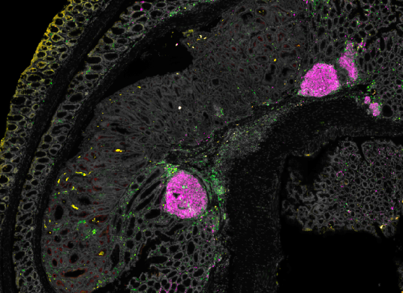
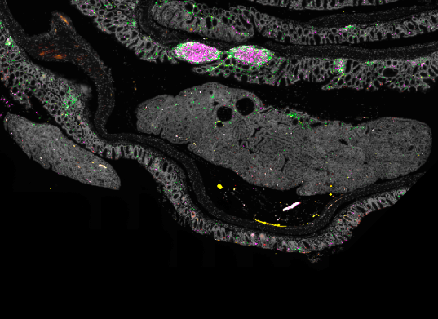
Environmental Contributions to Tumor Evolution
Bright Field
Fluorescent
Polarized Light
DAPI
FoxP3
CD8
CD4
MHCII

Slide 8
Uncoupling Tumor Ferroptosis from Host Health
Rohini Guin
Fall 2026
Janowitz Lab

Slide 9
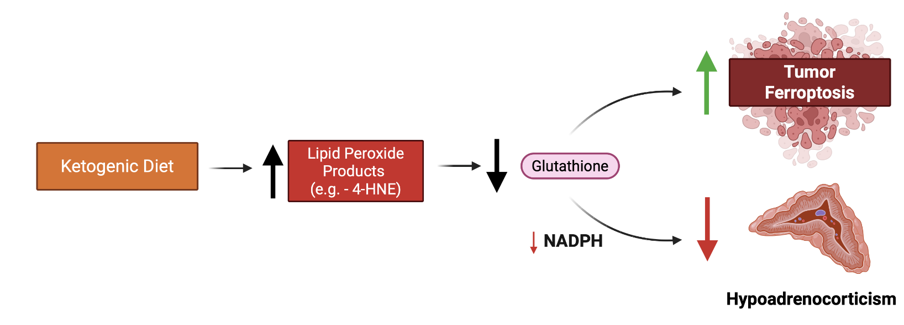
Background, Mechanism, & Goal
What therapeutic targets can be further exploited to increase tumor ferroptosis while preserving host function?

Slide 10
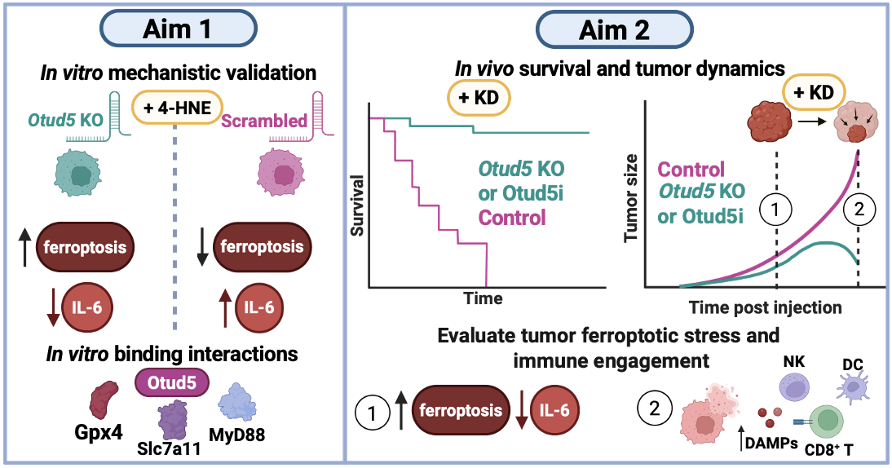


Project Plan & Central Hypothesis
GOI
GOI
POI
GOI
POI
POI
Hypothesis: Loss of function in GOIs will potentiate ketogenic diet–induced tumor ferroptosis and attenuate systemic effects of cancer, thereby improving overall host survival.

Slide 11
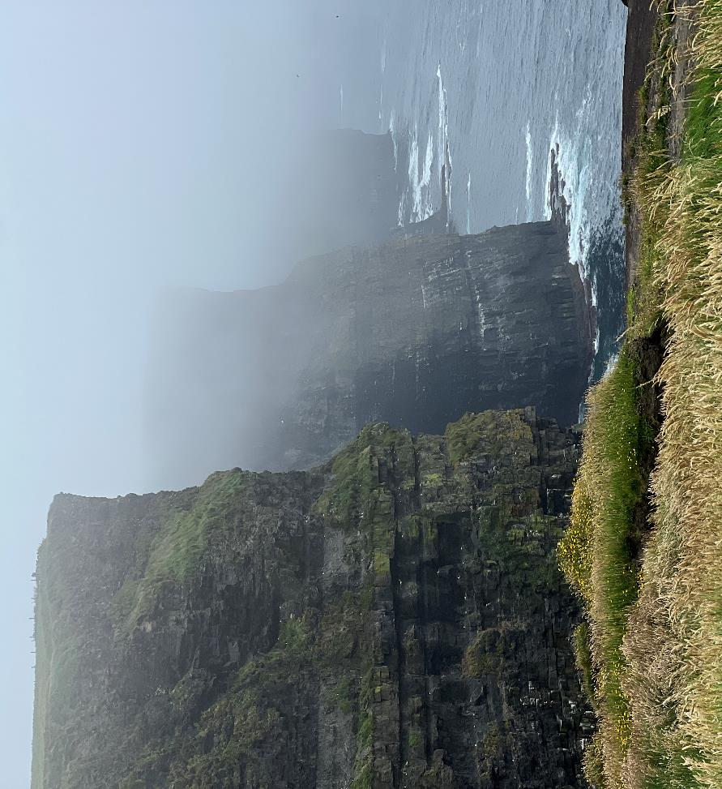




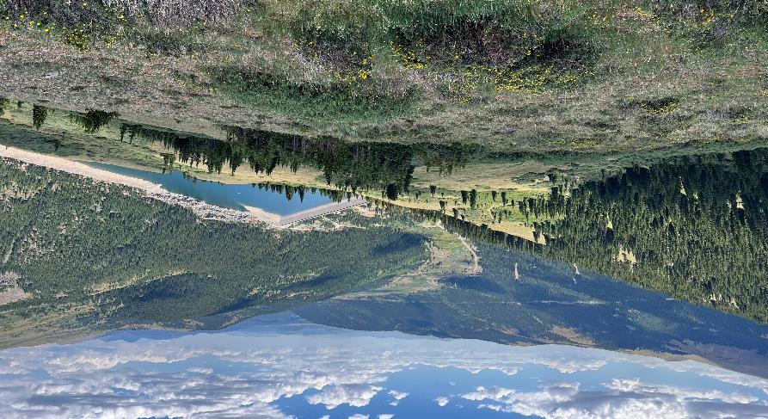




Slide 12
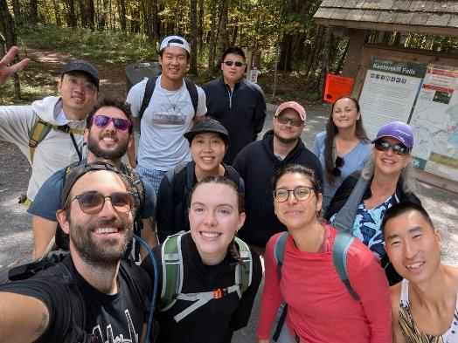

Paige Henderson
B.S. in Biology from Muhlenberg College
  Minor in Statistics
3rd year PhD student in the Cheadle Lab at CSHL
How does prenatal inflammation contribute to white matter differences in autism spectrum disorder?

Slide 13
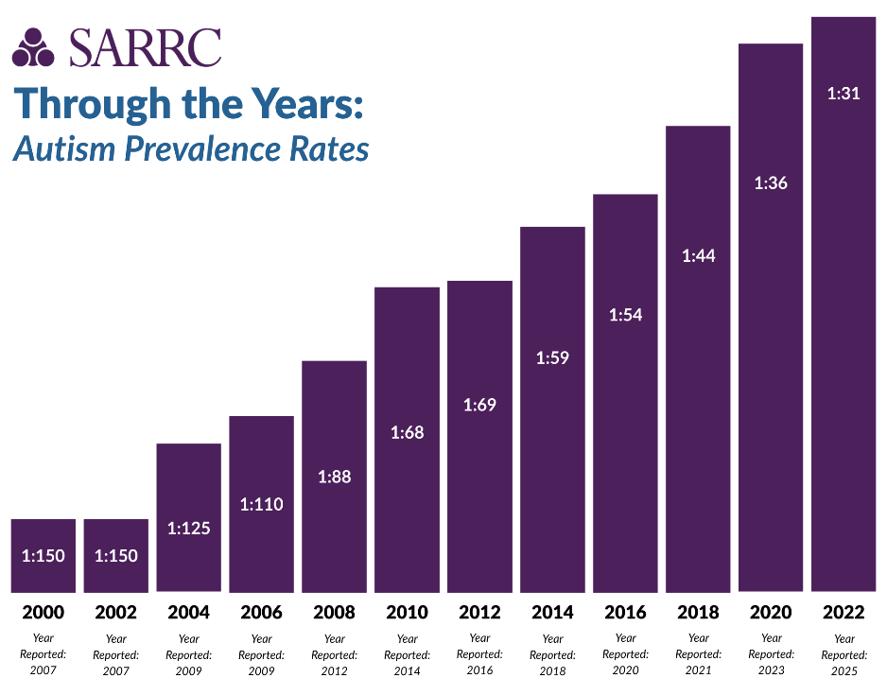
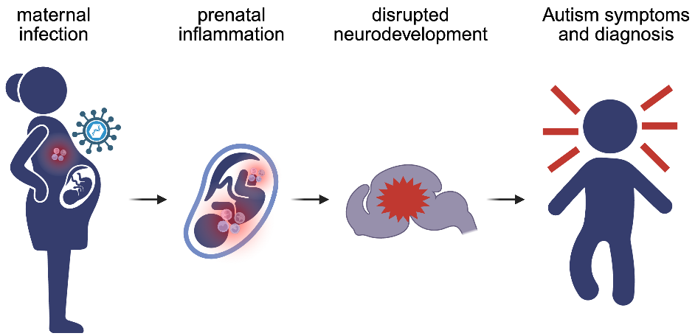
ASD prevalence has increased in recent years, but genetics alone cannot explain neurodevelopmental risk
SARRC, 2025
Notes:
Autism has a strong genetic component, but genetics is only part of the story. Environmental conditions during pregnancy can also influence fetal brain development. One example is maternal inflammation, where activation of the maternal immune system can change the developmental environment experienced by the fetus.
This is especially interesting because the brain is changing incredibly quickly during this period. My work focuses on oligodendrocyte precursor cells, or OPCs, which eventually generate the oligodendrocytes that produce myelin.
OPCs begin appearing very early in embryonic development, so they may be particularly sensitive to changes in the prenatal environment. I’m asking whether maternal inflammation disrupts that early developmental process, and whether those changes could contribute to the white matter differences that emerge later.
Ultimately, I’m trying to understand when those developmental differences begin, rather than only looking at the brain after they are already established.

Slide 14
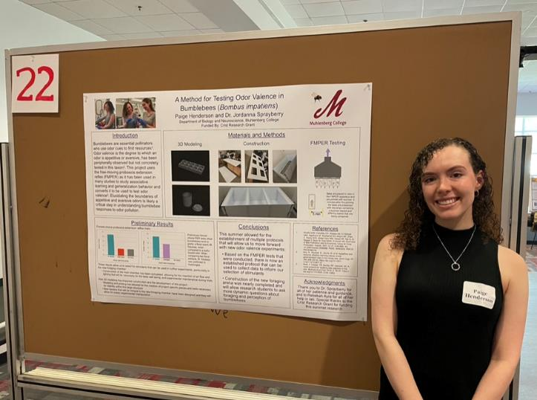
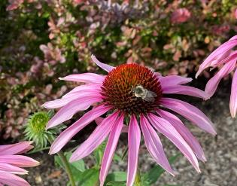
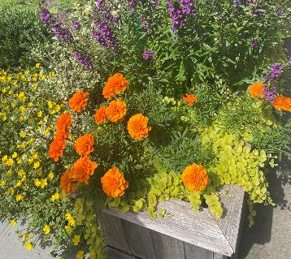
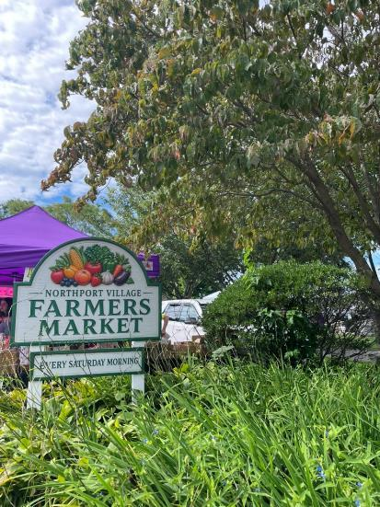
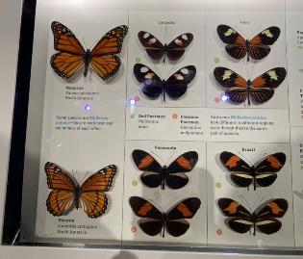


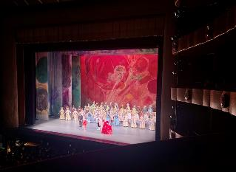
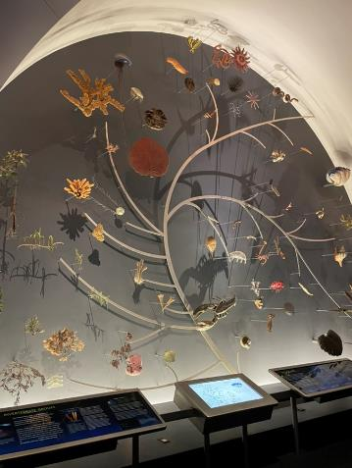

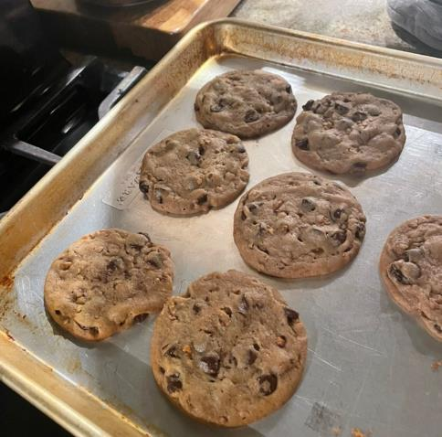
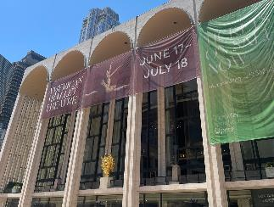
Notes:
Fun Slide!

Slide 15
Likelihood framework to infer recessive selection
Shareef Khalid
Siepel Lab (CSHL)

Slide 16
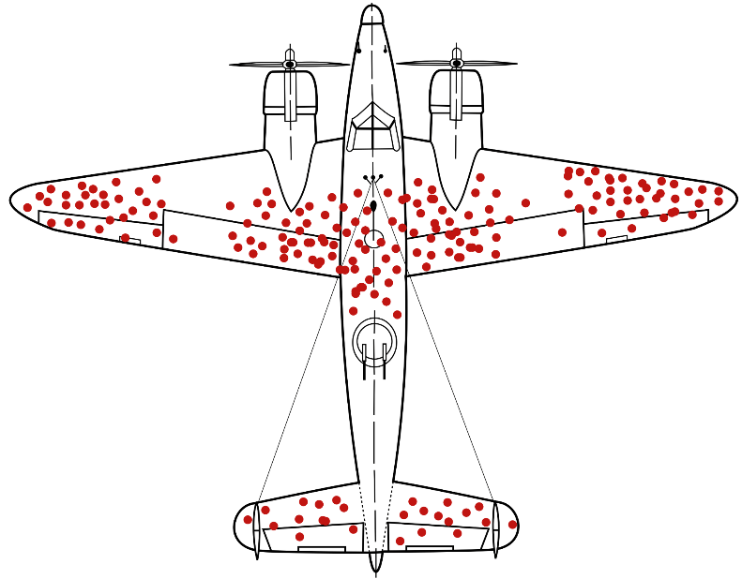
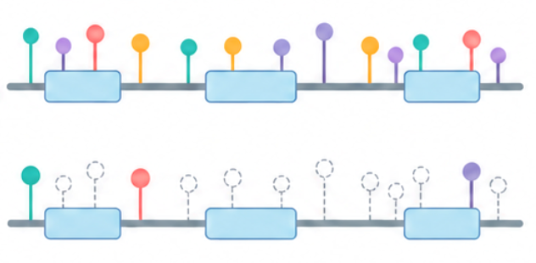
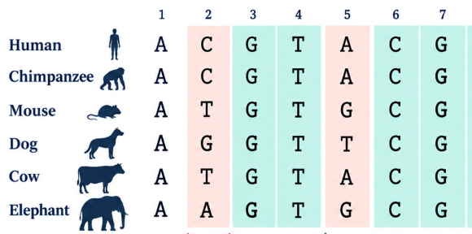

Depletion of variation is a sign of purifying selection
Observed/Expected << 1
Conserved residues across species
Expected
Observed
Mutational Constraint Across
141k exomes
Basepair resolution of constraint across
mammalian genomes
These methods pick up selection in the heterozygous (additive) state and miss recessive selection
$$p2+2pq+q2=1$$
~ 1 in 1000
~ 1 in 1,000,000

Slide 17
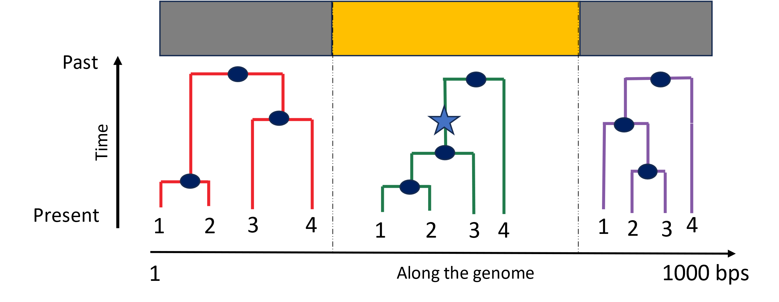
Recessive selection is exposed only when variants are present in Runs of Homozygosity (ROH)
Outbred population
Run of Homozygosity
Recessive
variant
Bottlenecked population /
Consanguineous population
Extended Run of Homozygosity
Recessive
variant exposed
to selection
Frequency of variants inside and outside an ROH will differ for variants under recessive selection
Given inferred genomic history, we can evaluate how long a variant has been exposed to recessive selection
Likelihood framework
$$Observed Genetic data \sim additive selection+recessive selection in ROH+ε$$

Slide 18
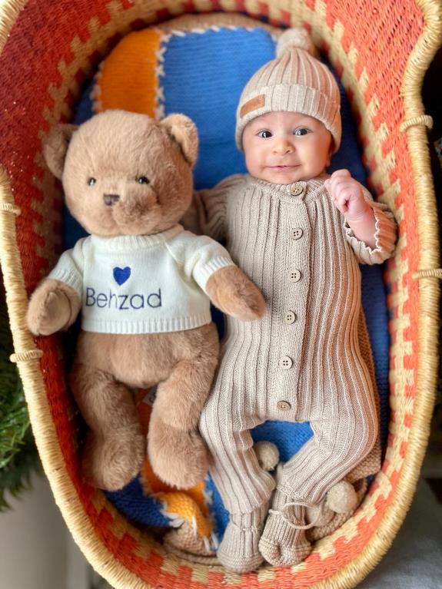
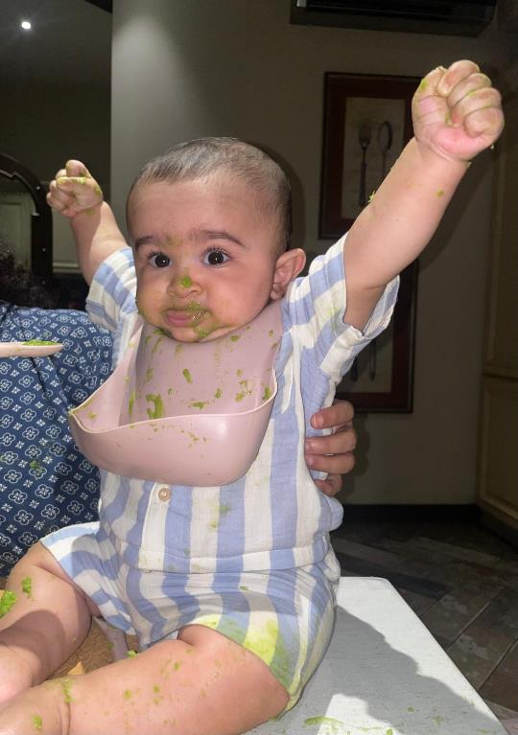

We love mashed peas!
Devils Bridge, Sedona

Slide 19
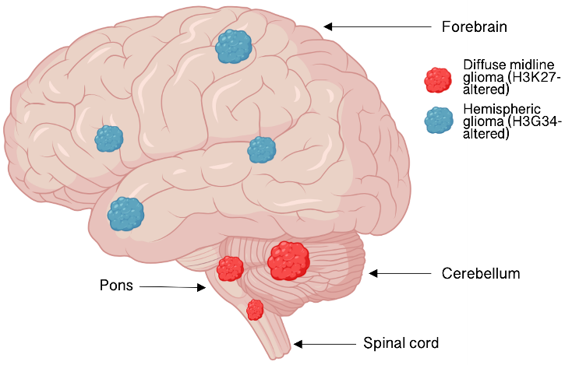
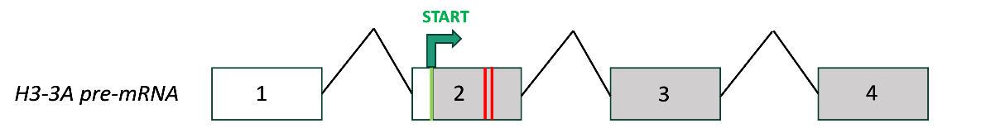
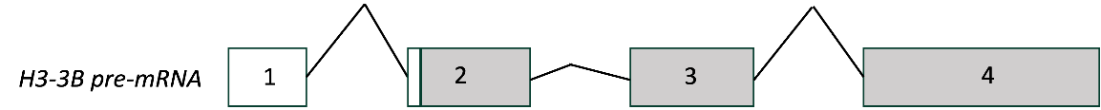
Targeting H3-3A using antisense oligonucleotides as a therapy for pediatric high-grade glioma
Shivani Deshpande
4th year graduate student
Krainer Lab at CSHL
Notes:
Explain splicing, mutations, the cancer

Slide 20
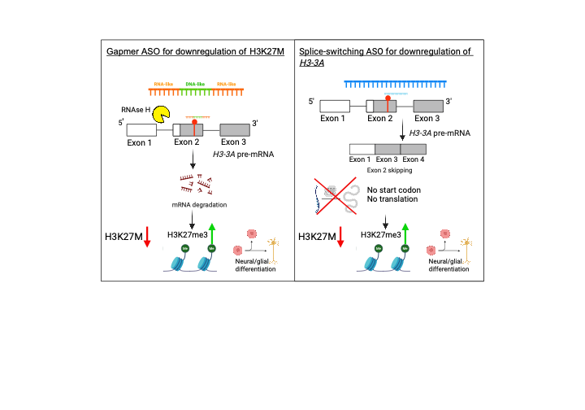
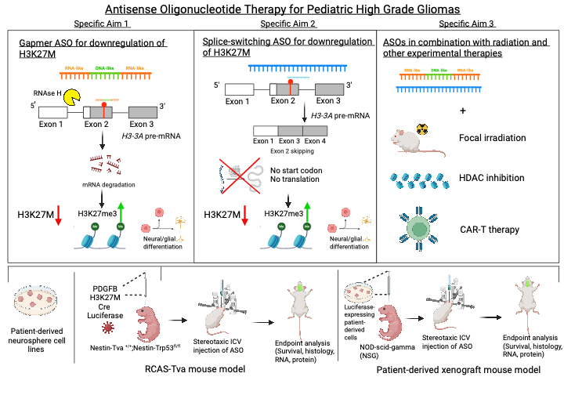
ASO Targeting of H3-3A
Qian Zhang, Lucia Yang

Slide 21

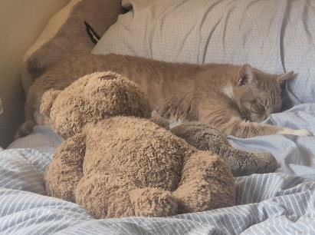
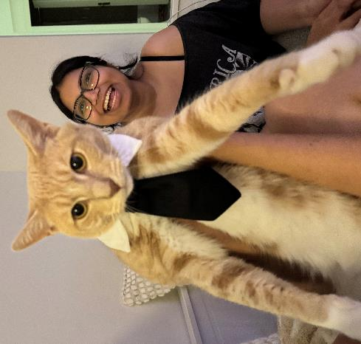
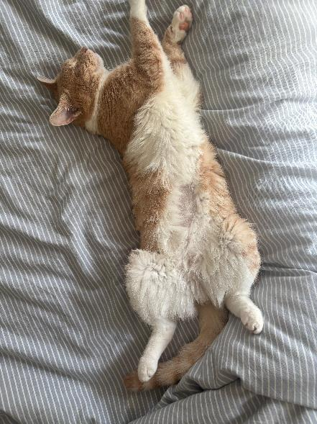



Zuko!!!!

Slide 22



Yijie Kang
Ph.D. student, Graduate Program in Genetics, SBU
Koo Lab at CSHL
Added to UNESCO World Heritage List this July!

Slide 23












Decoding the Sequence Basis of Pol II
Promoter-Proximal Pausing with Deep Learning
Promoter-proximal pausing is a rate-limiting step in transcription.
Time-course PRO-seq data from Notch-inducible SC2 cell.
Time-conditioned sequence-to-function model.
Pausing peak is a snapshot of the dynamic process.
Downstream model interpretation

Slide 24











Slide 25
OCA-T2 Activates the Tuft Cell Lineage In the Airway
Kamil Taneja
SBU MD/PhD Student
Vakoc Lab
Cold Spring Harbor Lab/St. Jude Children’s Research Hospital
Genetics Speed Science 2026

Slide 26
Mechanism of how OCA-T2 activates tuft cell lineage in airways
TF
OCA-T2
TF
OCA-T2
POU2F3
OCA-T2
POU2F3
Terminal
Tuft Marker
Airway Stem Cells
(Basal Cells)
Techniques: Epigenetics, intrinsically disordered regions, biochemistry

Slide 27









Speed Science 2026
Katie Donnelly-Sharon
van der Velden Lab
September 9th, 2026

Slide 28

Typhoid Mary: The Asymptomatic Salmonella Carrier
I scream…You scream… We all scream…
💩 WE ALL POOP 💩
📣

Slide 29





Granulomas are an immune cell “fortress” against infection
Granulomas are organized clusters of immune cells that surround a pathogen to control its growth and prevent it from spreading in tissue
Failure of initial immune response
Development of Granulomas
I study how granulomas are formed and maintained, with a focus on the role of a key immune cell called the inflammatory monocyte

Slide 30


Understanding the effects of life events and exposures and mammary immunity and the risk for tumorigenesis
Dhivyaa Anandan
dos Santos Lab
(formerly CSHL, currently St. Jude in Memphis, TN)
Genetics Speed Science
September 9, 2026

Slide 31
The mammary gland is a highly plastic organ
Mast cells
Macrophages
Eosinophils
Regulatory T cells
Macrophages
Neutrophils
Mast cells
Antibody-secreting B cells
Microbes
T cells
Slepicka et al., Trends Mol Med 2019
Vickers and Porter, J Mammary Gland Biol Neoplasia 2024

Slide 32








The trend in rising early-onset breast cancer may be attributable to lifestyle factors
Obesity and metabolic dysregulation
Microbiome imbalance
Shifts in reproductive patterns
Giaquinto et al., CA Cancer J Clin 2022

Slide 33


Understanding How the Tumor Microenvironment Shapes Cancer Progression and Metastasis
Sogol Ghanbari
Advisor: Mehdi Damaghi
Speed Science 2026

Slide 34

How Tumors Adapt, Evolve, and Progress
OUR RESEARCH FOCUSES:
Tumor Metabolism & Acidosis
Tumor–Stroma Interactions
Extracellular Vesicles & Communication
Tumor Evolution & Progression
Spatial Biology
Tumor Adaptation → Progression → Invasion & Metastasis

Slide 35











Life outside the lab

Slide 36


Slide 37


Slide 38


Slide 39


Slide 40



Dynamics of DNA Replication in Yarrowia lipolytica
Kimberly Hane
Speed Science 2026
Stillman Lab

Slide 41


Using Y. lipolytica as a Hybrid Model for DNA Replication
WGD
Shen, et al. 2018. PMID: 30415838
Hu, et al. 2020. PMID: 33056978

Slide 42








Slide 43



Investigating the role of cadaverine metabolism in cancer
Qingting Hu(Tina)
Dr. Michael Lukey lab
Notes:
Imagine your body as a bustling, super-efficient factory. Every single cell is like a tiny workshop within that factory.
Metabolism is the grand manager of this factory. It's all the incredible chemical processes that turn the food you eat (our raw materials) into energy to power everything you do – from thinking to running – and into new building blocks to keep your body healthy and growing.

Slide 44


cadaverine
Cancer Metabolism
Notes:
Imagine your body as a bustling, super-efficient factory. Every single cell is like a tiny workshop within that factory.
Metabolism is the grand manager of this factory. It's all the incredible chemical processes that turn the food you eat (our raw materials) into energy to power everything you do – from thinking to running – and into new building blocks to keep your body healthy and growing.

Slide 45




Slide 46





Longling (Silvia) Shui in Westcott Lab @CSHL

Slide 47


Longling (Silvia) Shui in Westcott Lab @CSHL

Slide 48

Use Naive T Cell Screening to Uncover the Genes Contribute to T Cell Priming and Memory Formation

Slide 49


ASO approach for Fusion Positive Rhabdomyosarcoma
Trace Le
Krainer Lab

Slide 50



Rhabdomyosarcoma (RMS) is a pediatric soft tissue cancer
Embryonal (ERMS)
5-year survival rate: 20-70% (American Cancer Society)
About 400 cases/ year in the US
Patients are mostly children under the age of 7 (Yale medicine)
The mass can develop anywhere including the head, neck, arm, trunk, etc.
Alveolar (ARMS)
Two main subtypes: ARMS and ERMS
ARMS is more aggressive with high relapse rate
Most patients with ARMS have PAX3-FOXO1 or PAX7-FOXO1 fusion protein
David M. Parham, Modern Pathology, 2001

Slide 51

Target P3F1 using ASO
Gapmer approach: Target mature mRNA at the fusion site
RNase H1
Can be generalized for many patients
The target is highly specific for the fusion
PD
HD
TAD
FHD
TAD
Spliceosome
Splice switching oligo approach: Target pre-mRNA
If work, most pre-mRNA of the chimeric gene is inhibited/ degraded
Exact breakpoint: Patient specific
PD
HD
TAD
FHD
TAD
5’ Donor
3’ Acceptor
Branch point + (Y)_{n} tract

Slide 52
POU2F3 Co-Activator OCA-T2 is Required for Tuft Cell Differentiation
Liam Shanley
Year 5
Speed Science
9/9/2026

Slide 53




POU2F3
OCA-T1
POU2F3
OCA-T2
Effector molecules
Leslie, M. Science (2019)

Slide 54






Slide 55







