Slide 1

SPEED SCIENCE 2026
Session One

Slide 2

About Efosa
4th year MD/PhD Student
2nd year Grad Student
Mak Lab

Slide 3
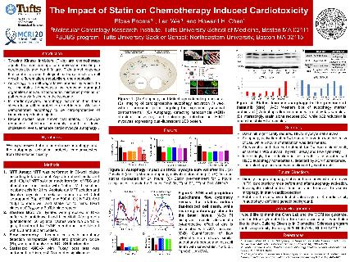
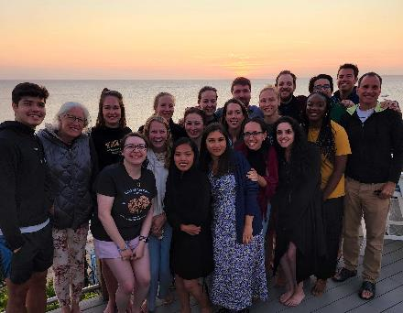

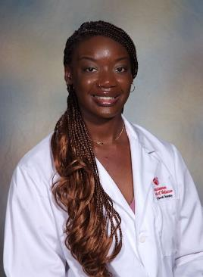
Previous Research
Started doing Research in Summer 2018 doing cardio-oncology Research
Undergrad Research on Mitochondrial Fusion and Fission as it pertain to fertility
Undergrad/Postbac research In Bernstein Lab on various projects
  Hypomethylation and Colon Cancer
  SETDB1 and PML Bodies
  Creating a Platform to study TET2 Methylation Patterns in hematopoiesis

Slide 4
Current Research
mak Lab
  Mechanosensing, ECM, and creating functional tissue and organs
  Breast Cancer and Fibrosis
    How does sensing local microenvironment lead to cancer progression
  Breast Cancer and Adipocytes
    How does a fatty environment effect mitochondrial metabolism in BACH1 regulated Breast Cancer

Slide 5





Interests

Slide 6
Tuning immune brakes
Suckwon Lee
Carpino Lab
Notes:
Opening (about 60–70 seconds):
My broad interest is immunology from a signaling perspective. I want to understand how immune cells decide whether to activate strongly, stay restrained, or fail to respond. This question connects infection, cancer, and aging. In all three settings, immune cells need enough activity to remove a threat, but too much or the wrong kind of activity can damage tissue. In the Carpino lab, I am interested in STS proteins because they act like intracellular brakes on immune signaling.

Slide 7

Can stronger immunity be separated
from stronger inflammation?
STS = Suppressor of T-cell Receptor Signaling
STS1/2 domain architecture
UBA = Ubiquitin-Associated domain
PDE = Phosphodiesterase domain
SH3 = Src Homology 3 domain
HP = Histidine Phosphatase domain
UBA
—
PDE
—
SH3
—
HP
Known observation
STS loss
→
better pathogen control
but not a proportional
inflammatory cytokine surge
Question
What kind of brake is STS?
Notes:
Hi everyone, I’m Suckwon Lee from the Carpino lab.
I’m interested in a simple question: can we make immune responses more effective without simply making inflammation stronger?
Our lab studies proteins called STS, which act as brakes on immune signaling.
What makes STS interesting is an observation from infection models. When STS is removed, mice can control pathogens more effectively. But in the S. aureus model, that improved protection was not accompanied by higher levels of major inflammatory cytokines like TNF-alpha, IFN-gamma, or IL-6.
A similar idea appears in the Candida model, where STS-deficient mice showed much better pathogen control without the classic hyperinflammatory response seen in wild-type animals.
So we know STS is an immune brake. What we don’t understand is exactly how that brake works.

Slide 8
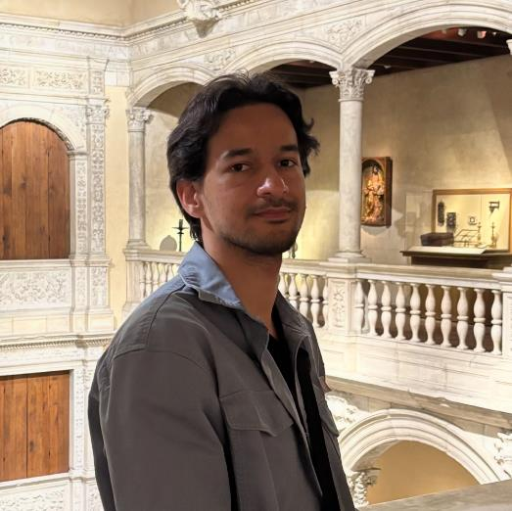
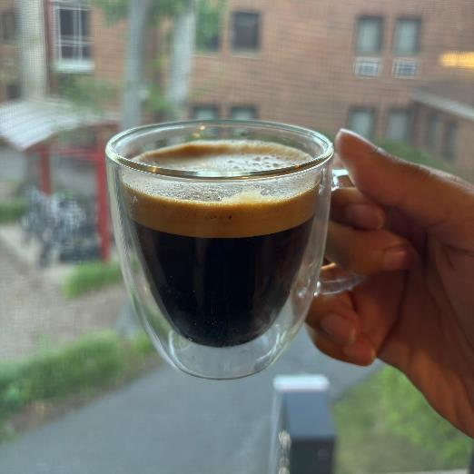

Luiz Henrique Lola Pereira
B.S. in Biomedical Sciences – Universidade Federal do Delta do Parnaíba, Brazil (2023)
Technician at Yale (2023-2025)
2nd Year PhD student – Hovel-Miner Lab

Slide 9
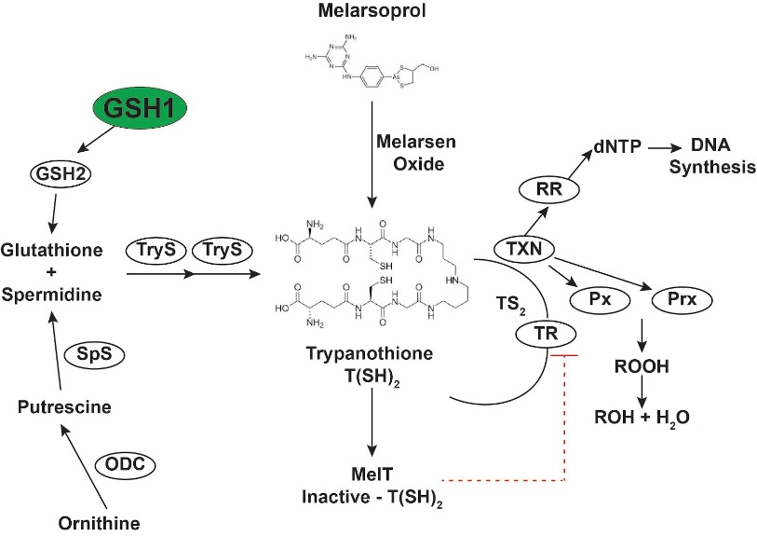
ROS/Redox system of Trypanosoma brucei
Tpx

Slide 10
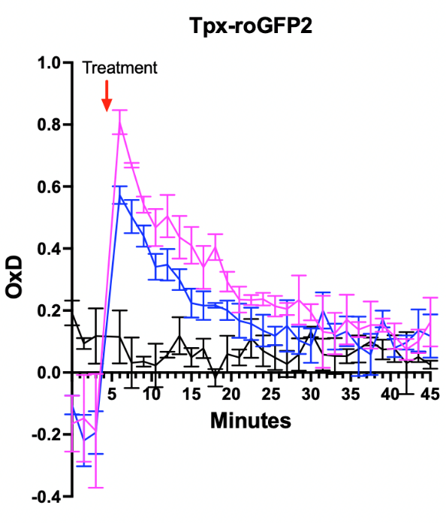
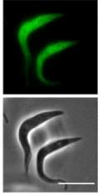
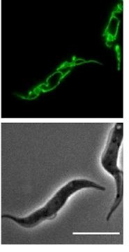
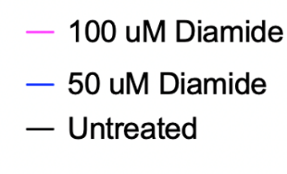
We have developed T. brucei with Dox-inducible expression of roGFP2 Biosensors
Tpx-roGFP2 mito-roGFP2-Tpx
Ref: Ebersoll, Samantha, et al., 2020

Slide 11

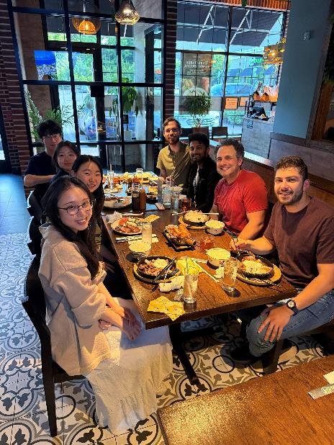
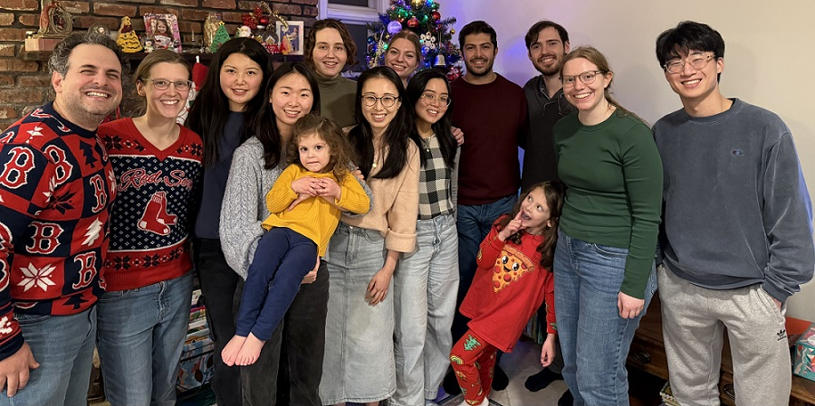
Characterizing a novel epigenetic lesion in IDH-mutant glioma
Wen Yi See
2nd year Genetics PhD Student
Rahme Lab
Speed Science Session
2 September 2026

Slide 12
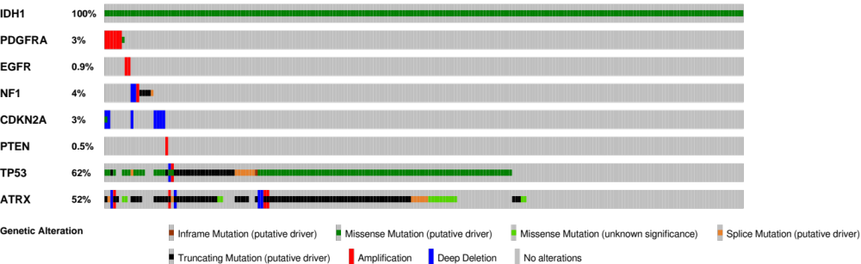

Diffuse Gliomas
Most common malignant primary brain tumors.
Despite advanced multimodal therapies, they remain incurable and among the most lethal of all solid tumors.
Primarily driven by gain-of-function IDH1 mutations.
LGG (grades 2-3)
Isocitrate
Metabolic
WT IDH1
IDH1
PDGFRA
α-Ketoglutarate
RTK
Mutant IDH1
EGFR
NF1
D-2-Hydroxyglutarate
TET dioxygenases
Tumor
suppressor
CDKN2A
PTEN
TP53
Genome-wide
hypermethylation
DNA demethylation
ATRX
Each row: Gene
Each column: A single patient

Slide 13
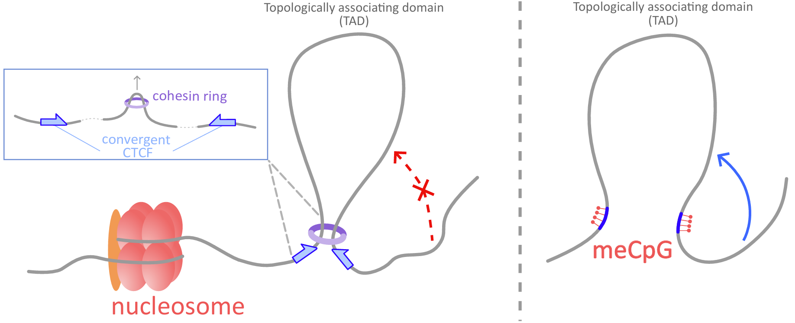
Insulator Dysfunction Model
Intact TAD and Loop structure
Aberrant TAD and Loop structure

Slide 14


Reversible Redox Regulation of T-Cell Protein Tyrosine Phosphatase (PTPN2)
TanChun Kuo
Tonks Lab

Slide 15
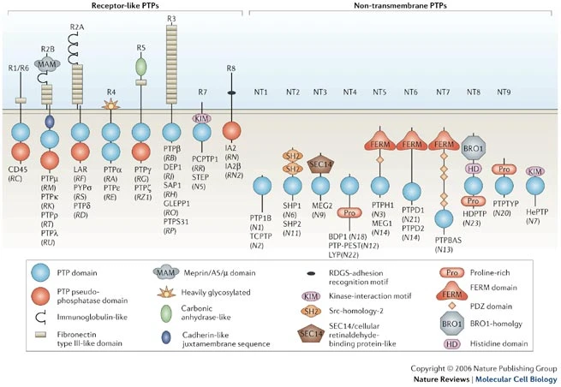
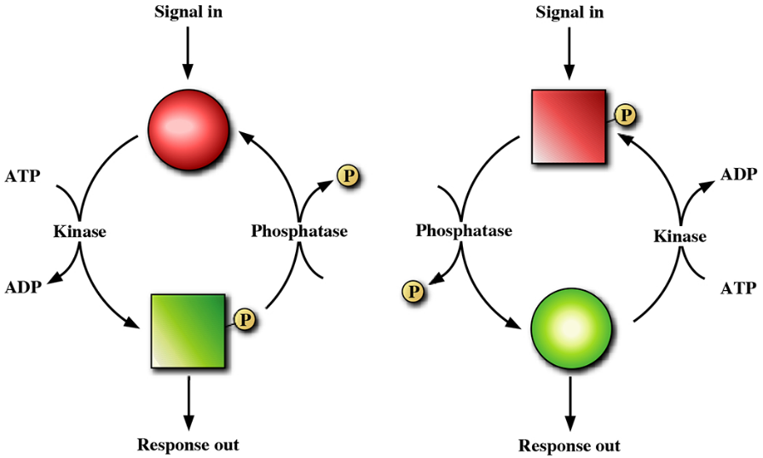
Reversible Redox Regulation of PTPN2 (TCPTP)
pTyr-Specific Classical protein tyrosine phosphatases (PTPs)
  Receptor – like PTPs
  Non-transmembrane PTPs
    PTP1B
    TCPTP
https://www.nature.com/articles/nrm2039
Notes:
To begin with, we know that reversible phosphorylation is a fundamental regulatory mechanism in signal transduction, where protein kinases add phosphate groups to target proteins and phosphatases remove them, switching the target protein's activity on or off. My work focus on protein tyrosine phosphatase. There are broad family of protein tyrosine phosphatase, their structures showed that they played fundamentally important roles in controlling cell functions. When those functions are abrogated, it can lead to diseases, so there is a lot of validation of these enzyme serve as therapeutic targets. Our labs explore the functions of different protein phosphatase, and Within this context, my focus is on the non-transmembrane phosphoTyrosine- specific classical PTPs, TCPTP, and it’s reversible redox regulation.

Slide 16
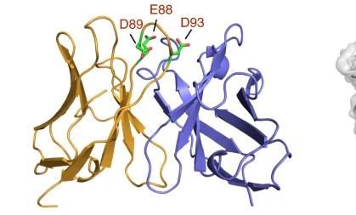
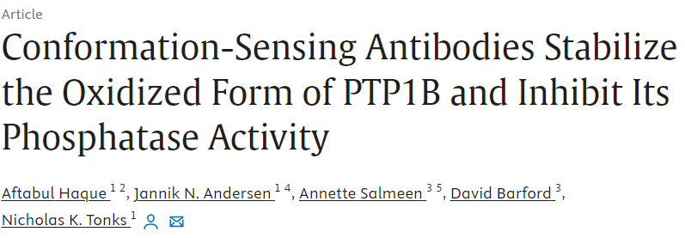
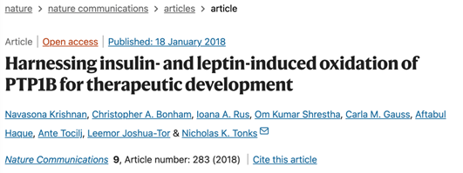
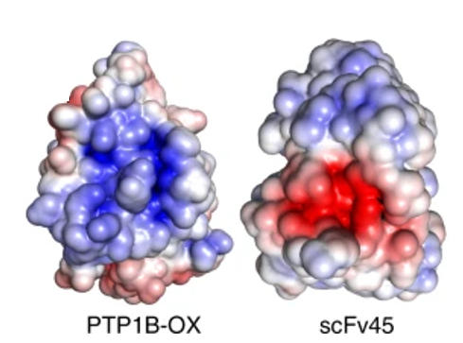
Utilizing scFv45 as a foundation for exploring and developing new single-chain variable fragments
Krishnan et al (2018) Nature Communications 9: 283
Notes:
What’s important here is that it is the redox regulation is an alternative mechanism that we can inhibit the phoshphatase, and we are only targeting the localized pool of PTP1B that’s important for regulation. And we’ve provided proof of concept here. So now, can we adopt the feature that’s seen upon oxidation and apply the similar concept with TCPTP. First, there the lack of TCPTP specific inhibitor, second, global inhibition leads to lethal effect in mice.
This way by utilizing the redox pathway, we can potentially selectively inhibit a very small pool of TCPTP to have a profound impact on signaling, that leaves large amount of the enzyme untouched. And we may be able to bypass the deficits that are seen in the knockout out mice.
Red- negatively charged
Blue – positively charged

Slide 17
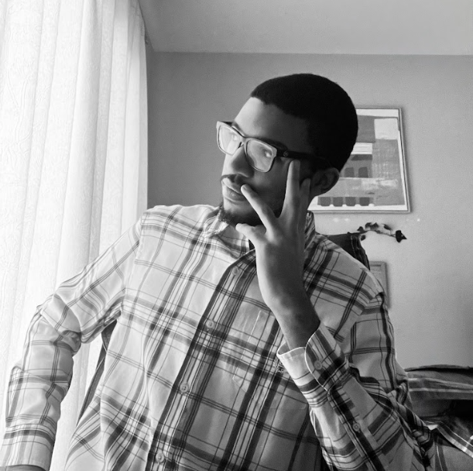
Jason Harper
B.S. – Stony Brook University, Class of ‘24
Advisor – Dr. Mario Shields

Slide 18
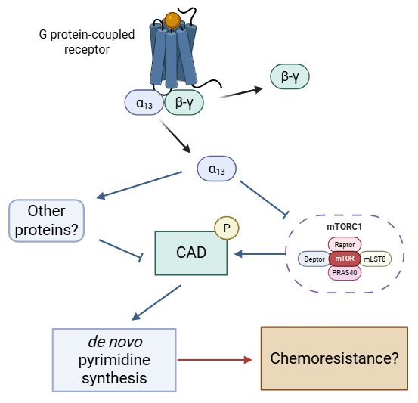
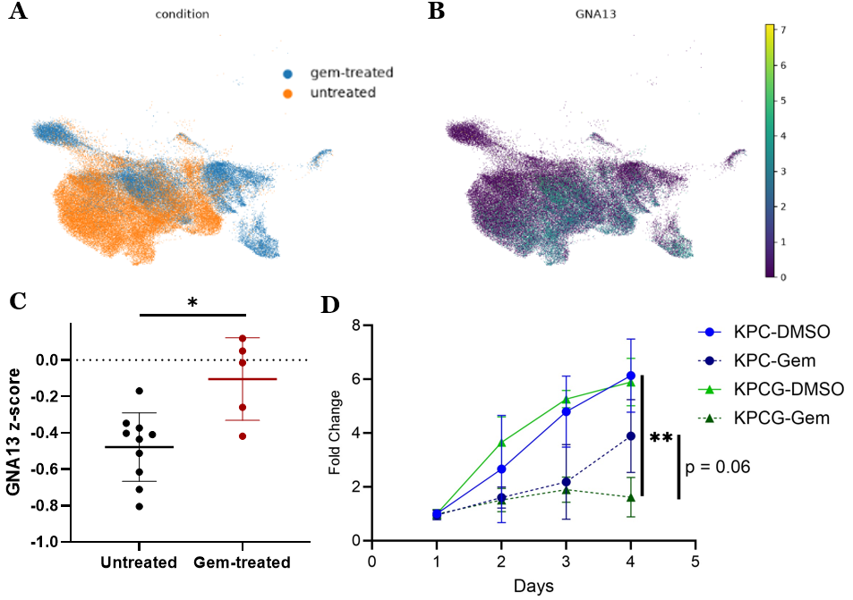
My project: How does Gα₁₃ regulate pyrimidine synthesis?

Slide 19
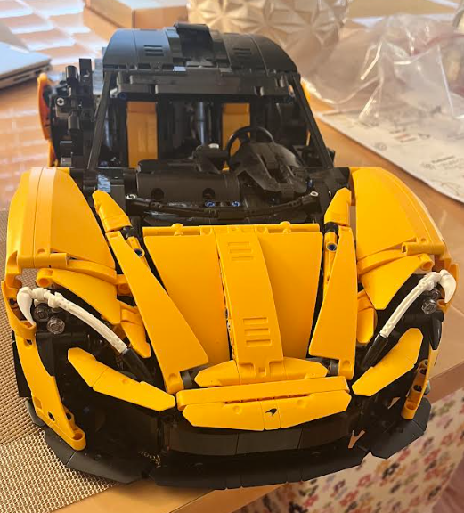
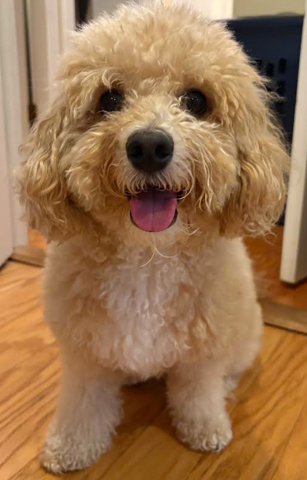

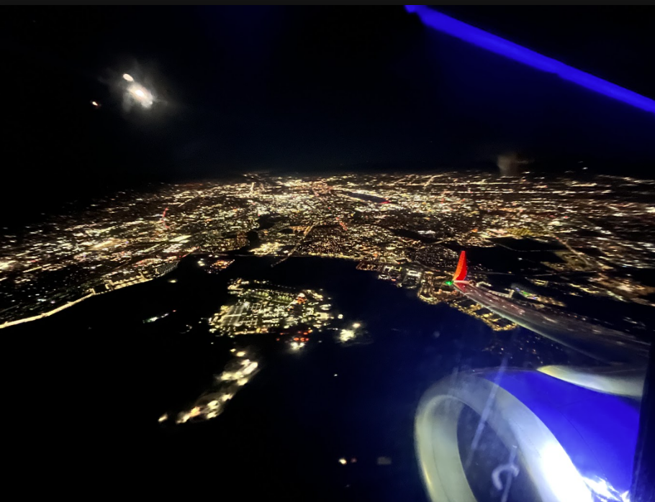

Slide 20


Pre-hatching Diapause in Killifish Embryos
Hamidreza Khodajou Masouleh
PI: Chi-Kuo Hu
Graduate Program in Genetics

Slide 21
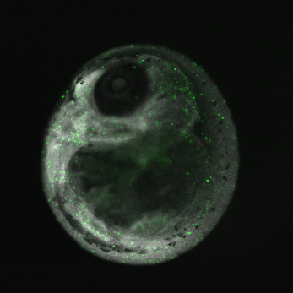
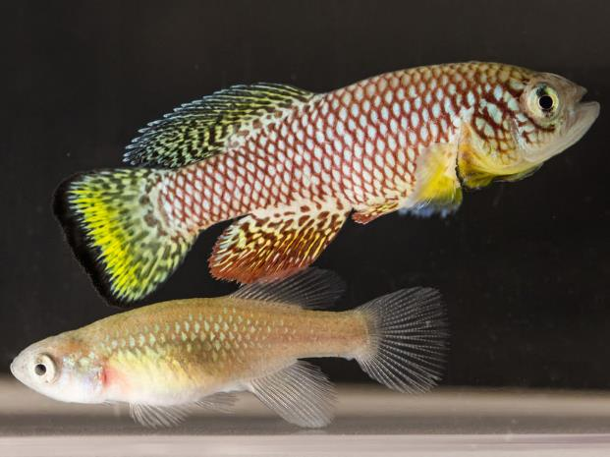
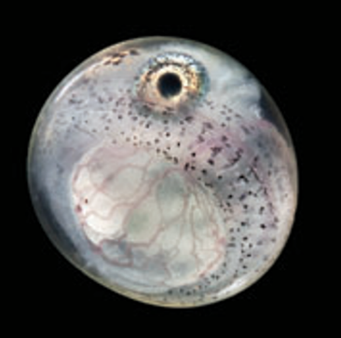
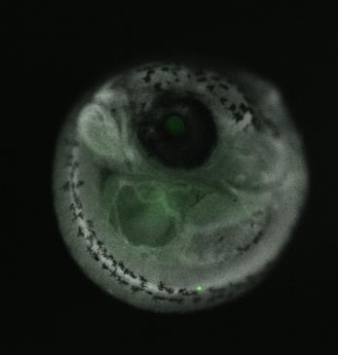
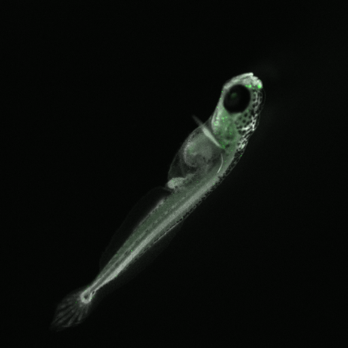

Explore the Wonder of Dormancy
African Turquoise Killifish
Initiation
Z
Z
Z
Pre-Diapause III embryo
How to stop the biological clock?
Diapause
Diapause III embryo
Termination
Post-Diapause III fry

Slide 22
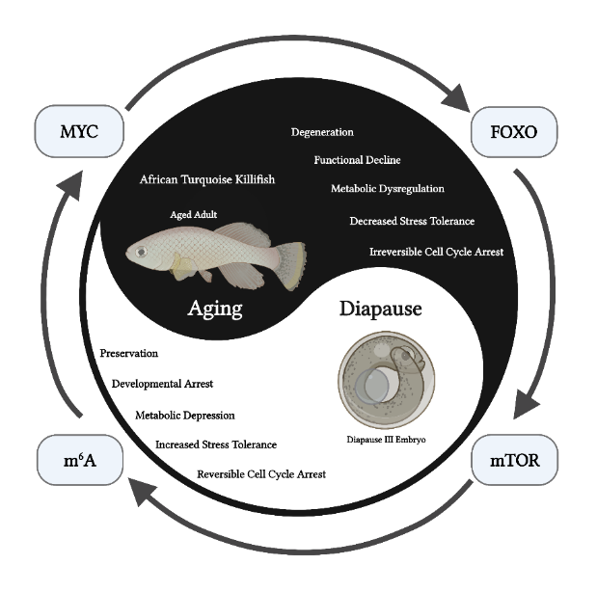
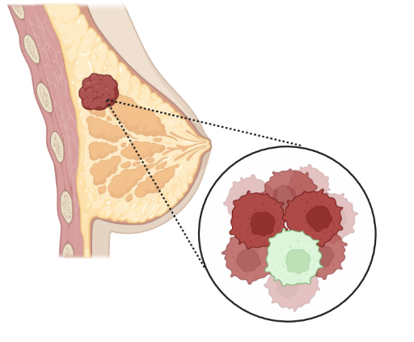
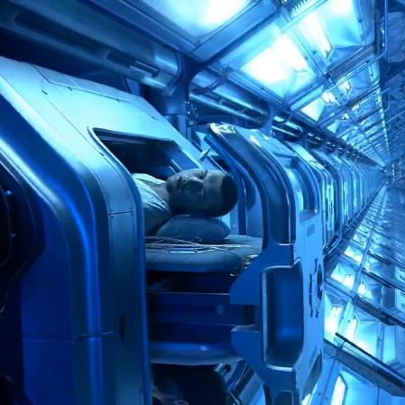
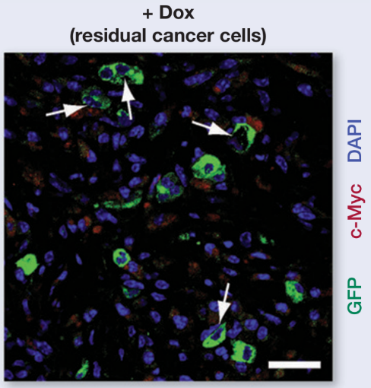
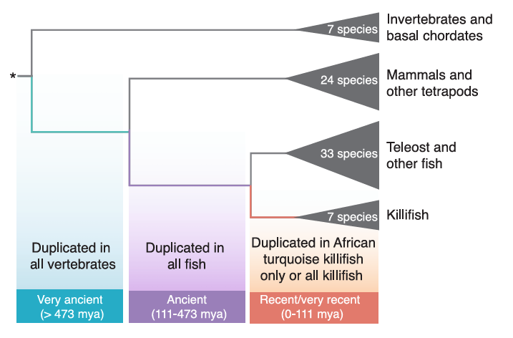
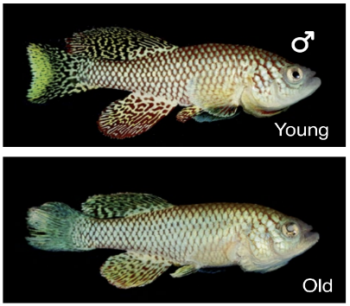
1. Aging Research
2. Cancer Dormancy
3. Space Travel
Z
Z
Z

Slide 23
Name: Fatima Ejaz
From Brooklyn, NY
Hobbies: walking, learning languages
Fourth year Genetics PhD student in the Talos Lab
  Project: exploring age, lineage plasticity, and intratumor heterogeneity in Prostate Cancer

Slide 24
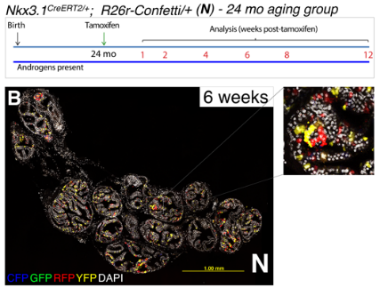
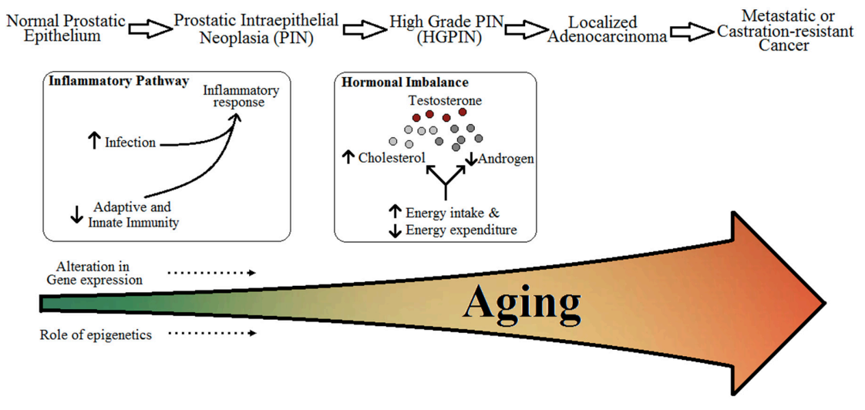
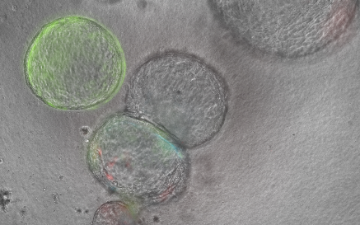
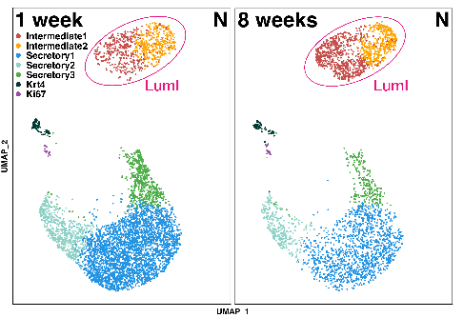
Prostate cancer and its heterogeneity remains a challenge
→ Most common non-cutaneous malignancy in men
  → Age is the leading risk factor for PCa
Vaidyanathan et al.,gereriatics,2016

Slide 25
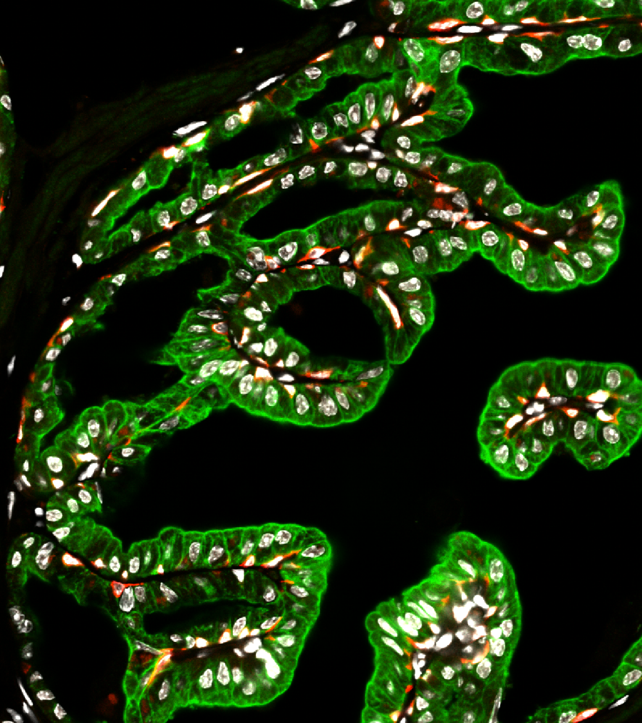
Aging-Induced Lineage Plasticity: Unveiling the Roots of Intratumor Cellular Heterogeneity
Intermediate states
Transcriptional regulation
Clonal dynamics

Slide 26
Elucidating the Mechanisms of Transcriptional Pause Release Via Notch
Wendy Zeng
Dr. Julia Rogers
Fall 2026

Slide 27
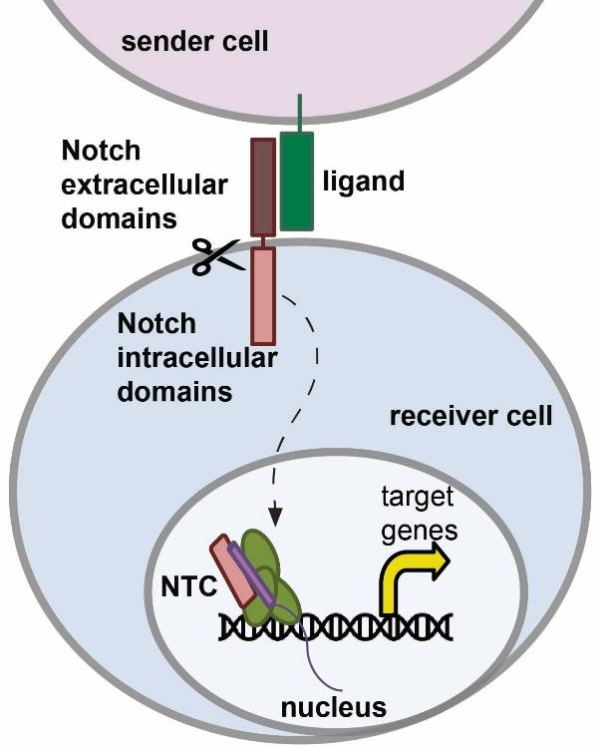
Notch activation and cleavage drive NICD nuclear translocation and target gene expression
The Rogers Lab Website
Notes:
Notch is a highly conserved cell-cell signaling pathway playing a role in embryonic development, adult tissue homeostasis, and cell fate, which is why its dysregulation is often associated with various cancers
In brief, this pathway is activated by ligand binding to the Notch receptor
Ligand binding triggers proteolytic cleavage, releasing the Notch Intracellular Domain (NICD, Nic-D)
NICD translocates to the nucleus, where it binds RBPJ and MAML to form the Notch Transcription Complex (NTC) to regulate transcription of target genes
Because Notch turns on different genes in different cells, Notch activation produces context-dependent effects across different cell types
(As a result, depending on the cell type and their target genes, Notch mutations can be oncogenic or tumor suppressive)
Therefore, one of the goals of our lab is to understand how transcription is regulated by Notch

Slide 28
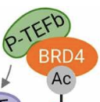
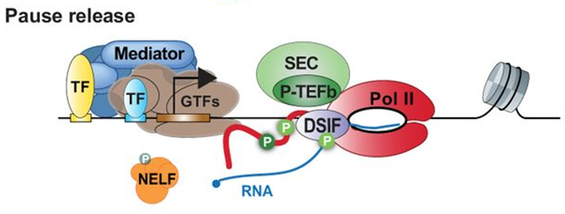

Promoter-proximal pause release serves as a key checkpoint for productive elongation
Core and Adelman, 2019; Altendorfer et al., 2022
Notes:
Precise gene expression is achieved through tight regulation of transcription in many different steps
One of which is the promoter-proximal pause release, which acts as major rate-limiting checkpoints, controlling whether Pol II enters productive elongation
Specifically:
The main player of pause release is PTEFb that phosphorylates Pol II, DSIF, and NELF for Pol II to enter productive elongation to transcribe target genes

Slide 29
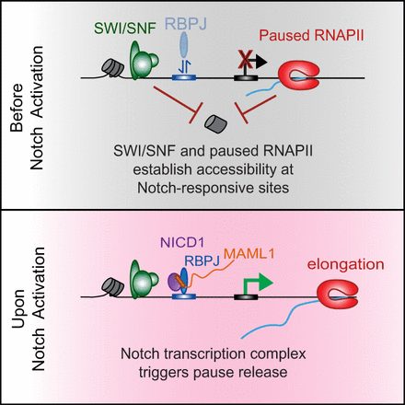
Notch promotes RNAPII pause release to enable productive target gene transcription
Goals:
Interrogating various cofactors that interact with NTC to promote pause release
Determining whether Notch promotes pause release in other Notch-driven cells lines
Sequencing Methods:
PRO-seq
TT-seq
ATAC-seq
RNA-seq
ChIP-seq
Rogers et al., 2024
Notes:
In my mentor’s postdoctoral work, she discovered that upon Notch activation, the Notch transcription complex help promote RNAPII pause release in squamous cell carcinoma cells by using various high resolution sequencing methods such as Precision Run-On sequencing that maps RNAPII location
Therefore, my project currently involves following up on her work by:
Interrogating the candidate cofactors, such as SEC and BRD4, which are known to regulate PTEFB to identify the mechanisms by which Notch promotes pause release
Analyzing sequencing data generated in other Notch-driven cell lines, such T-cell cancer (lymphoblastic lymphoma) cells, to see if Notch also promotes pause release in other cell types

Slide 30
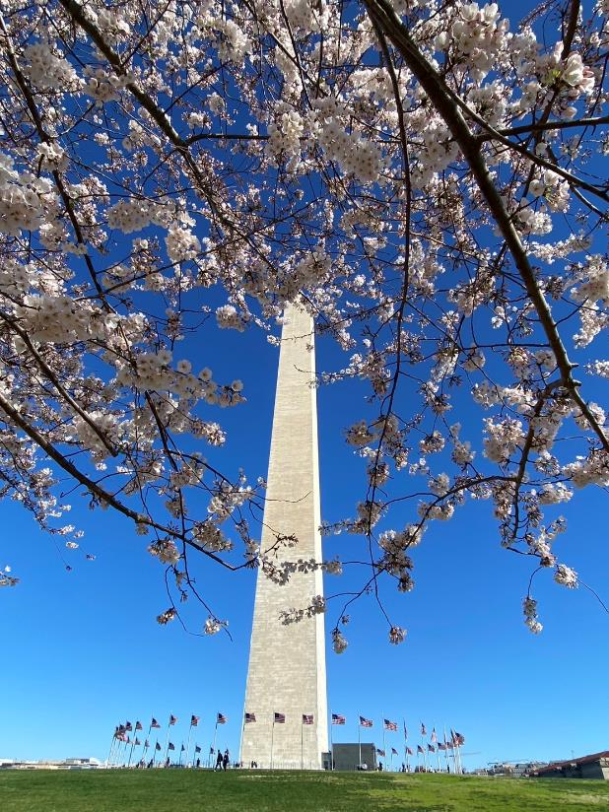
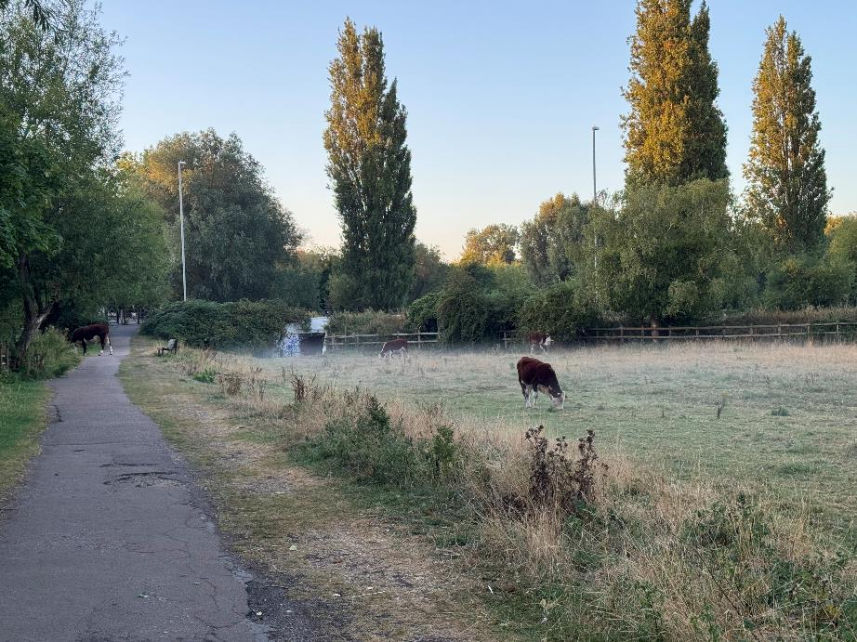

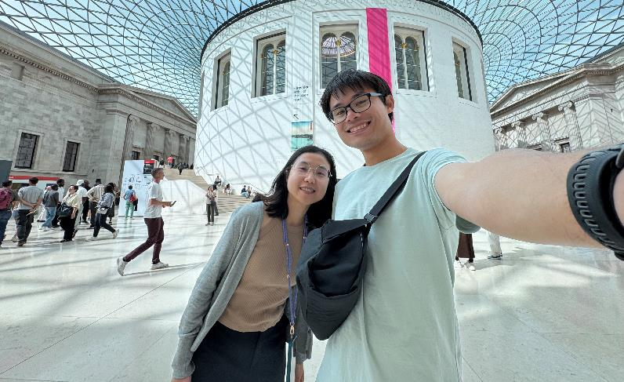

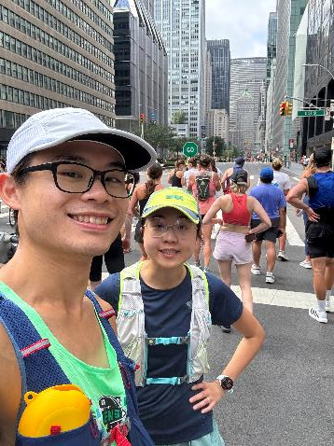
Alice Wang (Janowitz lab at CSHL)

Slide 31

Cancer cachexia
Ferrer et al. Cell (2023)

Slide 32

Recovery from cancer cachexia
What happens during the healing process? How do we help patients recovery from systemic illness?

Slide 33
Speed Science 2026
Sam Chiappone

Slide 34

Sphingolipids (SL) are a class of lipids found in eukaryotic cells, which help form the plasma membrane and endomembrane system (ER, Golgi, etc.)
Importantly, some families of SL species are bioactive, meaning that they trigger signaling within the cell
Hannun and Obeid, 2018

Slide 35






FOXA1 is associated with SL genes in breast cancer, and FOXA1 knockdown affects SL gene expression in MCF7 cells, positioning FOXA1 as a central regulator of SL

Slide 36
FOXA1 is known to mediate aggressiveness of cancer in multiple cancer types, but how remains elusive
My data suggests it is through repression of sphingolipids, some families of which are cytotoxic (they trigger apoptotic signaling in the cell)

Slide 37








Separable kinetic and distributional dimensions of promoter-proximal pausing
Harriet Wu
+1 nucleosome
(Zhao et al. 2023): β and σ separate release kinetics from pause-site spread.
TSS
(Žumer et al. 2021): RNA polymerase II initiates transcription at the promoter, often pauses near the promoter region.
(Aoi et al. 2020): acute NELF loss shifts paused Pol II downstream, to the +1 nucleosome.
β = pause release kinetics
σ = pause site dispersion

Slide 38

Speed Science 2026
---Yujia Ji
Michael Lukey’ Lab at CSHL
5Th Year Ph.D. in Genetics program
Stony Brook University

Slide 39



Deciphering the role of stearoyl-CoA desaturase 1 (SCD) in breast cancer
SFA
PUFA
Lipotoxicity
Ferroptosis
SFA: Saturate fatty acid
MUFA: Mono-unsaturate fatty acid
PUFA: Poly-unsaturate fatty acid
Cell membrane
SCD is a key player in populating this balance

Slide 40










Something About Me…
3D Bead Craft!
Figure Skate!
Kimble and Timea!

Slide 41




Introduction
Gabriel Chan
Renaissance School of Medicine at Stony Brook University MSTP (MD/PhD)
B.A. Columbia University, USA (Biochemistry)
M.S. École normale supérieure Paris-Saclay, France (Molecular nano- and bio-photonics / Quantum Mechanics) – Fulbright Scholar

Slide 42


Previous Research Experience / Thesis Lab Research
Prior Research
  Tatiana Engel Lab – CSHL/Princeton/Tufts
  Pawel Muranski Lab – CUIMC
  Martinot/Artiges Lab - INSERM U1299, G.Borelli Mathematics Center, ENS Paris-Saclay
Current Research
  Lucas Cheadle Lab – CSHL
    Neuroimmune interactions in healthy brain and glioblastoma
    OPC-Microglia and OPC-Glioblastoma Interactions

Slide 43

Outside of Lab

Slide 44







Kimberly Elicker
B.A. in Mathematics and Biology
M.A. in Mathematics Education
Epigenetics
12 years teaching in NYC Public Schools
through Math for America
Research Assistant at
Rockefeller University

Slide 45









My previous research:
Transcriptome-wide mapping reveals an RNA-dependent mechanism of platinum cancer drugs
Krishnaraj A, Wei X, Thakral R, … Nair SJ · bioRxiv 2025 (preprint)
Cisplatin doesn't only hit DNA — it binds RNA G-quadruplexes, and that binding tracks with platinum sensitivity in patient tumors.
Quantifying Intracellular Platinum Accumulation Using ICP-MS
Krishnaraj A, Nair SJ · Current Protocols 2024
Arun Krishnaraj
GS1 MD/PhD Student
HOMETOWN
Dallas, Texas
Stuff I like:
UNDERGRAD
University of Texas ‘21 – Majored in Math, Biology, Finance
BEFORE THIS
Masters in Bioinformatics + Post-Bacc at Georgetown, Sreejith Nair Lab
NOW
Entering the PhD phase – I study glioma epigenetics in the Rahme Lab
NON-SCIENTIFIC INTERESTS
Strategy games, coffee, my dogs, backpacking/outdoors stuff
SCIENTIFIC INTERESTS
Chromatin architecture, bioinformatics, tumor biology

Slide 46






Jessie Zhang, 1st Year PhD Student
Graduated from NYU Shanghai for my Bachelors degree
Started medical school and in the Stony Brook MSTP
2021 - 2024
2026
2021
2024
Worked as a research technician in the Hochwagen Lab at NYU studying yeast meiosis
Started graduate school in the Stony Brook Genetics program and 3rd year in the MSTP
Joined the Nelson lab for my thesis lab

Slide 47






Some hobbies…

