Slide 1

SEFA ePledge Tutorial https://www.givingnexus.org/_nyssefa/

Slide 2
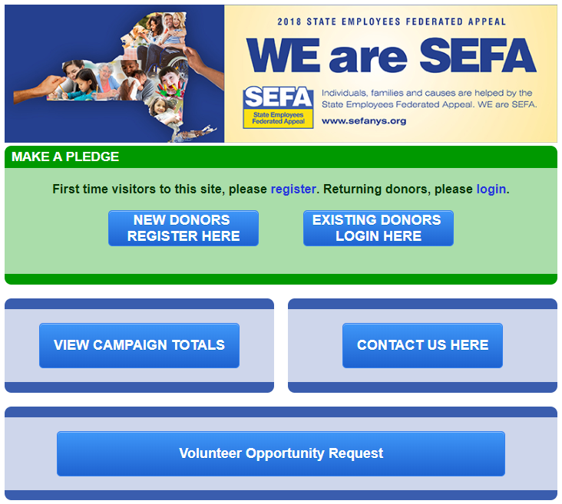
Home Page
Register or Login
Previous users may login with the credentials from a previous year. You can recover your credentials by clicking “recover my username/password” button under “Existing Donors Login Here.”
If interested in viewing the results of the SEFA campaign, click the
“View Campaign Totals” link.
Click “Contact Us Here” to contact us.
New in 2018. “Volunteer Opportunity Request”

Slide 3
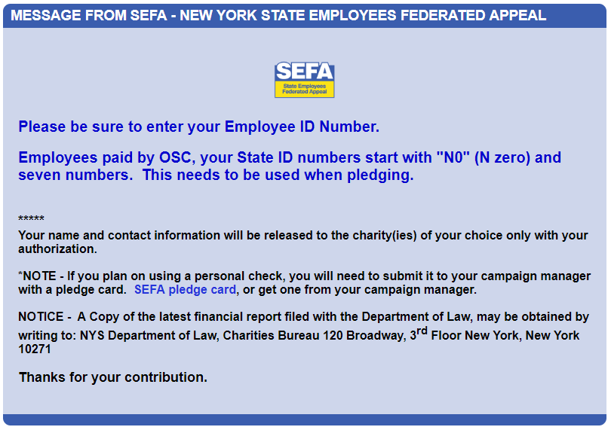
Home Page – Bottom
General Information
Take notice!

Slide 4
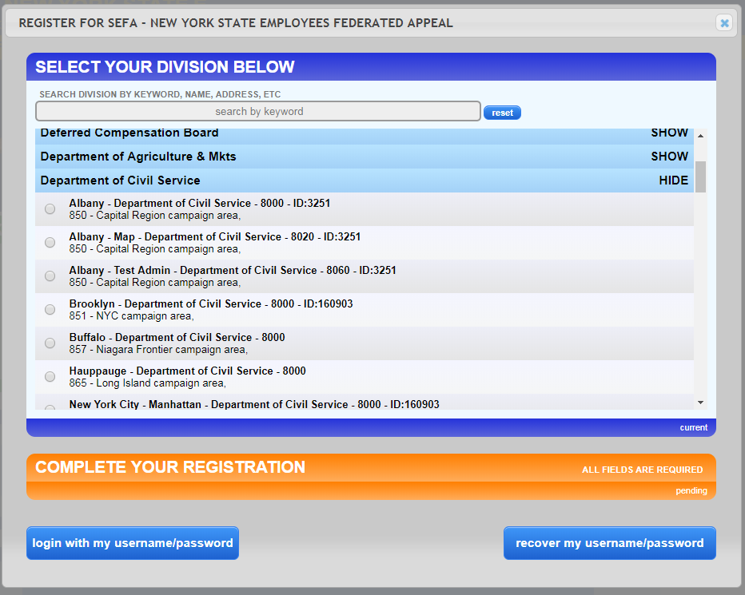
New people will need to register.
First, select your workplace. Read the descriptions carefully to ensure you choose the correct location and agency code you get paid under.
Previous users will be able to login with their existing username and password or recover them.

Slide 5
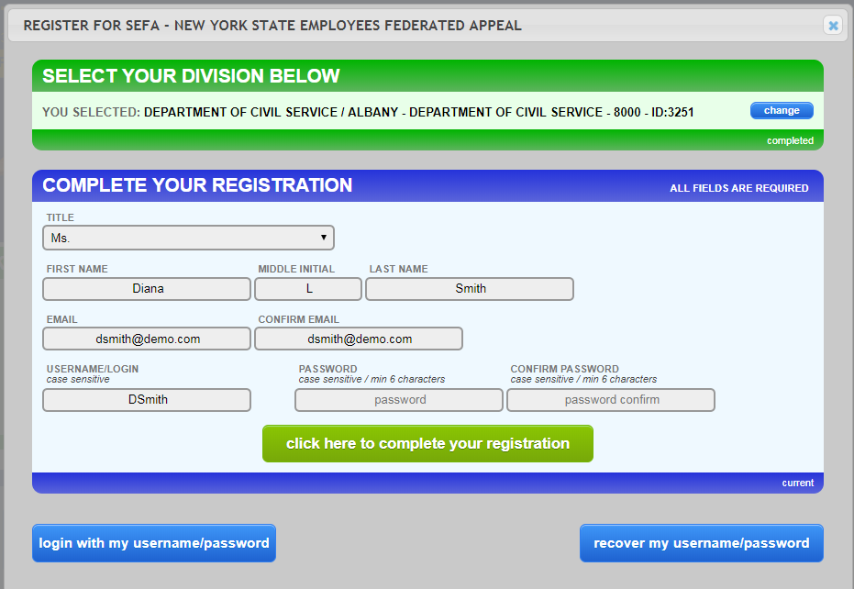
Critical! Before moving forward, confirm your “Division” is correct. Have chosen the correct work location?
Continue to complete the form with your personal data to finish the registration steps. Be sure to enter all fields.

Slide 6
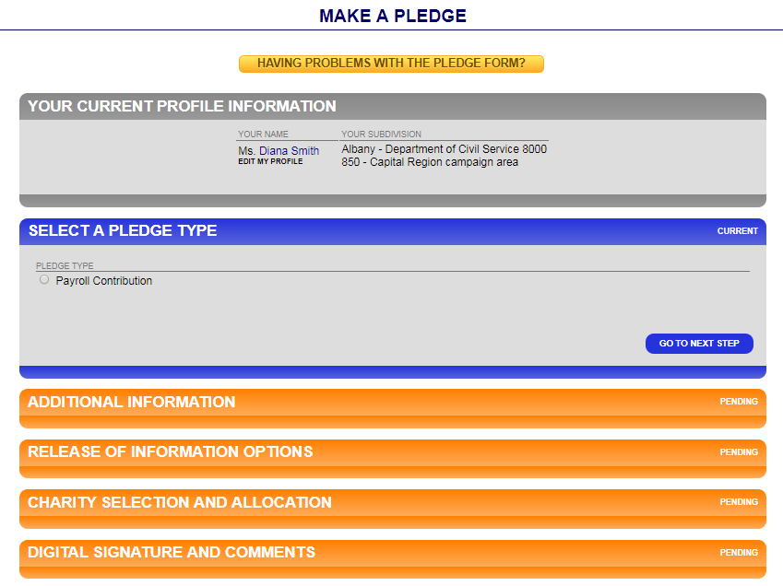
Make a Pledge
Currently we are only able to accept payroll contributions.
Click “Go To Next Step” after every step completed.

Slide 7
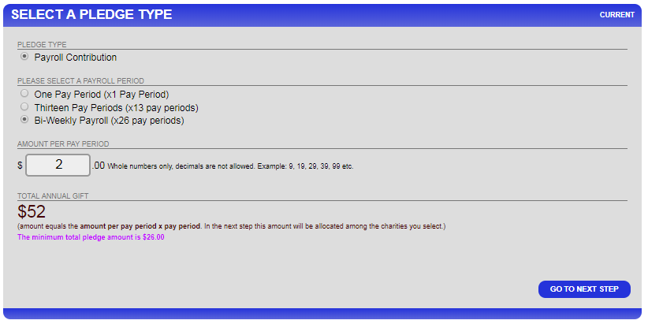
Select the number of pay periods and enter the amount per pay period**. The “Total Annual Gift” is automatically filled . Click “Go To Next Step.”
**New in 2018. There is a $26 minimum per year pledge. This was done to reduce processing costs.

Slide 8
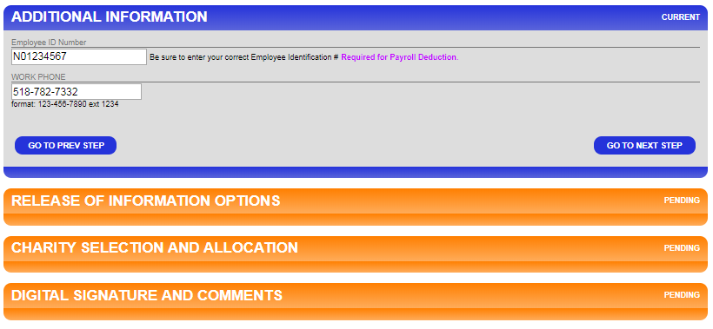
Enter your NYS Employee Identification Number. OSC employees identification numbers are N0&7 numbers. For most, numbers are located on your paystub. THIS INFORMATION IS VERY IMPORTANT.
Work Phone” is required. It will only be used if there is a question regarding the donors ID number, or another question regarding the pledge. Click “Go To Next Step.”

Slide 9
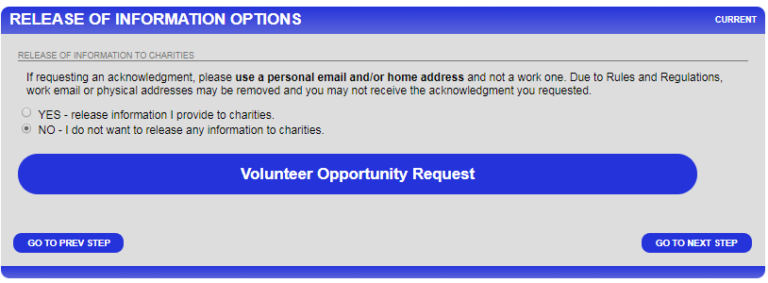
Select the “Release of Information Options” of your choice. Click “Go To Next Step.”
If interested in volunteering, click “Volunteer Opportunity Request” to send notice to your SEFA Coordinator.

Slide 10
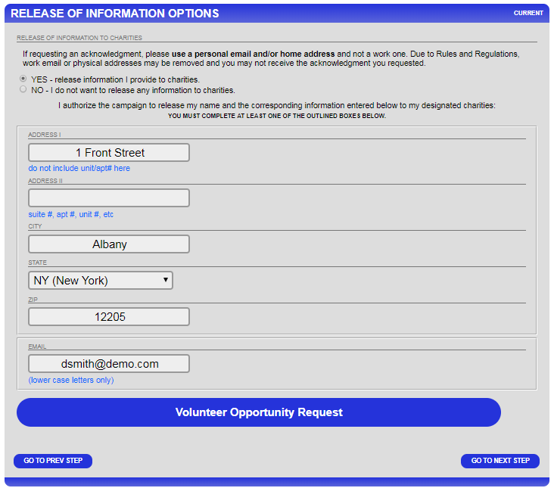
If you have chosen to release your information, an address and email form will open up. Complete the proper contact information.
Note: For an acknowledgment, you must provide either a personal home address and/or personal email. Due to Rules and Regulations, work email or work physical addresses may be removed and you may not receive the acknowledgment you requested.

Slide 11
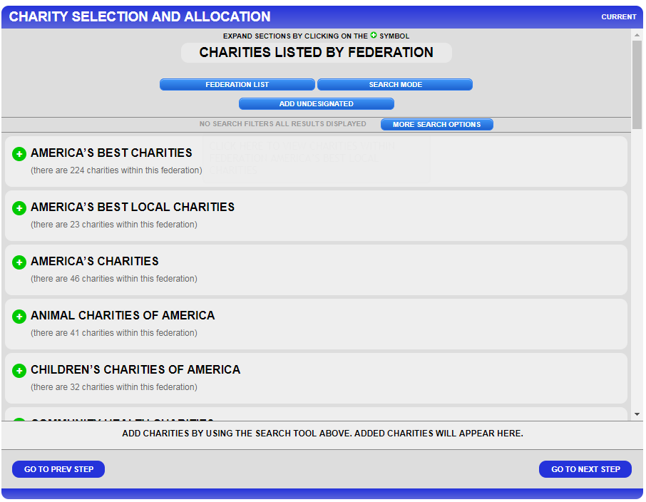
Make your designation choices, if any, here.**
You can use the “Search Mode” to enter keywords.
You may also opt to not designate all or some of your donation by using the “Add Undesignated” option.
**New for 2018. There is minimum of $26 per charity designation. This was done to reduce processing costs.

Slide 12
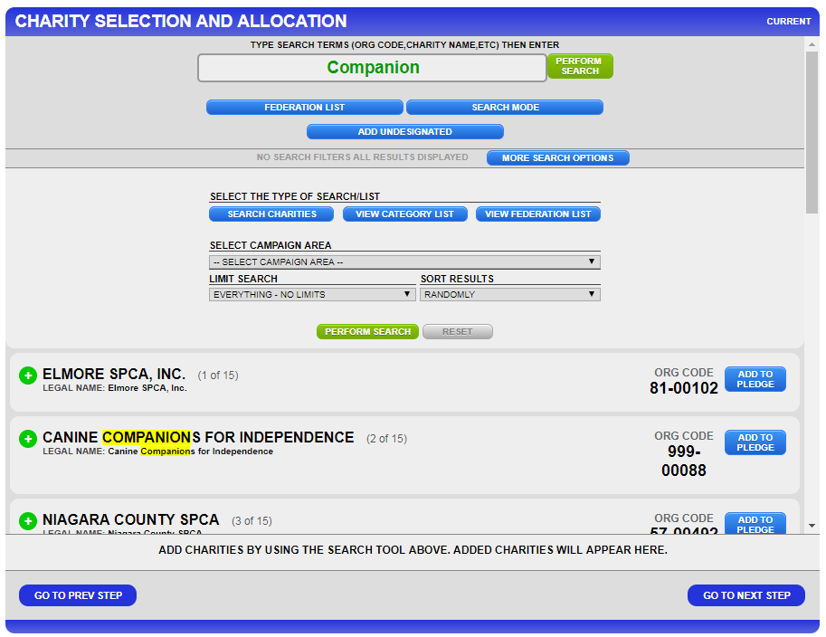
Using the “Search Mode” you will pick from the search results from your keyword.
“More Search Options” narrows your search and sort by many criteria.
Click the “Add To Pledge” button to the right of your charity choice.

Slide 13
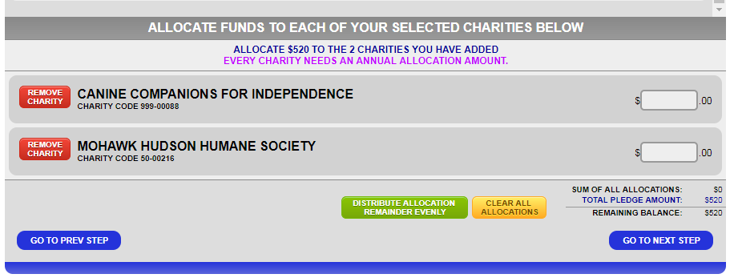
After you have added the charity choice(s), scroll to the bottom of the page.
Designate how much you want to go to each charity**. It calculates how much you have designated and shows a remaining balance. You have to designate 100% in order to “Go To Next Step”
**New for 2018. There is minimum of $26 per charity designation. This was done to reduce processing costs.

Slide 14
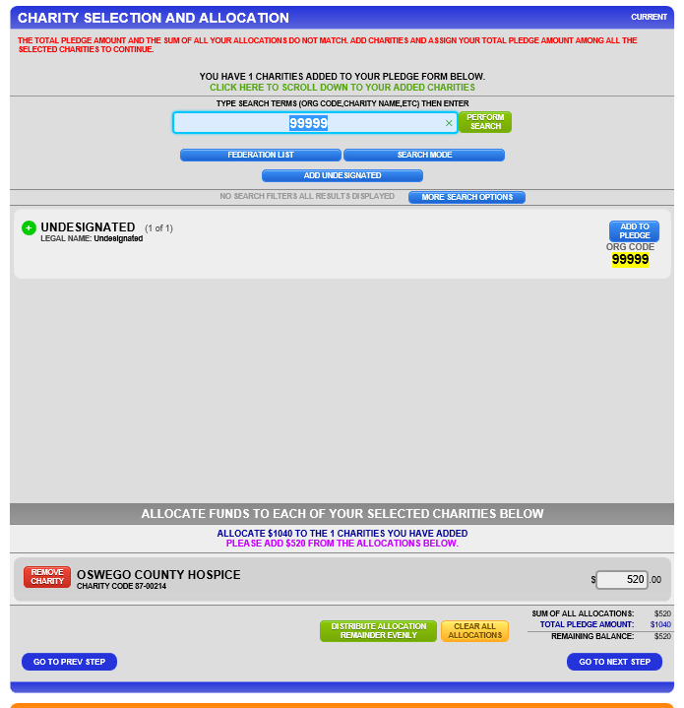
Your “Remaining Balance” must be $0, so you will need to add the “Undesignated” if you do not wish to designate all of your money.

Slide 15
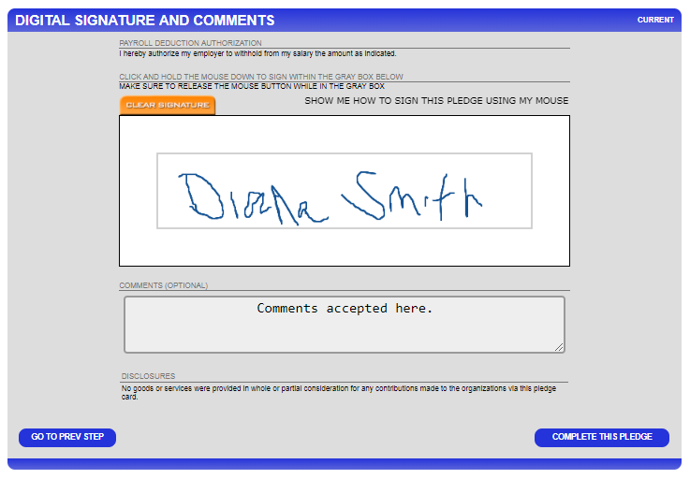
Add your digital signature using your mouse or other input device to do so. Do not worry about the neatness of the signature.
Click “Complete this Pledge.”

Slide 16
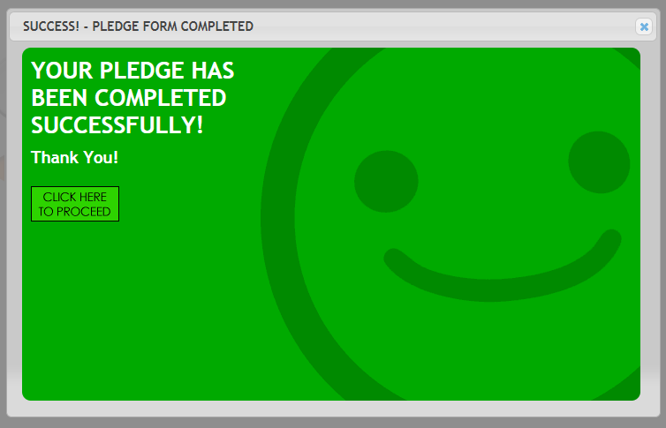
Your pledge has been successfully submitted and you will receive an email confirmation. Now click “Click Here to Proceed.”

