Slide 1
WolfieONE: Manager self Service (MSS)
WolfieONE: Manager self Service (MSS)
Transforming the Manager Experience

Slide 2
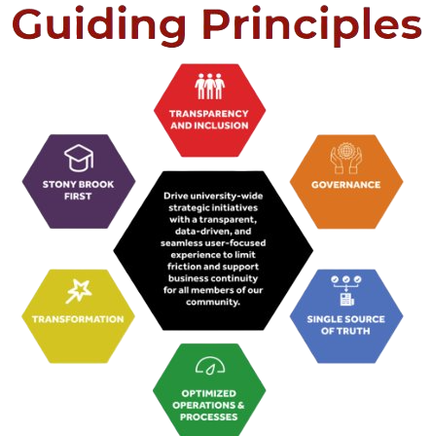
"Transparency and Inclusion"
To foster inclusivity and transparency, we’re sharing the approved solution design
from the WolfieONE project.
Stay tuned for more updates as the project progresses!
Notes:
02. Transparency and Inclusion:
Collaborate cross-functionally
Be transparent in decision making
Communicate fully, seeking input and feedback

Slide 3

The Importance of Early Communication in
Change Management
The Importance of Early Communication in
Change Management
Early communication builds trust and reduces resistance to change.
Engaging end users early helps identify potential concerns.
Timely information fosters a sense of inclusion and participation.
Clear expectations can enhance user adoption of new processes.
Feedback from users can guide adjustments before full implementation.
“Prosci Research shows direct correlation between starting change management early and meeting or exceeding project objectives”
Prosci. “How to Start Managing Change When the Change is Unclear.” https://www.prosci.com/blog/how-to-start-managing-change-when-the-change-is-unclear. Accessed 18 March 2025
Notes:
Change management emphasizes early communication with end users to build trust and mitigate resistance. By involving users from the start, organizations can address concerns and create a sense of participation. This proactive approach fosters user adoption, as clear expectations are set, and valuable feedback can be integrated into the project before full implementation.

Slide 4

Agenda
Agenda
What is WolfieONE?
What does it look like?
What is HCM?
Who uses HCM?
What’s changing in:
  Managerial requests and approval workflows
  Job title and description transformation
  Performance program and evaluation management
  Distributing merit and discretionary increases
  Learning & development for your employees
  Approving time and time-off

Slide 5
What is WolfieONE?
What is WolfieONE?
WolfieONE is Stony Brook University's new Oracle Enterprise Resource Planning (ERP) system that will provide a more unified, transparent, and user-friendly platform for
Managing finances & business operations
Human resources
Budgeting & planning
Notes:
In the Current state we have many different systems that provide various financial reports and human resource tasks. In the future state with WolfieONE all reporting systems and resources are in one ecosystem that will provide a more accurate picture for financial data. It will address pain points like eliminating manual processes, improving data accuracy and consistency and providing automation and workflow approvals. For Human Capital management (HR) we will have seamless HR tasks, onboarding, position and performance control, and labor resource reporting and more.
WolfieONE will be replacing a Peoplesoft (but not Campus solutions), Docusign, Taleo, the old Chart of Accounts, and Campus Budget Module
Some HR items to be digitized are paper timesheets

Slide 6

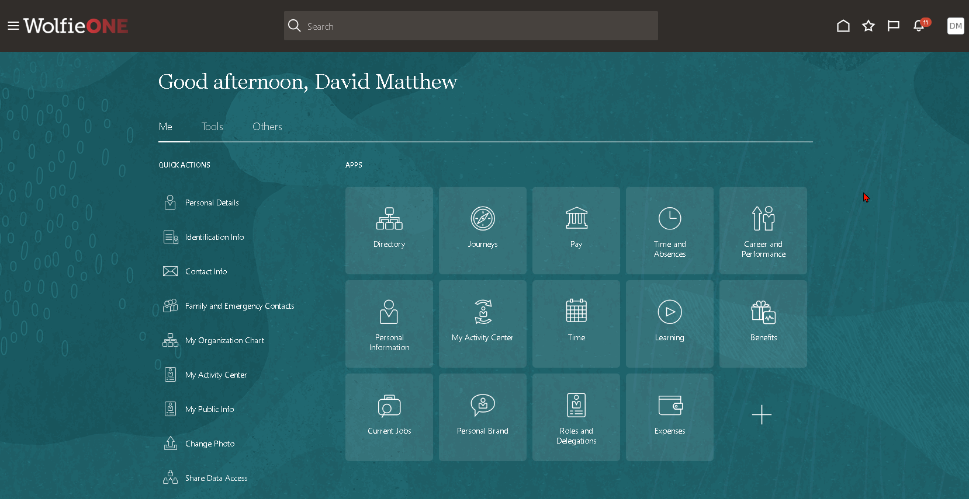


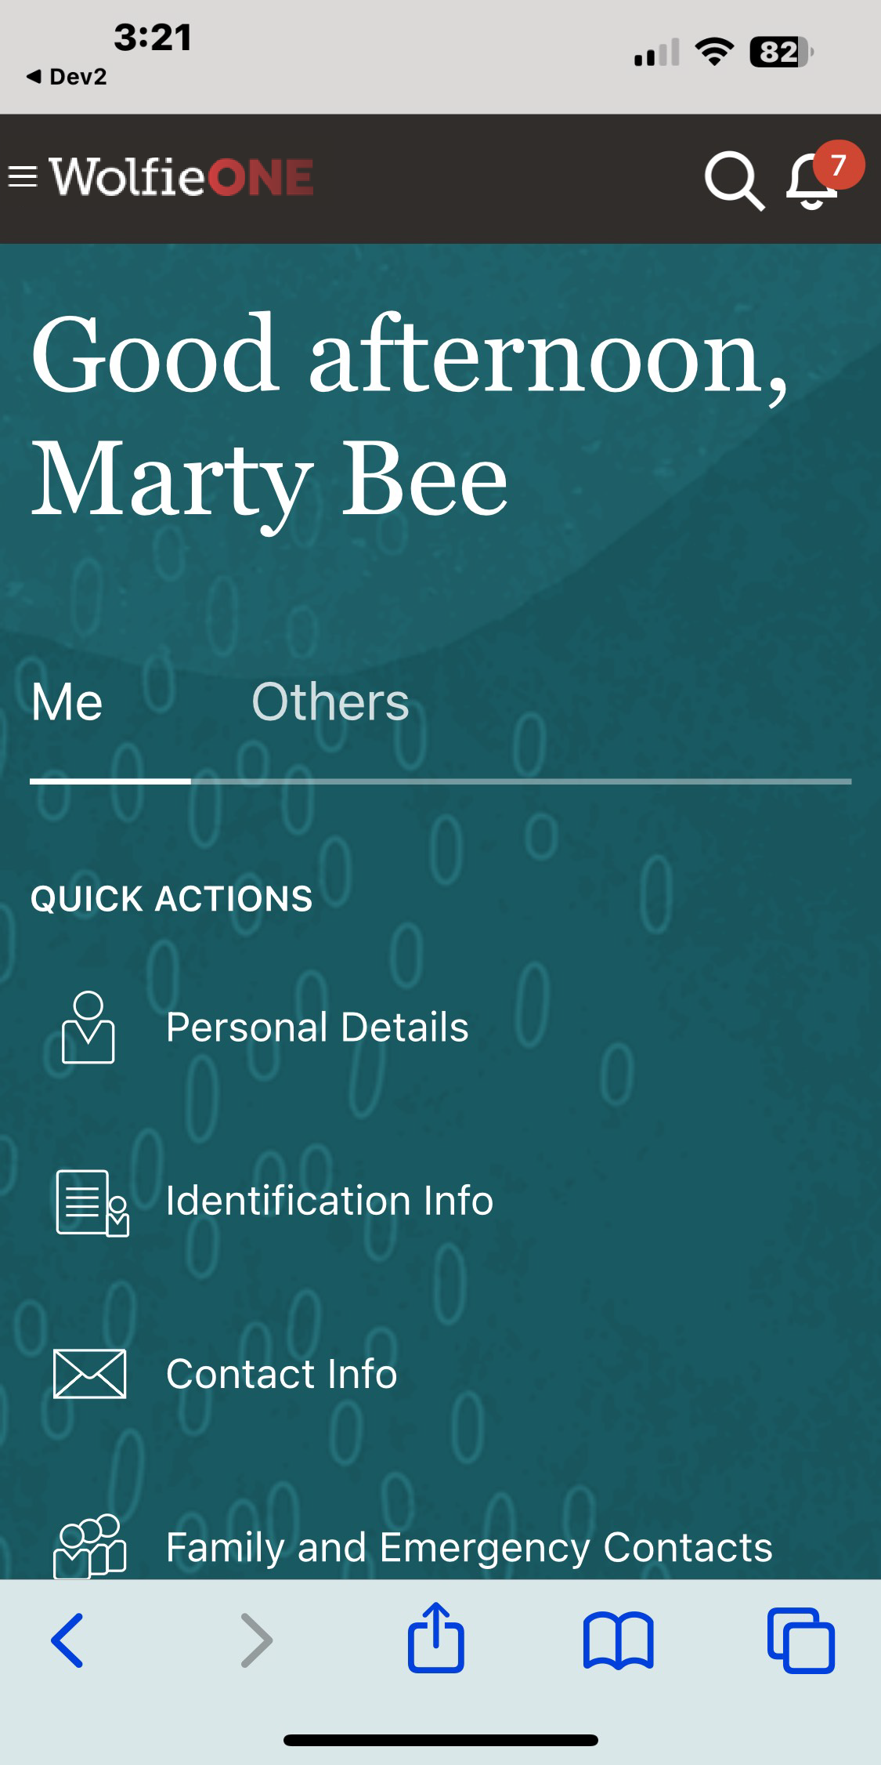

What does it look like?
What does it look like?
Note: Colors may change to SBU Brand, but functionality and navigation remains the same.
Notes:
As employees we will be able to do more on mobile, this includes timesheets, onboarding, professional development, and submit HR Requests.
Color may change.

Slide 7
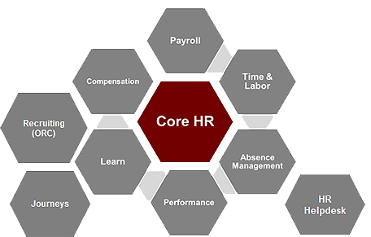
What is HCM?
What is HCM?
A suite of ORACLE modules we will use to deliver day to day human resources activities, reports and requests:
Human Capital Management (HCM)
Core HR
Payroll
Compensation
Time & Labor
Reporting
Absence Management
Performance & Goals
Learning
Recruiting
Journeys
HR Helpdesk
Learning
Notes:
All of these functions are now housed in one ecosystem for optimized data, insightful reporting and a better employee experience from onboarding to retirement.

Slide 8



Who uses HCM?
Who uses HCM?
Employees
Managers
HR & Division approvers
What do I do?
View employment and update personal information
Complete training
View pay slips (State)
Review benefits options
Review performance programs and evaluations
Submit time, Request time off
– excluding Hospital and Vets home
What do I do?
Manage a team (ensure they enter time and labor promptly)
Access to dashboards
Evaluate performance
Review and approve requests
Request changes to employees’ records; initiate transactions
Transact upon team
What do I do?
Review/approve/deny transactions
View entire division
Transact upon entire division
Notes:
Personas that will go into WolfieONE and have security roles assigned to them. Today we will talk about the Manager Role.

Slide 9
What’s Changing?
What’s Changing?

Slide 10
Requests and Approval
workflows
Requests and Approval
workflows
Core HR
Learning
Notes:
All of these functions are now housed in one ecosystem for optimized data, insightful reporting and a better employee experience from onboarding to retirement.

Slide 11

Requests to HR are Changing For Managers in 3 ways:
Requests to HR are Changing For Managers in 3 ways:
Many PDFs for requests/changes and approvals will be digitized within WolfieONE.
Requests that require approvals are automatically escalated to the appropriate approval groups in WolfieONE.
The approval process is transparent, allowing initiators visibility into its status.
Notes:
One of the strengths of the Core HR module is it’s ability to digitize requests with workflow approvals.
The next few slide will talk about the Current State of making HR Requests by PDF and the improved digitized experience with complete task lists and approval workflows.

Slide 12



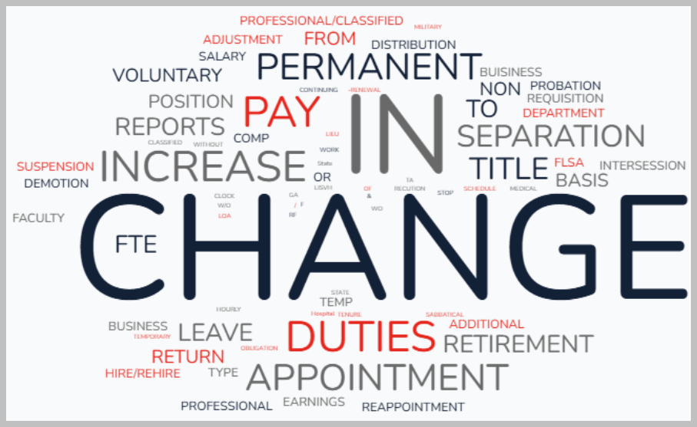

Managerial Requests and Approvals
Core
HR
Current State:
Future State:
West Campus: When making a request to HR via HR Forms a form is emailed or handed into HR.
Hospital: Uses SharePoint for requests.
LISVH: Transactions and their related approvals are manual through email/paper and not transparent.
At the division level, there are different levels of approvals for many transactions.
Many Manager tasks requesting changes to employee records will be made within WolfieONE.
Approval workflows are automatic and streamlined.
The initiator and approvers have visibility into the approval workflow.
Approvals are standardized to a maximum 3 levels.
Approvers receive notifications to approve.
Initiators receive notifications when approvals are completed.
Enhanced workflow automation and increased visibility for approvals
Notes:
Current State
HR forms: https://www.asa.stonybrook.edu/asa/ASAForms/Department/HRS
Forms filled out incorrectly delaying the process
Additionally, the information in the forms must be rekeyed into a system by HR for the change to take place.
Confirmation of the change is not automatic and there is no transparency.
Future State
Journeys have the added benefit of transparency. Employees will see approvals and where in the chain something is awaiting approval.
Journeys are multiple tasks organized together to reach a goal. For example a Name change journey would include
Correct spelling
Upload of supporting documentation
HR approvals
An automatic ticket sent to IT to change the name in boundary systems and email.

Slide 13

Future State: Workflow Approval Automation
Manager initiates transaction upon employee and has visibility into approval workflow.
HR can see the request and
approves.
Since there is no rekeying of information into a system, the transaction is committed on final approval.
Approvals are standardized to a maximum 3 levels.
3. HR Department Approves
2. Division Approver approves
1. Manager initiates a Request
Notes:
3rd Approval
Higher level HR department approves
2nd Approval
HR department approves
1st Approval
Manager or HRBP approves
Initiate
Employee or Manager initiates change or request

Slide 14




Start
Stop
Continue
Login to WolfieONE and initiate a journey for many requests.
Check WolfieONE for approval updates and
Alerts.
Login to WolfieONE and initiate a journey for many requests.
Check WolfieONE for approval updates and
Alerts.
Leveraging WolfieONE to make requests for changes for your employees or initiate changes.
Reviewing the status of requests in WolfieONE.
Checking WolfieONE for
Approval updates
Alerts
Stop using PDFs/paper to make requests.
Stop using SharePoint (Hospital)
Stop sending emails to make or check on requests.
Continue to be engaged with your employees and initiate transactions for changes where necessary.

Slide 15
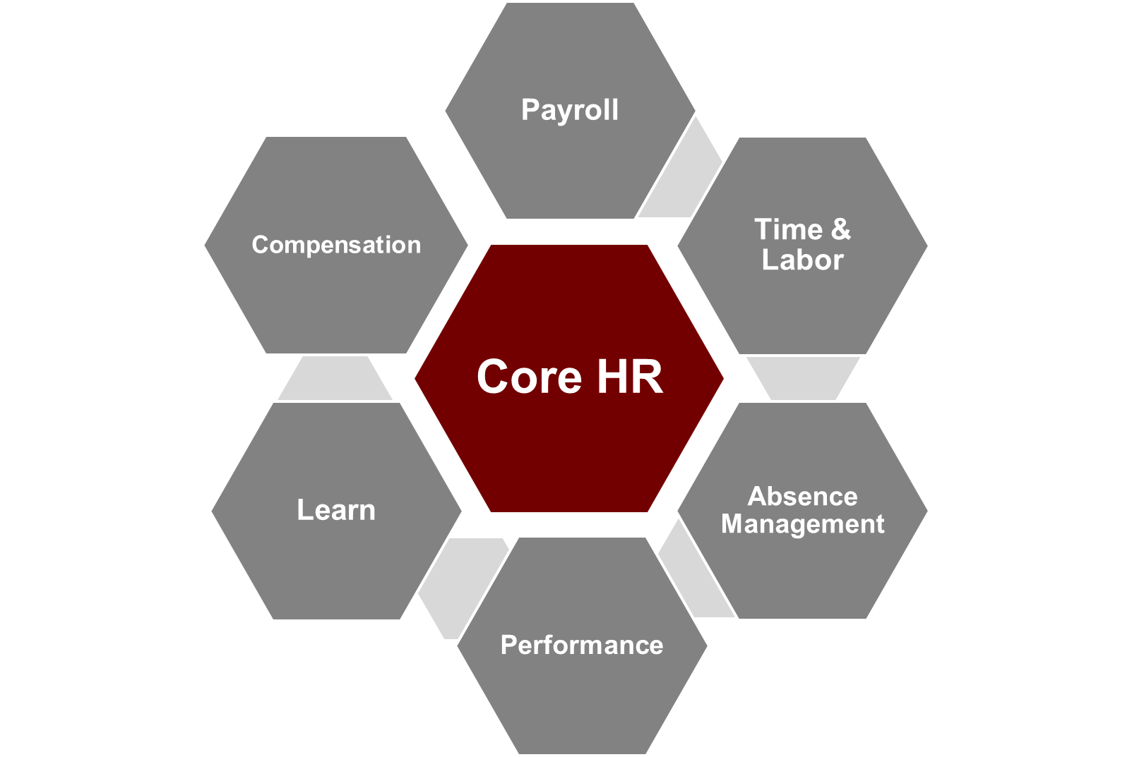
Job Alignment
Job Alignment
Core HR
Core HR
Recruiting
(ORC)
Learning
Journeys
HR Helpdesk

Slide 16

Job Alignment
CoreHR
Current State:
State and RF Official titles are broad and redundant.
Job levels and career paths are not consistently defined.
Non standardized job titles and descriptions.
Descriptions are lengthy/wordy and time-consuming.
Stony Brook titles are a more accurate reflection of the work that is being performed by employees.
Future State:
Using standardized Stony Brook job titles:
Allows for the enhanced use of delivered functionality in Oracle HCM
Enables transformation in Human Resource Services such as using Job Families and creating clear career paths for employees.
Reduces the variation of existing titles.
Shortens the hiring process by choosing a standardized job description rather than writing one.
Notes:
Job Alignment is about modernizing Titles to describe the actual work an employee does and to standardize the job descriptions.
Note: When recruiting, hiring managers are able to expand upon the standardized job description to find the right candidate.

Slide 17
JOB alignment
WolfieONE has presented Stony Brook with an opportunity to reimagine and standardize the current job titles. ​This would allow for the enhanced use of delivered functionality in Oracle HCM and enable transformation in Human Resource Services. The goal of this project is to reduce the number of and variations in local titles, have standardized job titles and job descriptions, and certain requirements for each position and level.
 | CURRENT TITLE | NEW TITLE
Character limitation - Local titles in PeopleSoft have been limited to 30 characters and so are often abbreviated and truncated to fit into this field. In WolfieoNE, there is no character limit for titles. Every word in the job title will be spelt out using no abbreviations. | Sr. Proposal Development Coord | Senior Proposal Development Coordinator
Missing or shortened words | Assistant Vice President for C | Assistant Vice President of Customer Engagement and Support
Special characters such as commas, dashes, or ampersands | Grants & Contracts Specialist | Grants and Contracts Specialist
Provide a title where none exists | Blank | Title reflecting work being performed
Employee has their state or RF title listed as local title | Staff Assoc | Associate Director of Academic and Transfer Advising Services
No local title and the employee uses only their state or RF title | Sr Staff Asso | Senior Staff Associate
Notes:
We can see the future state titles will be more descriptive of the jobs that the employees are doing and there are no abbreviations.

Slide 18
Start
Stop
Continue
Referring to the Standardized Job Titles and Descriptions to fill positions / requisitions in WolfieONE.
Stop creating new Stony Brook job titles for existing positions.
Stop creating new job descriptions for existing positions.
Continue to regularly review and update employee responsibilities based on the evolving needs and performance within your teams.
Continue ensuring the job description accurately reflects the current work being done.
What should we start doing?
Is there a tool, process or resources that would help us achieve our goals?
What strengths do we have that we aren’t currently leveraging?
What should we stop doing?
What do we do that takes up a lot of resources but doesn’t produce results?
Is there a tool or process that isn’t working the way is was intended to?
What are we doing right that we need to continue doing?
What works well that shouldn’t change?
(e.g. Jaggaer, Concur)

Slide 19
Digitized performance
Programs and
Evaluations
Digitized performance
Programs and
Evaluations
Performance and Goals
Core HR
Recruiting ORC
Learning
Journeys
Performance
HR HelpDesk
Notes:
All of your HR professional development training and compliance training will be located in WolfieONE. You can register for workshops or drop from the registration. View course materials and take tests. Attendance and completion rates are recorded.

Slide 20

Performance and Evaluation Management
Performance
Current State:
Performance evaluations and programs are PDFs, separate from any system.
Future State:
Managers can:
View, create, and manage digitized performance programs and evaluations anytime directly in WolfieONE.
Digitized Performance enhances efficiency and automation
Notes:
Managers can:
Deploy performance evaluation
Use AI to help with writing performance goals and evaluation comments.
Create any time evaluations earlier than review date, like for 6-month reviews.
Ask others outside of department to provide feedback on employee (as a task in WolfieONE)
3/14/2025 – The Standardardized Performance Period is not yet approved for socialization.
Add to 3rd bullet when approved: “during the standardized Performance Period. “

Slide 21
Start
Stop
Continue
What should we start doing?
Is there a tool, process or resources that would help us achieve our goals?
What strengths do we have that we aren’t currently leveraging?
Stop signing Program and Evaluation PDFs.
Stop saving and storing programs and evaluations on a separate drive.
Continue to communicate and engage your employees by setting clear goals and expectations to foster productivity and a culture of growth and motivation that will ultimately contribute to your team’s success.
What should we stop doing?
What do we do that takes up a lot of resources but doesn’t produce results?
Is there a tool or process that isn’t working the way is was intended to?
What are we doing right that we need to continue doing?
What works well that shouldn’t change?
(e.g. Jaggaer, Concur)
Adopting the new ways to conduct performance management.
Go to WolfieONE to complete performance programs and evaluations.

Slide 22
Distributing merit and Discretionary increases to your employees
Distributing merit and Discretionary increases to your employees
Compensation
Compensation
Core HR
Recruiting
(ORC)
Learning
Journeys
HR Helpdesk

Slide 23

Distributing Merit and Discretionary Increases to your employees
Comp
Current State:
Distributing discretionary and merit increases among a team of employees is a manual process.
Currently, HR sends out spreadsheet files for departments to enter employees' distributions then loaded into Peoplsoft or RF Oracle.
Future State:
Managers will be able to enter percentages or amounts from their pool directly in WolfieONE; no more spreadsheet files.
Managers will see a notification for this task. It will be on their “Things to Finish” list in WolfieONE.
There will be an electronic approval process that will commit the changes to WolfieONE for payroll.
Streamlined and digitized discretionary and merit distribution

Slide 24
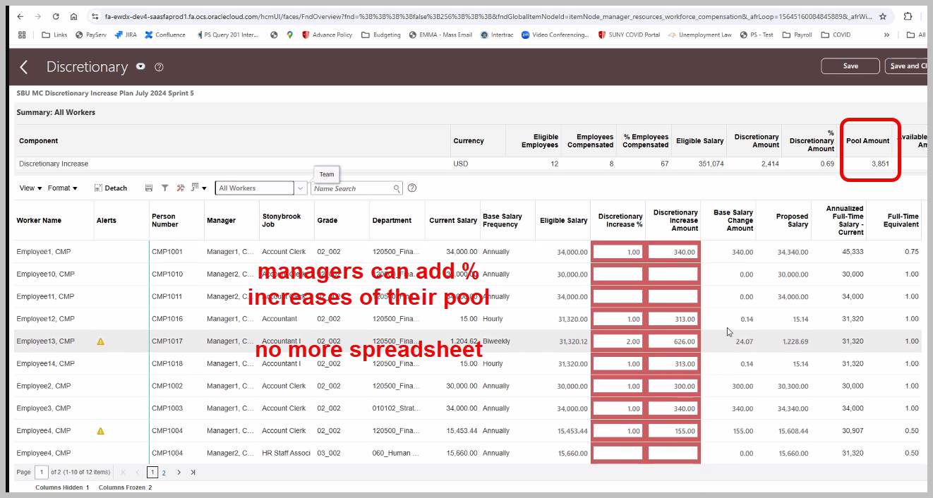
Screenshot of distributing pool
Screenshot of distributing pool

Slide 25
Start
Stop
Continue
Reviewing notifications within WolfieONE, detailing when and where to distribute merit and discretionary increases.
Viewing your pool amount to be distributed in WolfieONE.
Distributing increases either by amount or percentage in WolfieONE.
Stop using spreadsheet files to calculate and distribute merit or discretionary increases.
Continue to track employee performance to support merit-based increases.
What should we start doing?
Is there a tool, process or resources that would help us achieve our goals?
What strengths do we have that we aren’t currently leveraging?
What should we stop doing?
What do we do that takes up a lot of resources but doesn’t produce results?
Is there a tool or process that isn’t working the way is was intended to?
What are we doing right that we need to continue doing?
What works well that shouldn’t change?
(e.g. Jaggaer, Concur)

Slide 26
Upcoming Topics
Learning and Development (Learning Module)
  Applies to State, RF, and LISVH
Approving Time off and Time (Time and Labor Module)
  Applies to State and RF

Slide 27
Providing Learning and Development for your Employees
Providing Learning and Development for your Employees
Learning Module
Core HR
Recruiting (ORC)
Note:
The Hospital will continue using HealthStream for Professional Development.
Learning
Journeys
HR Helpdesk
Notes:
Healthstream will feed completion data back to WolfieONE to the employees’ records.

Slide 28

West Campus & LISVH: Providing Training to your Employees
Learning
Current State:
Various training sites for Professional Development.
Training materials and resources are distributed across multiple platforms or locations.
Registration is managed through various platforms or systems.
No visibility into employee completion rates by manager.
Future State:
Managers Can:
Access Manager professional development Training in WolfieONE.
Browse and assign training to employees.
Add employees to waitlists when a course is full.
View status and completion rates of employees’ training.
Enhanced manager self-service for direct report professional development
Notes:
Managers Can:
Assign training to their team.
See analytics and completion for their team.

Slide 29
Start
Stop
Continue
  Browsing the Catalogue for soft skills training
  Checking your compliance training due dates in WolfieONE
  Seeking assigned training
  Waiting for compliance training in email
  Browsing and assigning training for your employees.
  Checking the status of training for your employees.
(There is no equivalent to the unified learning management system in the current state)
  Continue ensuring employee engagement, satisfaction and career development by seeking training opportunities for your employees.
  Continue using HealthStream and any other training site required by your department.

Slide 30
Approving Time off and Time
Approving Time off and Time
Time and Labor
Time
&
Labor
Core
HR
Note:
The Hospital and Vets’ Home will continue using Kronos for Time and Attendance.
Recruiting
(ORC)
Learning
Journeys
HR Helpdesk

Slide 31

Entering time and approving time off requests
Time
&
Labor
Current State:
Paper time sheets are used for some employee populations.
Requests for time off varies from department to department. It can be verbal, an email, a calendar entry.
Some employees enter time on a computer into Solar (PeopleSoft).
Future State:
No more paper time sheets.
Managers can receive and approve, time off requests within WolfieONE notifications.
Managers can approve, deny or modify employees’ time in WolfieONE.
All records are maintained in WolfieONE.

Slide 32
Start
Stop
Continue
Check your WolfieONE notifications for time off requests.
Approve Time Off requests (such as vacation and sick time) in WolfieONE.
Approve employee time in WolfieONE.
Stop using paper timesheets.
Stop using Solar/PeopleSoft to approve, deny or modify time or absences.
Continue to manage time off requests and approve time for your employees.
Continue to communicate with your employees about time management practices that align with your team’s goals.
What should we start doing?
Is there a tool, process or resources that would help us achieve our goals?
What strengths do we have that we aren’t currently leveraging?
What should we stop doing?
What do we do that takes up a lot of resources but doesn’t produce results?
Is there a tool or process that isn’t working the way is was intended to?
What are we doing right that we need to continue doing?
What works well that shouldn’t change?
(e.g. Jaggaer, Concur)

Slide 33
(Summary) In WolfieONE, Managers can:
Initiate transactions for changes which will route through an approval process.
Choose from standardized Titles and Descriptions to streamline hiring.
Engage with digitized performance programs and evaluations.
Distribute Merit and Discretionary increases directly into WolfieONE.
Assign training to team in WolfieONE (West Campus and LISVH only)
Approve time, time off in WolfieONE (West Campus only)

Slide 34
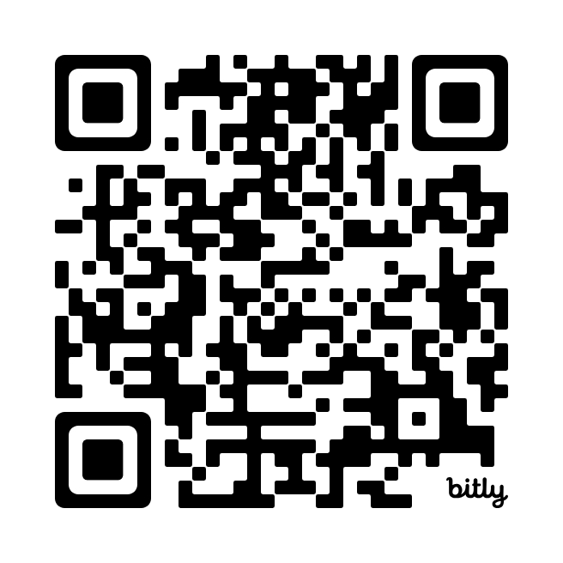
Questions and Feedback
Questions and Feedback
Share suggestions or feedback on WolfieONE here
or email us
ocm@stonybrook.edu

Slide 35
Resources
Stonybrook.edu/erp
Change Champion Stakeholder Awareness
Change Champion Toolkit

Slide 36



