Slide 1
Chart of Accounts
Educational
January 2026

Slide 2

Table of Contents
Topic | Slide
Overview | 3
COA Segments | 4
Terminology | 5
Segment details | 6 - 12
Examples | 13 - 15
Appendix | 16 - 33
Notes:
Mention that there may need to be a Future 2 (not the business users, but maybe someone who is designing an integration)
Commitments = (Ability for units to track and manage their commitments.)
Mention that for ERP is just SBU and SBF – the rest are on the COA for budgeting purposes only.

Slide 3
What is WolfieONE?
Business Transformation Initiative:
WolfieONE is a strategic transformation initiative that will design and implement an Enterprise Resource Planning (ERP) ecosystem at SBU, supported by Oracle, to better support our financial, budget, HR and business operations.
The new, cloud-based software will replace some of our systems, but will also seamlessly integrate with many existing systems.

Slide 4
Enterprise Resource Planning
General Ledger
Accounts Receivable
Accounts Payable
Fixed Assets
Cash Management
Notes:
Current state: Internal construction projects are paid via journal transfer between depts. CPDC starts the project in CPR and creates the MP2 numbers that correspond to each IFR. Future state: SBU decided to use AR for construction billing: MP2 numbers will be known from the fund segment on the invoice (invoice creation and invoice edit transaction) AR transactions can be sorted by transaction types. Each invoice will have one fund value only in the memo line. MP2 is in the description of the fund (in the COA), it will match th IFR fund number. Current state AR: Quickbooks is using the customer field to identify the MP2 project, which is NOT leading practice. There is one IFR (fund) per project. The MP2 will be linked to the IFR fund value in future state. Need a custom report and training on this custom report in the future state - AR summary- to track the billing items per project and show the balances by fund in WolfieONE.

Slide 5
What is a Chart of Accounts?
    The chart of accounts is a set of pre-defined segments (in a pre-defined sequence), with a fixed list of values available under each segment
    Every segment is a critical dimension in representing some aspect of the business – legal, financial, operational, management – on the books for every transaction
    Every event on a transaction that has a financial impact generates accounting entries posting it to a combination of segment values in the General Ledger
    All segments may not be relevant for all transactions, but all segments of a combination entry is always mandatory and cannot be blank
Simply put, the chart is a structure to label and organize transactions in a financial and HR system.
Segment
Delimiter
Combination
XXX.000.0000.YYYYYY.00000.000.0000
Fund Agency Program Natural Account Project Intercompany Future
*For illustration purpose only
Notes:
Commitments = (Ability for units to track and manage their commitments.)
Mention that for ERP is just SBU and SBF – the rest are on the COA for budgeting purposes only. ; while EPM is also the Hospital and LISVH
In the current state, many of you are using the current PS COA without even knowing it
Animate so that not ALL elements show up at once!
Uses the wardrobe metaphor
Benefits are: data integrity, accurately leabeled transactions, better reporting, compliance with SUNY/RF reporting requirements ad scalability

Slide 6
New SBU Chart Segments
Entity – Major institutional operating unit (e.g. SBF, SBU).
Org – An operating area that is responsible or benefits from the specific transaction. The area must have a financial budget greater than $100,000.
Fund – Segment to represent financial sources and uses related to specific activities, aligned with restriction categorizations.
Account – Nature of the transaction (e.g. asset, liability, expense, revenue, net position).
Classification –Describes other attributes refining the transaction. It describes the “what for”, such as for research or instruction. It defines a “type” of something. This segment is critical for reporting and auditable financial statements, and required for WolfMart Transactions.
.
Campus Commitments– Current and future operating obligations of the campus and units that require planning and reserving of funds, as well as funding transactions (one-time and multi-year) that are allocated to support a reporting unit.
Budget Year – Designates the appropriation year.
Notes:
Mention that there may need to be a Future 2 (not the business users, but maybe someone who is designing an integration)
Commitments = (Ability for units to track and manage their commitments.)
Mention that for ERP is just SBU and SBF – the rest are on the COA for budgeting purposes only.

Slide 7
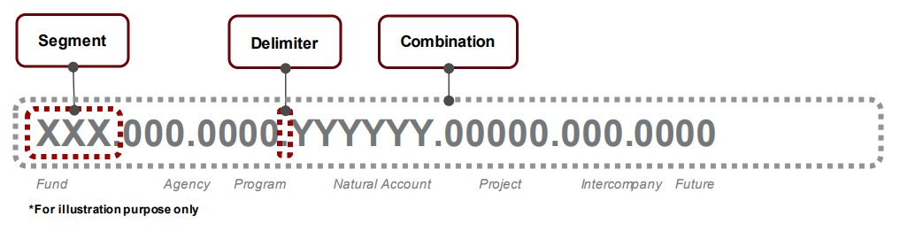
Terminology
Hierarchy: a structure that provides summarized nodes used to report on all the "children" that fall below it. Oracle gives the ability to rearrange the children values into alternative hierarchies that also summarize the reporting view. The parent and child levels are part of the hierarchy for each segment in the chart of accounts.
Child: Every node other than the highest node (at the very top of the hierarchy), is considered a child of the node directly above it.
Parent will be more specific. Only the node directly above a child, is its parent. (Nodes higher than that in the same branch of the tree, are its "ancestors".)
Chart Segment: Every segment is a critical dimension in representing some aspect of the business – legal, financial, operational, management – “tagging” every transaction, like a hashtag or a label. The future state “golden rule” is for each segment to have a single and standard use for every segment across departments. No “co-mingling” of purposes.
Chartstring: The combined segment values, in a fixed order, is called a chartstring. Every event on a transaction that has a financial impact generates accounting entries, posting it to a combination of segment values in the General Ledger. This illustrates what a chartstring looks like:
Notes:
Budgeting happens at the parent level!!! – EPM note
Attribute: acts like a static tag of the chart segments to provide an alternative way to write reports. Example: Academic vs. Non-academic Orgs.
Animate this!

Slide 8
Entity
Entity | Org | Fund | Account | Classification | Campus Commitments | Budget Year
Major institutional operational unit. This segment shows where the transaction resides, on the accounting ledgers. Future examples:
Stony Brook University
Stony Brook Foundation
Research Foundation
Segment Details
  The Entity segment will be the primary segment to consolidate for reporting and balancing (ability to rely on the entity itself for a full accurate picture of transactions)
  The entity segment will have a hierarchy that provides reporting capabilities
  Requirement: an entity needs to be entered for every transaction
  Mapping: Normally the new entity value is closest to “business unit” in a current state PeopleSoft environment.
Notes:
NOTE: when we say business unit in Oracle, it means something different, which will be included in the AR module training.
Mention that the hospital is staying on their current COA.
If I am transacting with Hospital funds, I would select (in Concur), the hospital policy!

Slide 9
Org
Entity | Org | Fund | Account | Classification | Campus Commitments | Budget Year
An operating area that is responsible or benefits from the specific transaction.
When you see Org, that corresponds to the current state Dept. (typically a level 4, if your unit has both level 4 and level 5 dept. “accounts” in the current state)
Segment Details
An operating area that is responsible or benefits from the specific transaction- a department, in the HR sense of the word.
Must have intended permanence.​
An Org should have an employee and/or a financial budget greater than $100,000.
Requirement: all Oracle Cloud transactions require an Organization value.
Mapping: typically, the current state department, with greater consistency across the institution. ​This will streamline accounting and reporting.
Notes:
While exceptions were made, moving forward, end users need education so that they don’t request “Orgs” that are not real orgs by our new definition. Governance needed moving forward to prevent users from doing this.
In some instances (sports) the mapping is from the current state Program to this segment. Athletics currently uses program codes for their sports, this will be in ORG in the future state. (only Athletics needs to know this)

Slide 10
Fund
Entity | Org | Fund | Account | Classification | Campus Commitments | Budget Year
Segment to represent financial sources and uses related to specific activities, aligned with restriction categorizations. This is what people typically enter in the current state across various forms (like an MSR or journal transfer) and systems as their “SUNY account” or “dept. ID” in the current state, to state where the money is coming from or going to.
Segment Details
  The financial sources available for spending, including their classification of restricted and unrestricted.
  Normalization of data will decouple the Org concept from the Fund.
  The Fund segment will be a key element for proper GASB and FASB reporting for the main entities of Stony Brook University and Stony Brook Foundation.
  Requirement: All transactions require a Fund value, so no default is created.
  Mapping: Fund will typically map to the current Dept Level 5 segment values (sometimes referred to as “department account” in the current state).
Notes:
These are the “pots of money” that people are using to draw from or to add to (graphic to illustrate it)
We can mention what GASB and FASB mean in the voice over. Add definitions to appendix.
When people reconcile their P cards, they’re going to be operating in a “SUNY system” so they still need to know their SUNY accounts.
Today when we say “fund”, people are thinking of the highest (grand) parent level (such as “revenue offset” or “IFR”) in the future state. “fund type” is also a parent level. – ask Cassie for her latest fund spreadsheet!

Slide 11
Account
Entity | Org | Fund | Account | Classification | Campus Commitments | Budget Year
Nature of the transaction from an accounting perspective: This indicates whether a transaction is a liability, expense, asset, revenue, etc.
Segment Details
  The Account segment is built to align better with financial statement reports along with reduction of unused accounts over the past five years.
  Alternative hierarchies for the Account segment are typical and will be utilized if reporting requires a different rollup with different summary levels.
  In most instances, the account will be derived and auto-populated (from the object code or RF-expenditure type).
  NOTE: The use of the word “account” in the current state is not consistent. Some stakeholders mean “Dept. level 5” or “SUNY account” or “SBF account”, when they use the word account.
Notes:
NOTE that the user won’t be picking the Account value in WolfieONE anywhere.
It’s closely aligned with object codes or expense type. (commodity codes in WolfMART, and no change for Concur, which is “expense type”)
Mapping: Account segment in the old PeopleSoft chart (general ledger account) maps to this segment. (only visible if you are in SB reporting)
Most folks just know revenue category and expense category
Alt hierarchies: This concept will only be used by Central Acct and BFP&A. Long term, for reporting it might matter for more stakeholders.

Slide 12
Classification
Entity | Org | Fund | Account | Classification | Campus Commitments | Budget Year
Describes other attributes refining the transaction. It describes the “what for?”, such as for research or instruction. This segment is critical for reporting and auditable financial statements, and required for WolfMart Transactions. When you see the new Classification field know it houses:
For expenses: this provides the official NACUBO classification of expenditures. The functional reason for the transaction
For revenue: The current Class field provides the semester terms related to revenue transactions. Additionally, it denotes the revenue transaction category, such as CRT (cash receipts), REF (refunds), FIN (financial aid payment), CHG (charge).
Segment Details
  This segment will have a hierarchy that provides reporting capabilities.
  Mapping: current state Program or Class. It is paramount that this be entered correctly for all expenses. This segment also contains academic terms to classify certain revenues. The current state Class field provides the terms related to revenue transactions that is also included in this new segment.
Notes:
This segment/concept is not brand new. The user will enter it in the future so we can have increased accuracy. Instead of setting the classification in the background once for each fund and assuming all transactions for that fund will be correct, we categorize it at the transaction level. One of the key benefits of this whole implementation is capturing this at the transaction level. Depending on the situation, the primary purpose should be entered, or the line items should be split out.
We are moving from having this at a very high level (fund setting) to a “per transaction”, we are looking at each transaction rather than who is spending or “which pot of money”.
SBF transactions in Concur are an exception basis, where, for a few reasons, Classification will be “invisible” and not have to be entered.
For EPM: Eli will follow up with Cassie to find out whether there is a need to put in classifications when it comes to planning (for revenue)

Slide 13
Campus Commitment
Entity | Org | Fund | Account | Classification | Campus Commitments | Budget Year
NET NEW. This segment will give units the ability to track their commitments. Campus Commitments are current and future financial obligations between campus leadership, schools, departments, or units that require planning and reserving of funds. These commitments may be one-time or multi-year funding promises that support operations across the university.
The total value of commitments is substantial. This segment helps track whether and when those committed funds are used in a transaction. Currently, commitments are tracked outside of financial systems, through spreadsheets, emails, or local databases. The new structure will bring greater consistency and visibility into how these commitments are recorded, managed and spent.
Segment Details
  Current and future operating obligations of the campus and units that require planning and reserving of funds, as well as funding transactions that are allocated to support a reporting unit.
  Not all transactions require a Campus Commitment code, so a default of “00000000” was established.​
  No mapping exist to a current state segment.
Notes:
Explain that even lower level transfers within units have to carry the official (original) campus commitment value of the commitment that was given out. Major training needed for units. If you have commitments, it will be reflected in your target. When you get a target, you know how much you can spend (spending authority). Example: I am the Dean, the commitment is from the Provost and my commitment needs to be used for a specific purpose such as “grow the entering class”, when I (Dean) give it to the department, the Dean is responsible for telling the departments to see their commitment in their targets in EPM. The Dean would be responsible for the telling their units (in the target build up) that their target includes that commitment and what the commitment number is (on their target in EPM.
While some commitments are for in-year resources, there can also be commitments against reserves.
It might look like you did nothing with the dollars that was given to you if you don’t use your commitment code.

Slide 14
Budget Year
Entity | Org | Fund | Account | Classification | Campus Commitments | Budget Year
An identification of the budget year.
During year-end lapsing (July through Sept), end users can either post the transactions to the current year or the prior year (for appropriated funds).
Segment Details
  The Budget Year segment allows for the ability to track re-appropriated funds being used for SUNY.
  Mapping: from the current state Bud Ref to this segment.
Notes:
In most cases, budget year = fiscal years. There are times when funding is appropriated (by SUNY) in a prior budget year.
When the manager wants to pay from the lapsing year, the obligation date of the requisition must be for that prior year.
SBF is not an appropriated fund.
On the revenue side, it will default to 0000.

Slide 15
In-system examples

Slide 16
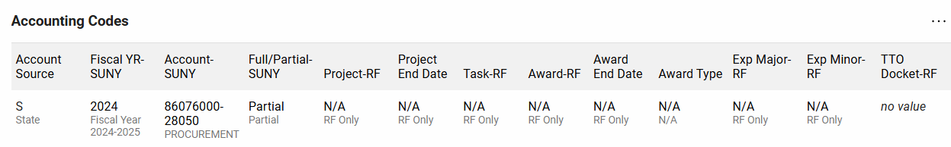
Current state WolfMart
RF-funded purchases: User should continue to enter what they currently enter in these segments. NO change.
Future Entity
We are keeping this segment and adding a budget year segment
Future Fund (this current field will be hidden and the new segment for fund will have a new name – TBD)
Notes:
Can we say this: Speed Types are values containing Chart of Accounts data?
This is current state (Jason will send me the future state link)
Who needs to learn alternate hierarchies? – ask Cassie
Org will be derived but will still show here
View will be different for SBF
Classification is at the header level (need current state screenshot of header level)
The future state will have more columns so we’ll have to scroll all the way to the right in the future state – horizontal scroll! Get everyone used to it.
Initial period might require us to maintain SUNY fiscal year fields (transition period)- We will default those values.

Slide 17
WolfMart and Concur data entry
 | Entity | Org | Fund | Account | Classification | Campus Commitment | Budget Year
WolfMart | Displayed: Y User Entry: Y Note: Displayed as “Account Source” | Displayed: Y User Entry: N Note: Derived from Fund | Displayed: Y User Entry: Y Note: Provisioned from ERAS | Displayed: N User Entry: N Note: Derived from Commodity Code | Displayed: Y User Entry: Y Note: Header Level Displayed | Displayed: Y User Entry: Y Note: Default as 000s Entered and displayed at the Header level. | Displayed: Y User Entry: Y Note: Default to current year (user has an option to change it)
Concur | Displayed: Y User Entry: Y Note: Displayed as “Account Source” |  |  | Displayed: N User Entry: N Note: Derived from Expense Type | SBU: Displayed: Y User Entry: Y Note: Header Level Displayed SBF: NOT Displayed | Displayed: Y User Entry: Y SBU: Header SBF Credit card: Line level SBF travel: Header | SBU: Displayed: Y User Entry: Y Header level SBF: NOT Displayed
Notes:
Unless otherwise specified “header level”, the value will be at the line level, at the granular level.
SBF- “allocate” in Concur is considered the header
Hospital and LISVH users will continue to enter what they use in the current state. SBU employees may have hospital-funded transactions (hospital funds that are used on the University side)
NO change to RF-funded purchases
The commitment segment will require HIGH amounts of training for WolfMart/Concur. The system defaults to all zeroes, but the user absolutely needs to know to change this if they are using committed dollars.
In Concur, you can differentiate what “fund” is called for SBU vs. hospital, but NOT in ERAS. Hospital will continue to call “fund” their “account”

Slide 18
Appendix

Slide 19
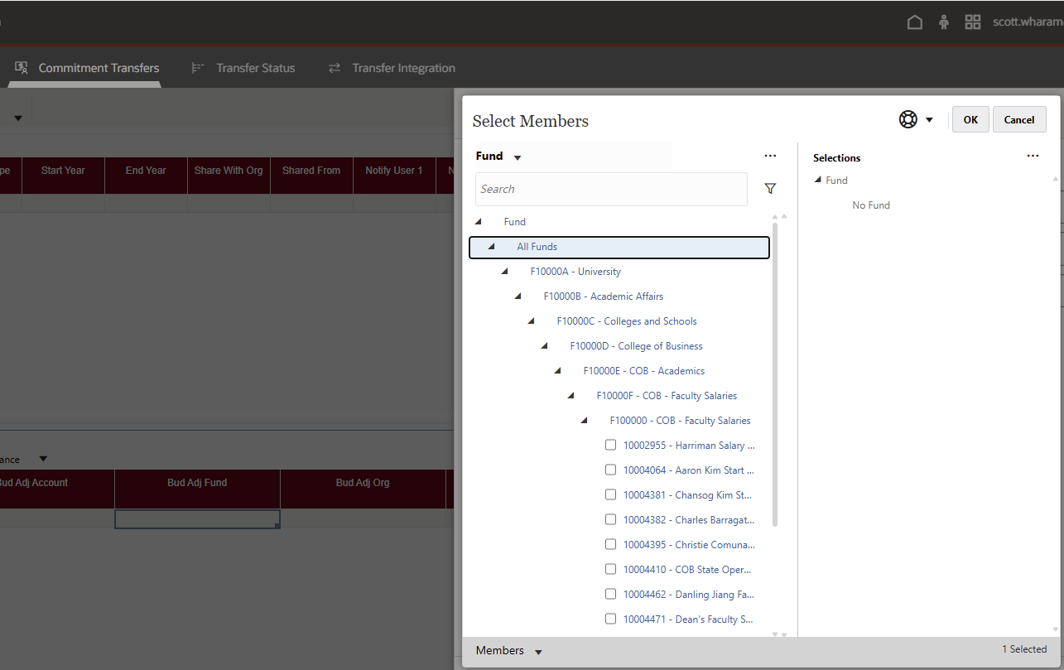
EPM Fund Example
All planning will be performed using Account, Campus Commitment and Fund segments.

Slide 20
HCM User entry expectations
The following use case pertains to entering the correct chart values to denote what fund is paying for a given employee’s salary in the HCM module of WolfieONE:
Entity
Org
Fund
Account
Classification
Campus Commitment
Budget Year
Only Fund and Commitments will be entered for labor costing.
RF-funded employees will enter their Project-task-award combination instead of fund in this HCM field.
Notes:
Is there a direct mapping earn codes to object codes?- confirm with Korak and Caleb about the account segment.
WolfMart and Concur do not need to see this slide!

Slide 21
Sample Chart Usage in WolfMART & Concur
Entity | Org | Fund | Account | Classification | Campus Commitments | Budget Year
Major operating unit. | An operating area that is responsible or benefits from the specific transaction. The area must have intended permanence and must have an employee and/or a financial budget greater than $100,000. | Segment to represent financial sources and uses related to specific activities, aligned with restriction categorizations. | Nature of the transaction (e.g. asset, liability, expense, revenue) | A classification of expenses (The “what for”, such as instruction or research) This is the NACUBO classification. | Ability for units to track and manage their commitments, which are for budget purposes. | An identification of the budget year for prior budget spending.
In WolfMart and Concur, the user will have to select it. | (Defaulted in WolfMart/Concur) | Must be entered when using WolfMart and Concur. (this is your RF or State account, etc) | (Defaulted in WolfMart/ Concur) | Must be entered when using WolfMart and Concur (SBU only for Concur). | Only need to enter if there is a commitment. | Defaulted to the current year, but during lapsing, the user can choose the prior.
Notes:
The child value level rolls up to parent 5, which rolls up to parent 4, and so forth. The parent levels are reporting nodes.
Transactions are tracked and posted at the child level.

Slide 22
  Additional Concepts

Slide 23
Example (Illustrative only)
NEW segment names | Entity | Org | Fund | Account (natural account, NOT SUNY acct.) | Classification | Campus Commitments | Budget Year
Current state counterpart | Unit or “Account source” in WolfMART | “Dept ID” | “Dept ID” | GL Account (not dept. account or SUNY account) | Program OR Class | N/A | Budget Ref
Current state example value | S (State) | 42007600 (“parent account”) | 83002200 (Dept. account/ Level 5) | 812601 | 00 | N/A | 2324 (no change)
NEW segment description | Stony Brook University | Physics | Physics CFNS Simons Operating | Office Supplies - Printing Supplies | Instruction | N/A | 2023-2024 State Budget Cycle
NEW value | 100 | 140080 | 10200857 | 566004 | 1001000 | 00000000 | 2324
Chartstring that will show up in the WolfieONE subledger for the example above:
100-140080-10200857-566004-1001000-00000000-2324-00000
Notes:
In the current state, there is no “chart” concept. People only enter one segment (dept) in the current state.
Drive home the benefits (reporting) of having things laid out this way. Refer back to the guiding principles.
A VP areas in the future can be an ORG, but not all VP Areas are structured the same in the new COA. Some VP areas are a Parent level value, and some are lower in the hierarchy in the future state.
Cassie or Sara to think if there’s an example where the user’s lives will become easier when leaders ask for reporting
When the account or cost center is set up (in the current state), we assume that all the funds corresponding to it go to the same classification and account! In the future state, you have more flexibility, for scenarios in which the transaction you are entering has a certain fund that needs a variable classification.
If you don’t know your commitment and you haven’t gotten one (if this looks foreign, you probably don’t have one , and no need to worry about it)

Slide 24
Hierarchy example (illustrative only)
Ways in which values “roll up” to their parent levels in the real world:
Parent / Ancestor | Reporting node | Reporting node | Child (value) | Description - Borough
Federal
 | NY345 (NY State)
 |  | NYC Mayor
 |  |  | 100007 | Queens
 |  |  | 100008 | Manhattan
 |  |  | 100009 | Brooklyn
 |  |  | 100010 | Bronx
 |  |  | 100011 | Staten Island
 | MA111 (MA State) | Boston
 |  | Lexington
In the above example, a transaction on the accounting books that is associated with Manhattan, would be entered with “100008”. The end user of the system could report on “all transactions for NY State by searching for “NY345”, which would summarize all the other values below it. This is how a hierarchy works.

Slide 25
Notes on boundary systems
SBU is moving towards a CoA structure distinctly separate from the SUNY structure.
EDM is the tool that will be used to govern and manage the chart of account values. When a new value is needed, EDM is where the request will be put through.
Users are expected to transact using the SBU CoA in boundary systems, such as WolfMart, Concur and Campus Solutions (except RF EBS, which will continue to use their CoA in WolfMART)
Boundary systems feeding data to WolfieONE need to retrofit the CoA so users are transacting using the new CoA (Fund, Classification, and Campus Commitment, if the transaction has one, will be mandatory fields to enter, while the other segments will be defaulted and the boundary system user does not have to know them)
Segments are laid out left-to-right or top-to-bottom in Oracle as per the approved CoA design. Any exceptions due to restrictions/ limitations of boundary systems will be taken into account.
Aliases and related value sets (akin to speedtypes/ speedcharts in the current state) are available in WolfieONE. However, the creation of new aliases post go-live requires maintenance. Only relevant for transactions initiated in Oracle can have aliases. Oracle also allows cross-validation rules, preventing unallowable combinations from posting (e.g. all expense transactions should have a non-default NACUBO classification) This reduces the risk for end-user mistakes because the transaction is not accepted by the system if the values entered don’t meet the related value set (or cross validation rule) terms.
Oracle is expecting to consume the full CoA from each boundary system.
Notes:
Speaker to provide an update on the latest of WolfMart, Concur, and Campus Solutions, potentially Kindsight as well.
The recommendation is to not create aliases unless really necessary.
CURRENT STATE: it’s all done via email now for a new Level 5 value and manually entered in PS/SUNY.

Slide 26
Chart Mapping Summary (PeopleSoft to WolfieONE)
Business Unit
Fund
Account
Department
Program
Bud Ref
Class
Effective Date
Entity
Org
Fund
Account
Classification
Campus Commitments
Budget Year
Future

Slide 27
Potential - SUNY to SBU Mappings
The SUNY chart will likely (once approved) map to the 7-segment SBU chart as follows: Object code to Account; SUNY account to SBU Fund-Org-Entity; Function Code to Classification; and Budget Ref to Budget Year.
SUNY Chart
SBU Chart
Object Code
Account
Fund
Org (defaulted)
Account
Entity
Campus commitments
Function Code
Classification
Budget Ref
Budget Year
Notes:
This is a work in progress.

Slide 28
RF to SBU Mappings (Transactions coming in)
The 5-segment RF PATEO chart will map to the 7-segment SBU chart as defined below:
RF Chart
SBU Chart
Exp. Type
Account
Org
Org
Entity
Fund
Budget Year
Award
Project
Task
Classification
Commitments
Mapping Notes:
New RF Projects, Tasks, and Awards will create new SBU Fund Source values
RF Exp. Type will map to SBU Accounts, and RF Orgs will map to SBU Orgs
A combination of RF Project, Task, Award will map to 6 of the 8 SBU CoA segments as seen above
The combination of the mappings described in points 2 and 3 will allow transactional lines from RF to be posted to SBU’s GL
Notes:
When explaining to Champions: each fund that is RF-owned will have a corresponding PTA combo in the fund attributes (properties or DFF) in EDM.

Slide 29


Guiding Principles
Change Management:
Foundational Elements
Notes:
Hina

Slide 30
Progression
Initial COA survey
Defining COA structure
Input for future mapping
What happens next?
Initial COA values socialized
Oct 2023
Initial survey sent out to key stakeholder groups (identified by workstream leads). This led to the current state mapping.
Jan-July 2024: Future COA structure (segments, order, definitions) was designed and socialized for feedback.
March 2024: First COA Foundations educational session.
Aug 2024: The COA structure was approved through KDDs and the future COA values (mapping) were socialized for feedback.
Oct 2024: VPCs were reminded to submit Org segment input.
NOW: The COA values are being finalized and all VP areas are asked to review the new Org segment values. Ongoing education about how future Org differs from Fund.
Feedback will be incorporated. RF will be consulted about Commitments segment. As WolfMart and Concur get retrofitted, key groups (such as SBF) will be asked to meet about special use cases. As we get closer to go-live, fewer changes will be made (partial freeze). Post go-live, we will leverage EDM for new requests.
Notes:
Hina: Initial survey was designed to to gain a better understanding of the segments, attributes, fields, etc. that your area currently uses to effectively categorize budget and financial transaction information.

Slide 31
Human Capital Management
CoreHR
Payroll
Time & Labor
Absence
Performance
Learning
Compensation
Recruiting
HR Helpdesk
Journeys

Slide 32
Enterprise Performance Management
EPM
Commitments Planning
Workforce Planning
Revenue Planning
Budget Creation
Scholarship Planning
Financial Planning
Notes:
Commitments = Tomas- a way to designate how money is going to be used and whether it will be shared w another group and how it is to be spent. Instead of tracking it offline, you can create commitments and see balances within the system and report against them within the system. The Commitment segment of the COA must be used. When you’re doing planning or commitment transfer, you can select from a defined list of commitments to be associated. The person sending the funds is responsible for creating any new commitments in the system.
Ker= Workforce and budgeting (Annual Plan on the home page to start budgeting once a year, gives you historical actuals as well as current year budget to use as starting point, track progress, make better assumptions towards the future and the planning is broken out between base and fiscal – all in the new W1 COA); shift towards the activity based model from the current state incremental model. PCM will help with the transition to the new economic framework. (Tomas to include the NEF hyperlink)
Workforce planning – allows for people to budget employee related expenses, taking a feed from HCM that has the full roster so that users can budget for upcoming year factoring new positions salary bonuses, or attrition. It mirror HCM as far as how salaries and benefits are calculated. Key new piece – users will be able to create request for new positions in EPM and those will be sent to HCM.

Slide 33
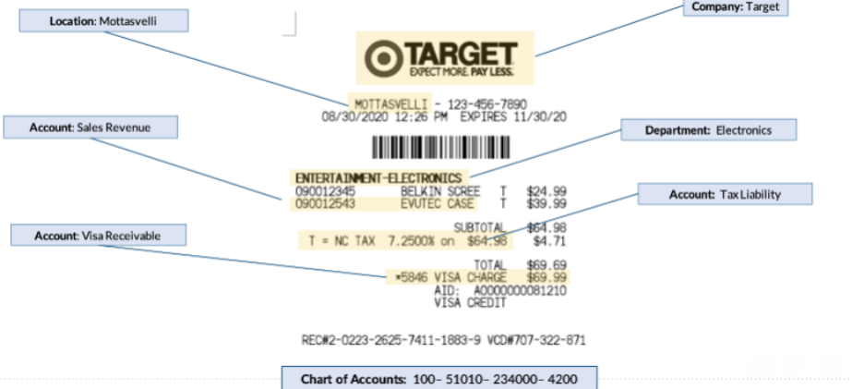
CHART OF ACCOUNTS
To give you an example of a chart of accounts, let’s look at an everyday usage of how retailers leverage their chart to classify financial transactions:
Each field tells a story about the transaction. Here we have, for example, the field tells you the store location, this field tells which department sold those goods, whether it was a sale, a return, or an exchange, which in in the Account segment.
Notes:
These are the areas within ERP, which is the Finance side of WolfieONE. Anyone who uses PeopleSoft finance in the current state will be using some of these areas in the future state – the ones in dark red/maroon.
The General Ledger is the main accounting book of business, which will be managed by the Controller’s Office.
All the other areas around it are called subledgers, and the data in these subledgers flows over to the General Ledger automatically.
The most commonly used areas will be Accounts Payable and Accounts Receivables.
Accounts Payables will be for the University to issue refunds (to students and patients) and for the Stony Brook Foundation (and for them ONLY) to also pay suppliers (companies that provide us products or services).
Accounts Receivables is the area you would use to send out invoices to external parties (only certain units will be expected to use this Receivables area themselves)

