Slide 1
WolfieONE
Monthly Change Champion Meeting
March 2026
Notes:
Before we get to the agenda, the OCM team has been working on revising the deck’s format set you up for success in 2026.
--------
Purpose: Set the tone, reinforce the purpose of the Change Champion network, and establish the meeting as a working change-management forum.
NO IMMEDIATE ACTION or communication needed.
This slide is about orientation and engagement.
Champions ARE EXPECTED to:
Understand the purpose of the meeting
Feel grounded in their role as partners in change
Champions are NOT expected to:
Take action or respond to content on this slide
Change Management Value:
Creates psychological safety and reinforces shared ownership of change.

Slide 2
Agenda
Topic |  | Presenter
Welcome & Introductions |  | Kim
Communications & Key Messages |  | Kim
Champion Learning and Insights |  | Kim
Champion Toolkit Enhancements |  | Kim
2026: Championing Change |  | Kim
Timeline Overview |  | Hina
Questions, Discussion, & Feedback |  | Hina & Kim

Slide 3
Communications & Key Messages
This slide previews the key topics from this month's newsletter to help you prepare for upcoming conversations.
Monthly Newsletter – February being released tomorrow, February 5
Change Champion expectations:
Review the new resources in the toolkit to understand what's relevant this month to share with your teams
Share the identified highlights as appropriate with you teams
Change Champions are NOT expected to:
You are not expected to share everything.
OCM will clearly flag when Champion action is needed
Updated Timeline
Project Updates
  Tax engine for SBF
  Integrations Ecosystem
OCM Updates
  Stakeholder Engagement
    COA educational sessions
    Planning for NERM educational sessions
  Training
    Curriculum is being reviewed
    Leveraging Brightspace to rollout WolfieONE training
    Train-the-Trainer has kicked off
Notes:
Explain the purpose of the monthly comms and the example of what is included in it.

Slide 4

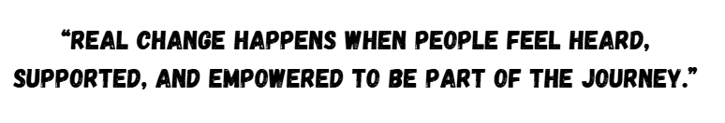
Champion Learning and Insights
Key takeaways from Change Champion Reengagement Meetings from November:
Champions want clearer, more concise messaging materials to share with their teams. Many feel overwhelmed by information and are unsure which materials to disseminate, both from meetings and training videos.
Champions value the established communication channels and regular, proactive updates from the OCM team.
Champions seek additional guidance and clarification on what specific information to share, ensuring their teams receive focused and relevant updates.
Jane Goodall
Notes:
we have incorporated this new slide to prepare you for conversations or concerns you may hear in your areas. In our monthly meetings, we will share what concerns or issues people are having about the project.
Just insight for champions to help them navigate concerns, issues, etc. About WO
For presenter: This side reflects what's being experienced in the field. This is for situational awareness not action needed
Purpose:
1)To provide situational awareness to CC from what we already know: what people are currently experiencing, saying, or asking, and how the change is landing NOW – CURRENT/OBSERVED reality – this prepares champions, reduces surprises
2) Ask Champions what they are seeing and/or know. Does it match what we have heard or know. It validates assumptions for Change team, surfaces blind spots, strengthens trust, improves change decisions
"How the change is actually landing"
Info supplied by: Project and/or Change team
ACTION required is to be prepared for questions and concerns and surface themes, and observations to CM team
This slide is to prepare for you might see or hear, so we are going to say what we’re seeing and hearing
Champions ARE EXPECTED to:
Be prepared for question and concerns
Share patterns they are hearing or seeing
Validate or add context to the themes presented
Surface confusion, resistance, risks, or early wins
Why Is This Happening?
Unclear Role Expectations: Change champions may not fully understand their responsibilities or the importance of their role as communication conduits.
What Change Champions Should Do
Proactively Share Updates: Schedule regular team updates about change initiatives in meetings, emails, or chats.
Tailor Communication: Adapt messages to their audience—focusing on what matters most at each team level.
Ask and Listen: Encourage feedback, gather questions or concerns, and act as a bridge between their teams and leadership.
Model Behavior: Demonstrate positive attitudes about the change themselves, setting an example.
Leverage Available Tools: Use any toolkits, FAQs, or communication templates provided by the change/project team.
Document and Report Back: Keep a log of team concerns and share this with the project team to help refine messaging and support.
Continuous Learning: Seek out information, attend training sessions, and ask for clarity if unsure.
Guiding Conversations
Frame the “Why”: Begin conversations by explaining the purpose and benefits of the change.
Acknowledge Concerns: Validate any worries and explain what’s being done to address them.
Encourage Questions: Use open-ended questions (e.g., “What are your thoughts on this change?”) to foster discussion.
Reinforce Support: Let the team know about resources, support structures, and how they can get help if needed.
Follow Up: Make it clear that communication is ongoing; follow up after initial conversations.

Slide 5
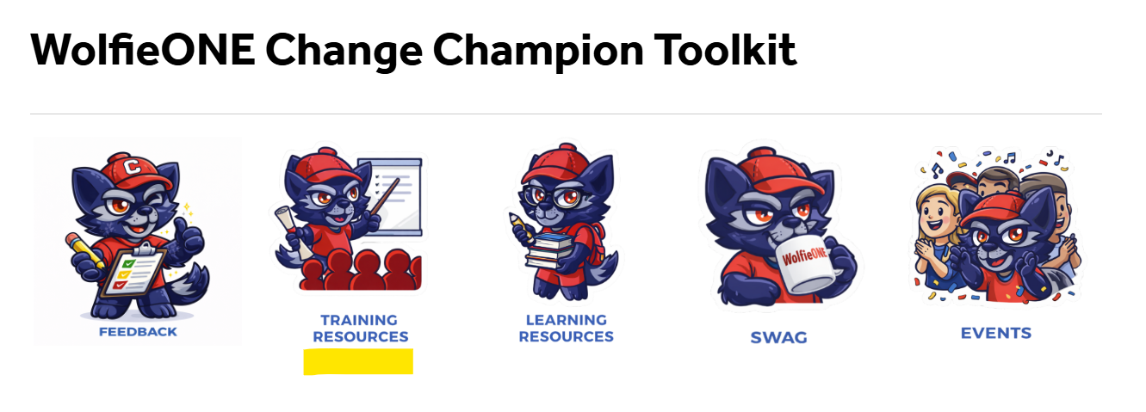
Champion Toolkit Update
New Training Resources Alert:
What has been added: Email Template and Resource Repository
Why: To help you introduce yourself as a WolfieONE Change Champion to your teams OR to let them know about your upcoming/scheduled Champion-led session.
Actions for Champions:
Open the email template, make changes (if you want) to suit your tone, send it out to your teams.
Use the Resources table to choose which of the materials in the Champion toolkit you should present to your audiences.
Email Templates
Repository Link
Champion Toolkit Link
Change Champion expectations:​
Use Training Resources to share WolfieONE updates in a way that work best for your teams​
  Team / Department meetings​
  Staff huddles​
  Email updates​
  Lunch and Learns​ ​
Notes:
Talking point: You (champions) gave us feedback, we heard you, and these are some of the materials that we created to address your needs for more specificity around what needs to be communicated.
Purpose: Create space for dialogue and clarification.
Info supplied by: Champions
ACTION OPTIONAL, but encouraged
Champions ARE EXPECTED to:
Ask questions
Share feedback
Change Management Value:
Builds trust, surfaces risk, and strengthens partnership.

Slide 6
2026: Championing Change
This overview highlights monthly change objectives, and the role Change Champions will play in supporting WolfieONE in the near term.
Goals
Month | March | April | May
Change Objective | Build confidence and foundational knowledge. | Expand departmental awareness and foundational understanding of WO. | Reinforce engagement and participation in training and key readiness events.
Change Champion Actions & Cascade | Self: Participate in Train-the-Trainer program if selected. Complete EDM (Enterprise Data Management) Brightspace learning module distributed from the OCM mailbox on 2/13. Review WolfieONE Overview and refamiliarize yourself with your toolkit. Send your introduction email to your department as their WolfieONE Champion. Cascade to your departments: Share learnings from the EDM module, if applicable. | Self: Present WolfieONE Overview to your departments. Enter feedback and questions into feedback form or encourage your peers to enter them into the CC Toolkit feedback form. Add your event to the CC Events Calendar here Events Cascade to your departments: Encourage your team to complete any WO Web-Based Training (WBT) that has been assigned to them. | Self: Continue to complete assigned training. Present any applicable trainings provided in your toolkit to your departments. Cascade to your departments: Encourage departments to enroll in end-user training. Remind departments about the upcoming Town Hall.
Ongoing Activities: attend monthly meetings, visit the Champions' toolkit, host sessions for your departments as appropriate, and collect and share questions and feedback with the OCM team.
Notes:
on 3/2 EDM completion only 45 of 117

Slide 7

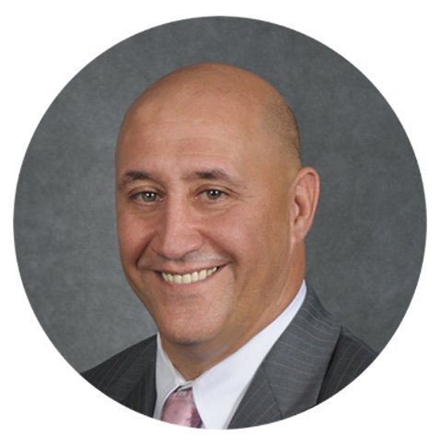
Guest Speaker
Lyle Gomes
Vice President for Finance

Slide 8

Timeline Overview - A Look Ahead at 2026
 | 2023 |  | 2024 |  |  |  |  |  | 2025 |  |  |  |  |  | 2026
 | Sep | Nov | Jan | Mar | May | Jul | Sep | Nov | Jan | Mar | May | Jul | Sep | Nov | Jan | March | May | July
Project Start and Planning
Design and Build
Testing Activities
Implementation
Project Kickoff
Sep 26, 2023
Planning
Workstream Preparation
Design/Build Sprints
We are here
Testing
Testing Start
July 21, 2025
Champion testing
April/May, 2026
Training
Go Live
Jul 1, 2026
PCM Go Live
Jul 7, 2025
Hypercare
Production
Configuration
Production Ready
Notes:
Explain what hypercare is
Hypercare is the initial support period immediately after go-live, when the project team closely monitors the system and provides extra support to address issues quickly as users begin working in the new system.
For presenter: This slide shows where we are in the broader WolfieONE journey.
Keep this at a high-level only.
Purpose: Anchor the discussion in the overall program timeline and reinforce progress.
Info supplied by: Project team.
NO IMMEDIATE ACTION or communication needed.
Champions ARE EXPECTED to:
Understand the current phase of WO.
See how near-term activities connect to long-term goals
Champions are NOT expected to:
Communicate timeline details
Change Management Value:
Builds confidence and reduces uncertainty by reinforcing predictability and progress.

Slide 9
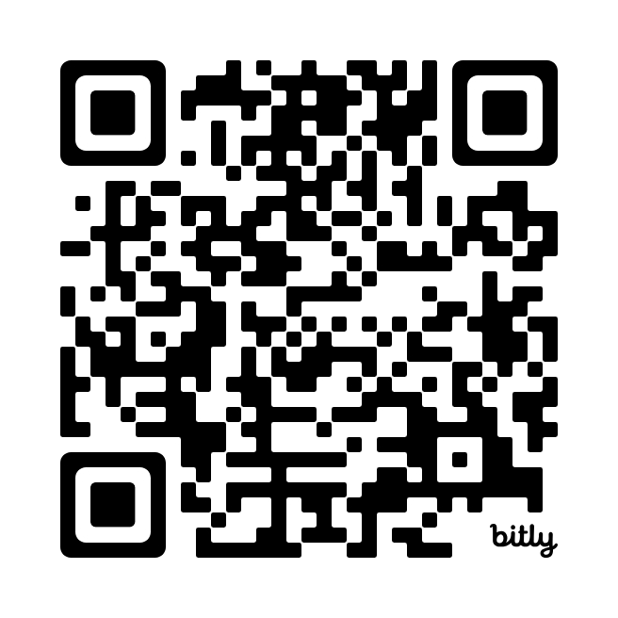
Questions, Discussion, and Feedback
Kim
Share suggestions or feedback on WolfieONE here
or email us
ocm@stonybrook.edu
Notes:
For presenter: This is an open forum for discussion and feedback.
Purpose: Create space for dialogue and clarification.
Info supplied by: Champions
ACTION OPTIONAL, but encouraged
Champions ARE EXPECTED to:
Ask questions
Share feedback
Change Management Value:
Builds trust, surfaces risk, and strengthens partnership.

Slide 10
Thank You!
Suggestions?
Notes:
Hina

Slide 11




placeholder
Thank you for your leadership, partnership, and commitment throughout 2025!
In February, Change Champions helped:
Disseminate key changes through meetings and communications
Surface questions, concerns, and feedback early
Reinforce WolfieONE messages
Your contributions directly supported project momentum and preparedness heading into this next phase.

Slide 12
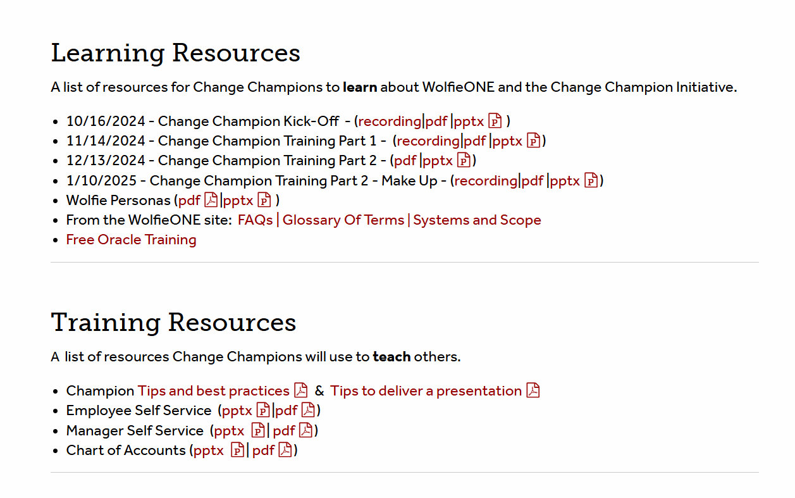
Change Champion Toolkit
Change Champion Toolkit
Notes:
Tomas

Slide 13
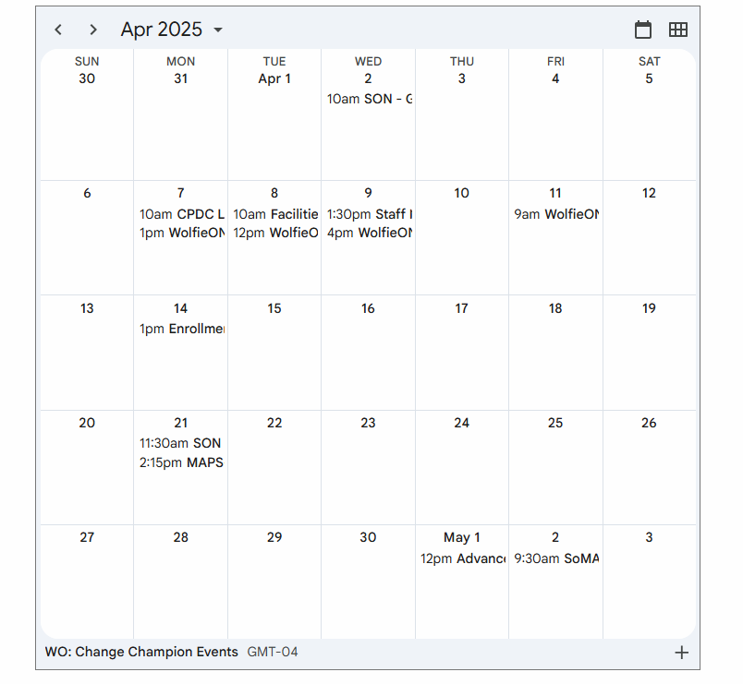
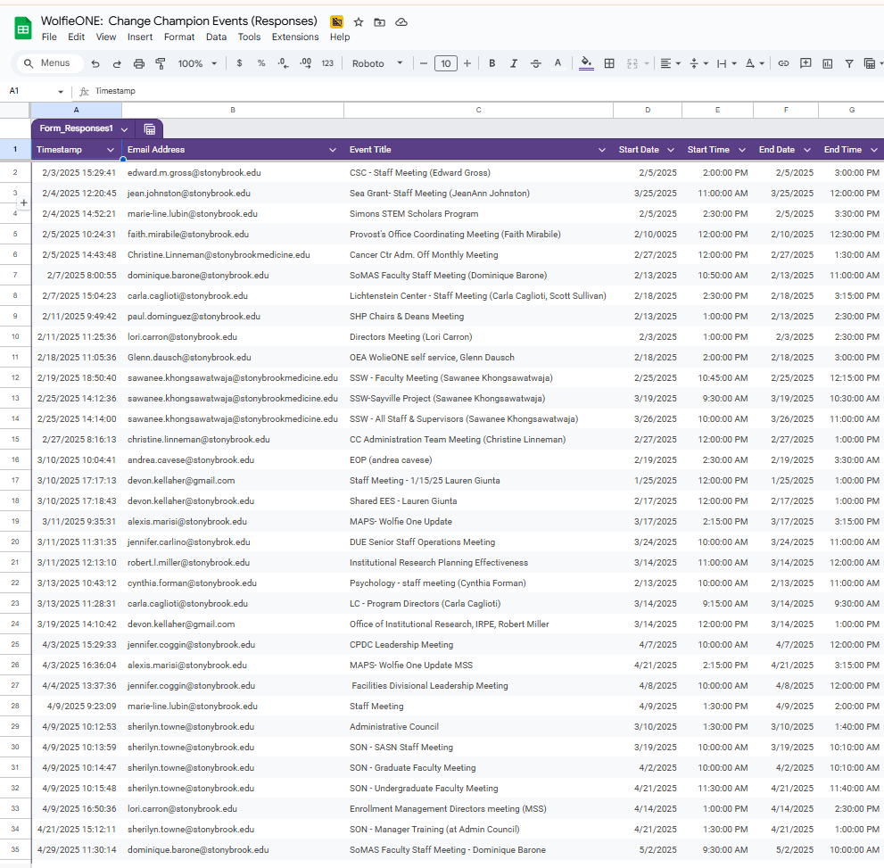
Calendar
WolfieONE: Change Champion Events
Notes:
Put the Calendar and the report.

Slide 14



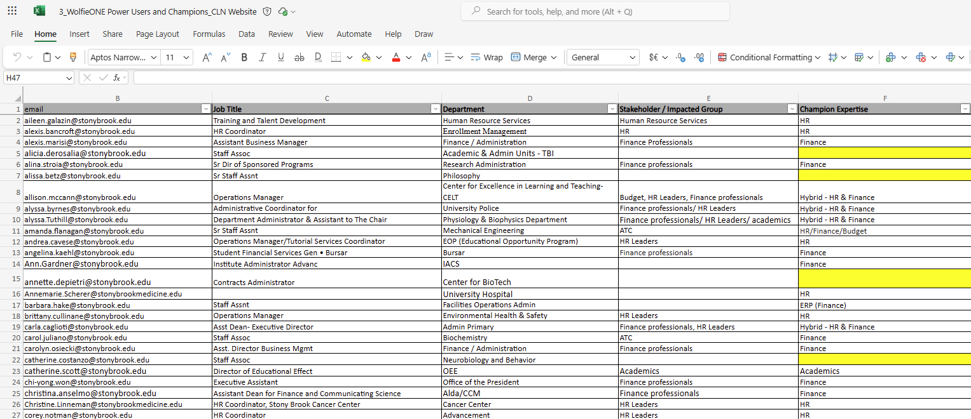
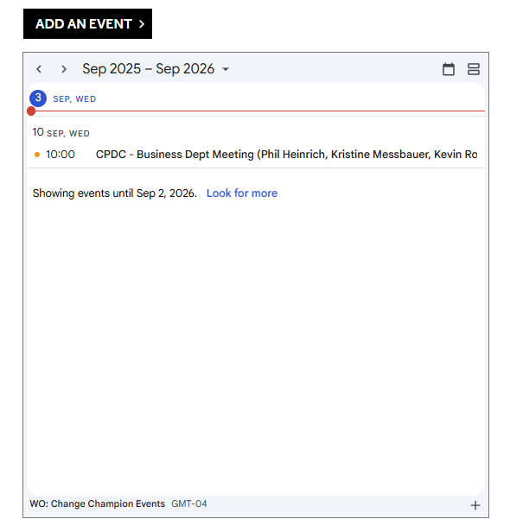
Checklist
Get familiar with OCM / WolfieONE website and the Change Champion Toolkit site.
Add your WolfieONE Change Champion e-signature.
Add your WolfieONE Zoom background.
Set a meeting with your Department/Division to present the COA.
Check the List of Change Champions to see if you can team-up with other Champions.
Add that meeting to the Change Champion calendar.

Slide 15
2026: Championing Change
This overview highlights monthly change objectives and the role Change Champions will play in supporting WolfieONE in the coming months.
Goals
Month | April | May | June | July
Change Objective | Prepare departments for upcoming training and change activities by addressing concerns and readiness gaps. | Strengthen organizational readiness by setting expectations and finalizing support structures. | Build confidence ahead of go-live by ensuring employees know how to prepare and where to get help. | WolfieONE Go Live!
Change Champion Actions & Support | Share department-level feedback Identify areas needing additional support Promote upcoming training Reinforce readiness messaging Flag high-risk areas or concerns Help set expectations cutover | TBD | Encourage training completion Remind teams where to go for help | Serve as a local point of support Share feedback and issues Reinforce patience and adoption
Regular Activities: Attending monthly meetings, reinforcing key messages within your departments, collecting and sharing feedback with the OCM team.
Notes:
For presenter: This slide looks ahead and reinforces the long-term importance of the champion network.
Purpose: Connect current efforts to future vision and sustained change.
Info supplied by: Change team
Champions ARE EXPECTED to:
Understand the long-term role of the champion network
Change Management Value:
Sustains engagement beyond immediate milestones.

