Slide 1
WolfieONE
Monthly Change Champion Meeting
February 2026
Notes:
Before we get to the agenda, the OCM team has been working on revising the deck’s format set you up for success in 2026.
--------
Purpose: Set the tone, reinforce the purpose of the Change Champion network, and establish the meeting as a working change-management forum.
NO IMMEDIATE ACTION or communication needed.
This slide is about orientation and engagement.
Champions ARE EXPECTED to:
Understand the purpose of the meeting
Feel grounded in their role as partners in change
Champions are NOT expected to:
Take action or respond to content on this slide
Change Management Value:
Creates psychological safety and reinforces shared ownership of change.

Slide 2
Agenda
Topic |  | Presenter
Welcome & Introductions | 2 | Kimberly McKenzie
Guest Speaker - Message from our Sponsor | 2-4 | Lyle Gomes
A look Back at 2025 - Champion Network Metrics | 5-10 | Hina Kausar
Timeline Overview - A Look Ahead at 2026 | 11 | Lyle Gomes
Guest Speaker - Testing Update | 12-13 | Nicholas Candela
Q&A with Guest Speakers | 13 | Kimberly McKenzie
Communications & Key Messages | 14
2026: Championing Change | 15-16
Questions, Discussion, & Feedback | 17

Slide 3

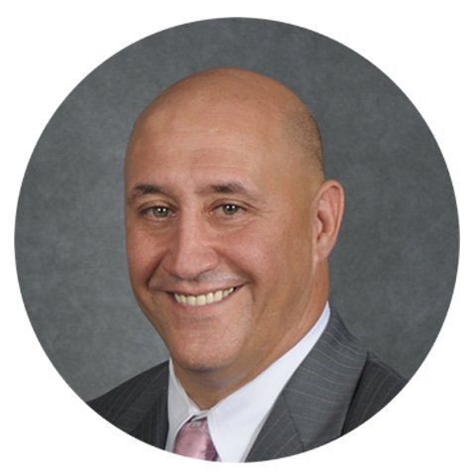
Guest Speaker
Lyle Gomes
Vice President for Finance

Slide 4




Happy New Year!
Thank you for your leadership, partnership, and commitment throughout 2025!
In 2025, Change Champions helped:
Disseminate key changes through meetings and communications
Surface questions, concerns, and feedback early
Reinforce WolfieONE messages
Your contributions directly supported project momentum and preparedness heading into 2026.

Slide 5
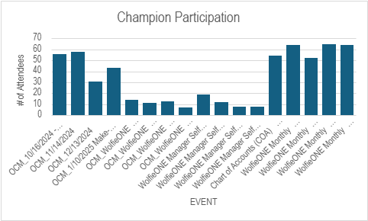
A Look Back at 2025
Change Champion Events – OCM Conducted

Slide 6
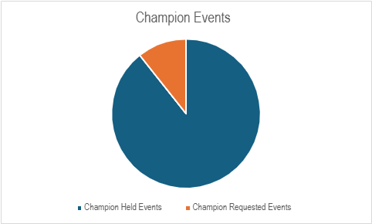
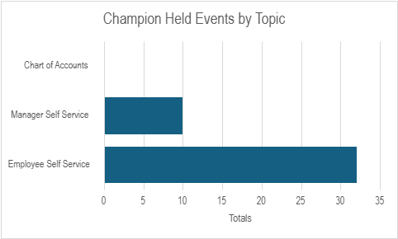
A Look Back at 2025
Change Champion Events

Slide 7
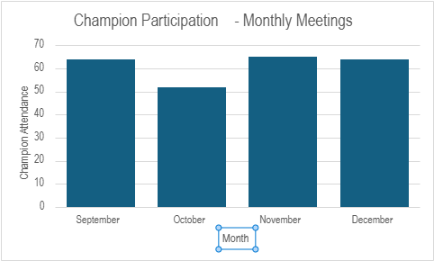
A Look Back at 2025
Champion Monthly Meeting Participation

Slide 8
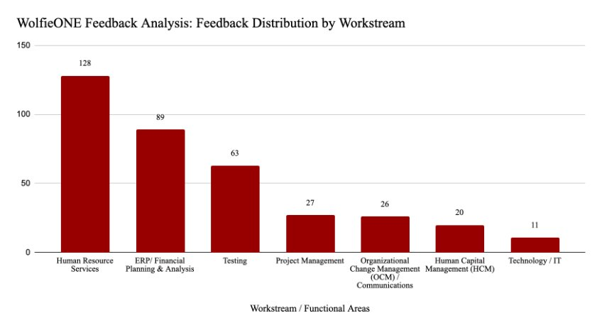
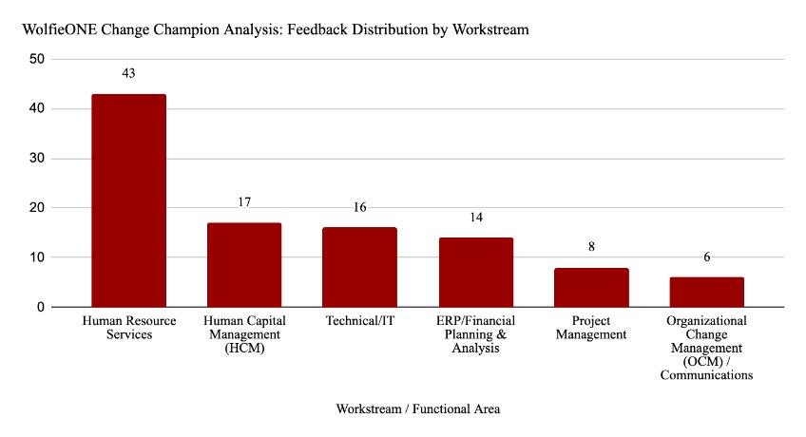
A Look Back at 2025
The Key Takeaway:
Feedback trends remain consistent across all channels. Human Resource Services and ERP/Financial Planning are the primary drivers of engagement, representing the highest volume of inquiries from both the feedback tracker and Change Champion sessions.
Total Feedback : 364 entries
Total Change Champion Session Feedback : 104 entries

Slide 9
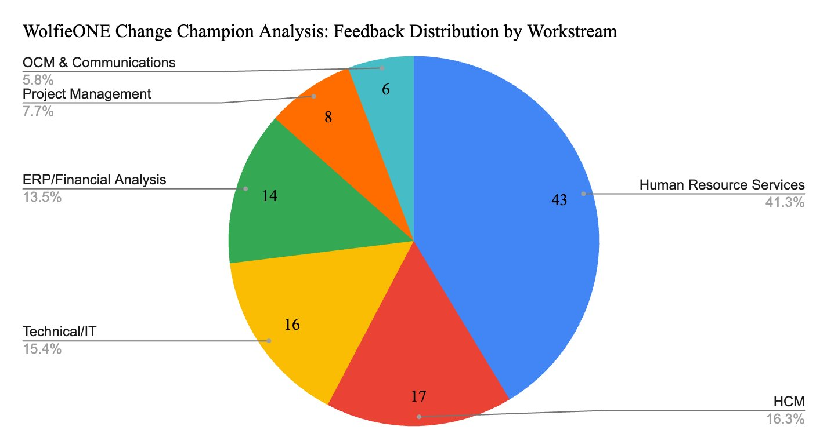
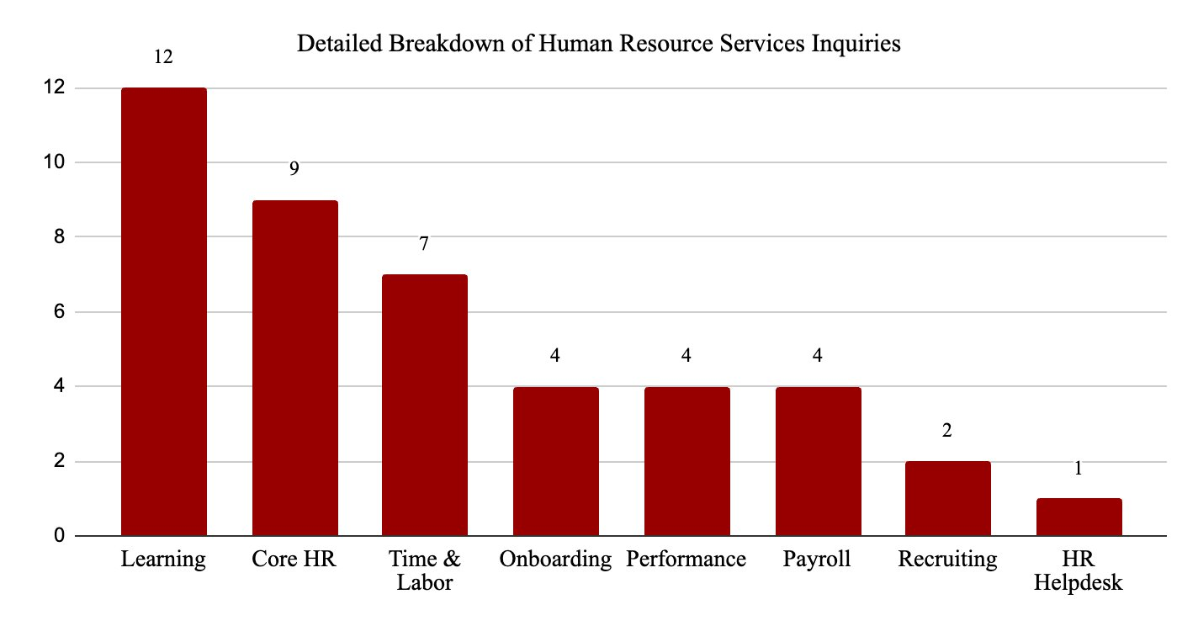
A Look Back at 2025
The Key Takeaway:
Human Resource Services remains to be the primary driver of engagement, specifically with Learning and Core HR functional areas.

Slide 10
A Look Back at 2025
Champion Survey Findings:
There is an overall positive trend in awareness about WolfieONE.
The majority of stakeholders polled are excited and see real benefits to the initiative.

Slide 11

Timeline Overview - A Look Ahead at 2026
 | 2023 |  | 2024 |  |  |  |  |  | 2025 |  |  |  |  |  | 2026
 | Sep | Nov | Jan | Mar | May | Jul | Sep | Nov | Jan | Mar | May | Jul | Sep | Nov | Jan | March | May | July
Project Start and Planning
Design and Build
Testing Activities
Implementation
Project Kickoff
Sep 26, 2023
Planning
Workstream Preparation
Design/Build Sprints
We are here
Testing
Testing Start
July 21, 2025
Champion testing
April/May, 2026
Training
Go Live
Jul 1, 2026
PCM Go Live
Jul 7, 2025
Hypercare
Production
Configuration
Production Ready
Notes:
Explain what hypercare is
Hypercare is the initial support period immediately after go-live, when the project team closely monitors the system and provides extra support to address issues quickly as users begin working in the new system.
For presenter: This slide shows where we are in the broader WolfieONE journey.
Keep this at a high-level only.
Purpose: Anchor the discussion in the overall program timeline and reinforce progress.
Info supplied by: Project team.
NO IMMEDIATE ACTION or communication needed.
Champions ARE EXPECTED to:
Understand the current phase of WO.
See how near-term activities connect to long-term goals
Champions are NOT expected to:
Communicate timeline details
Change Management Value:
Builds confidence and reduces uncertainty by reinforcing predictability and progress.

Slide 12
Guest Speaker
Nicholas Candela
Senior Director Business Transformations

Slide 13
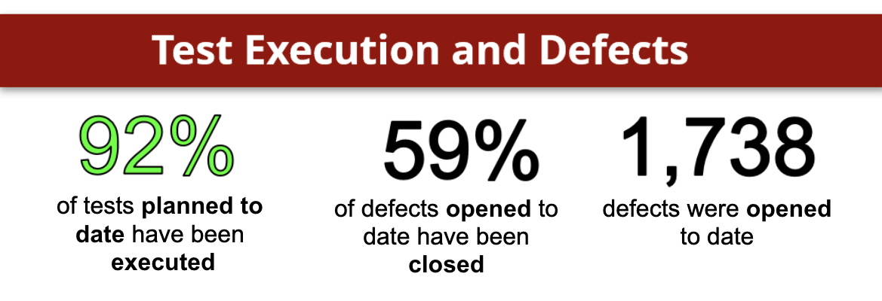
Testing Update
Recap of SIT 3:
Pass Rate was 81% (2609 actual scenarios tested with 2123 passed, 486 failed, and 353 skipped)
The following are the metrics as of 2/2/2026:
2. SIT 4 start date will be 2/23/26 and will end on 3/20/26. ​
3. Upcoming Testing
Notes:
Explain the purpose of the monthly comms and the example of what is included in it.

Slide 14
Communications & Key Messages
This slide previews the key topics from this month's newsletter to help you prepare for upcoming conversations.
Monthly Newsletter - January
Change Champion expectations:
Review the highlights to understand what's new or relevant this month to share with your teams
Share the identified highlights as appropriate with you teams
Change Champions are NOT expected to:
You are not expected to share everything.
OCM will clearly flag when Champion action is needed
Updated Timeline
Project Updates
  Systems Being Retrofitted
  WolfieONE Invoices
OCM Updates
  Stakeholder Engagement
    COA educational sessions
    Planning underway for NERM educational sessions
  Training
    Curriculum has been submitted
    Brightspace being leveraged to rollout WO training
    COA learning module in BS
Notes:
Explain the purpose of the monthly comms and the example of what is included in it.

Slide 15
2026: Championing Change
This overview highlights monthly change objectives, and the role Change Champions will play in supporting WolfieONE in the near term.
Goals
Month | February | March | April
Change Objective | Build shared understanding and alignment around WolfieONE’s purpose, scope, and upcoming changes. | Build confidence and engagement by increasing awareness of upcoming activities and what to expect next. | Prepare departments for upcoming training and change activities by helping address concerns and readiness gaps.
Change Champion Actions & Cascade | Self: Complete Chart of Accounts (COA) and Enterprise Data Management (EDM) training module. Brightspace emails will be in your mailbox soon. Self: Participate in the Train the Trainer (TTT) program if selected. Cascade to your departments: Share (knowledge transfer) this information and resources about COA and EDM. | Self: Prepare for upcoming User Acceptance Testing (UAT) activities involving selected Champions and employees. Self: Attend new educational sessions that will be announced in the coming weeks. | Self: Participate in User Acceptance Testing (UAT), if you are confirmed Cascade to your departments: Set expectations around cutover dates, including a temporary shift from systems we are retiring.
Ongoing Activities: attend monthly meetings, visit the Champions' toolkit, host sessions for your departments as appropriate, and collect and share questions and feedback with the OCM team.
Notes:
Explain UAT (“some time in march more will come out about UAT criteria for who can be a tester”)
Explain Cutover which is the time period in which we will “rehearse” operating in WolfieONE and temporarily refrain from using PeopleSoft and the Campus Budget Module.
For presenter: This slide looks ahead and reinforces the long-term importance of the champion network.
Purpose: Connect current efforts to future vision and sustained change.
Info supplied by: Change team
Champions ARE EXPECTED to:
Understand the long-term role of the champion network
Change Management Value:
Sustains engagement beyond immediate milestones.

Slide 16
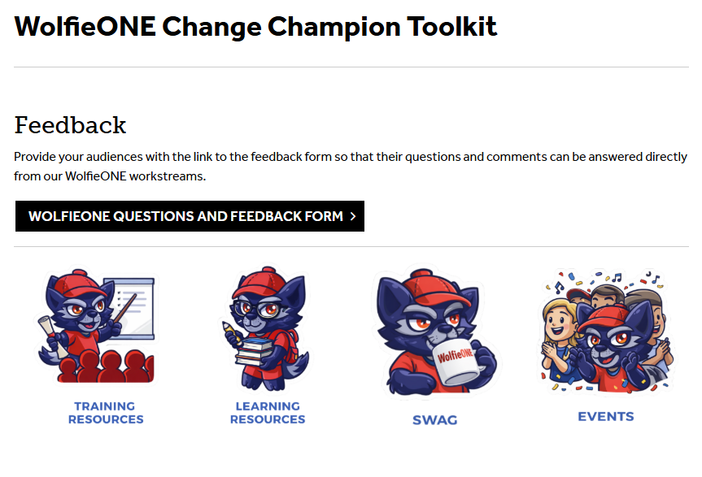
Champion Toolkit Update
New Training Resource Alert:
What has been added: Email template
Why: To help you introduce yourself as a WolfieONE Change Champion to your teams
Action for Champions: Open the email template, make changes (if you want) to suit your professional style, send it out to your teams
Change Champion Toolkit
Notes:
Talking point: You (champions) gave us feedback, we heard you, and these are some of the materials that we created to address your needs for more specificity around what needs to be communicated.
Purpose: Create space for dialogue and clarification.
Info supplied by: Champions
ACTION OPTIONAL, but encouraged
Champions ARE EXPECTED to:
Ask questions
Share feedback
Change Management Value:
Builds trust, surfaces risk, and strengthens partnership.

Slide 17
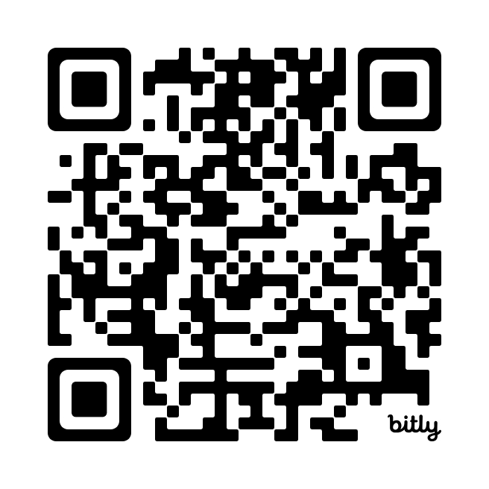
Questions, Discussion, and Feedback
Share suggestions or feedback on WolfieONE here
or email us
ocm@stonybrook.edu
Notes:
For presenter: This is an open forum for discussion and feedback.
Purpose: Create space for dialogue and clarification.
Info supplied by: Champions
ACTION OPTIONAL, but encouraged
Champions ARE EXPECTED to:
Ask questions
Share feedback
Change Management Value:
Builds trust, surfaces risk, and strengthens partnership.

Slide 18
Thank You!
Suggestions?
Notes:
Hina

