Slide 1


Slide 2

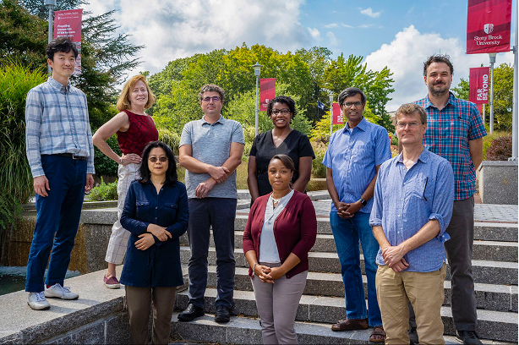
NSF Research Traineeship (NRT)
Data science and artificial intelligence (AI) provide powerful tools for generating new knowledge, fueling innovation, and dealing with society's most pressing problems.
However, "big data" and machine learning tools can perpetuate biases that advantage some people while disadvantaging others.

Slide 3
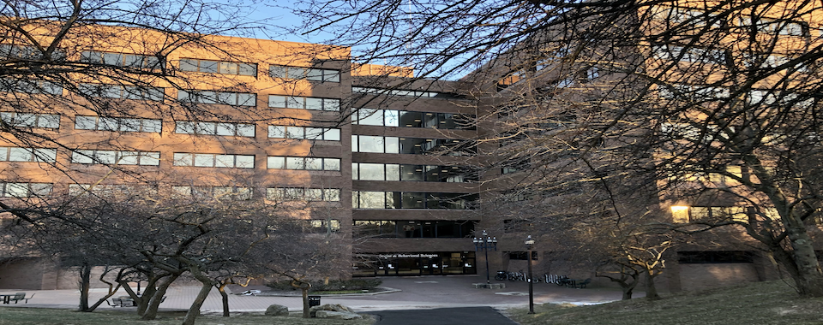
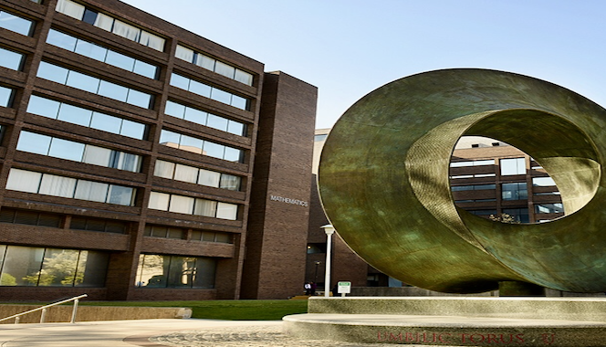
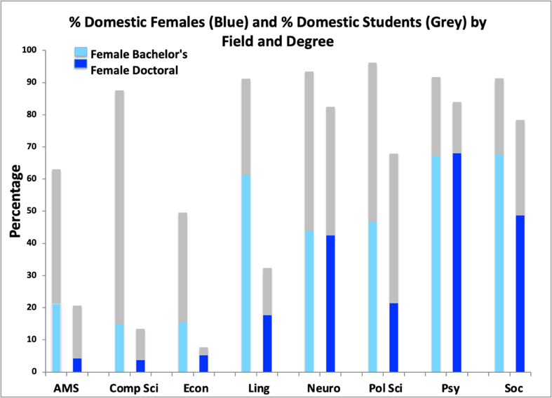
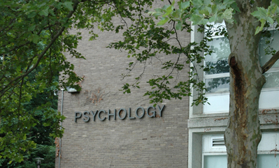


SBU science students tend to gather in distinct silos, with higher proportions of women in the human-centered sciences than in the data sciences.
A lack of diversity in the AI workforce is concerning because addressing bias and solving hard societal problems demands diverse perspectives.
Fig. 1. Stony Brook Students by Field and Degree, Fall 2019
The gray bars indicate % domestic students per field. The blue bars indicate the % of women.

Slide 4

Overview for prospective trainees
This is a new, 5-year graduate training project funded by NSF open to PhD students from the participating human-centered science and data science departments.
BIAS-NRT is creating a two-way bridge between the human-centered sciences (Africana Studies, Economics, Linguistics, Neurobiology & Behavior, Political Science, Psychology, and Sociology) and data sciences (Applied Mathematics & Statistics and Computer Science).
There are two focus tracks within the project:
  Track 1: A Focus in Artificial Intelligence
  Track 2: A Focus in Human-Centered Data Science
Track 1 is open to human-centered science (HCS) students as well as Applied Math & Statistics students.
Track 2 is open to all trainees.
All trainees are expected to participate in at least 2 research practica (like a brown bag, but with hands-on collaboration). The focus will be on bias in data, people, and institutions. Trainees and faculty across disciplines will collaborate on convergent data science research projects. You can join an existing project, or you can develop your own.

Slide 5

A Focus in Artificial Intelligence
PhD students from Applied Mathematics & Statistics, Africana Studies, Economics, Linguistics, Neurobiology & Behavior, Political Science, Psychology, and Sociology can choose the Focus in Artificial Intelligence.
This focus requires four courses (12 credits), at least one of which must be Machine Learning or Artificial Intelligence.
Intensive “bridge courses” offered will prepare students without formal Computer Science preparation to succeed in these Computer Science graduate courses, along with a cohort of other NRT trainees .
You can take whichever of the 3 bridge courses (algorithms, theory, and programming) that you need. These are an intensive introduction to what an undergrad computer science major covers, but for graduate credit. Two can be counted toward the AI Focus.
Please note: an elementary knowledge of programming is preferred.

Slide 6
A Focus in Artificial Intelligence
This focus requires 12 credits (four courses), at least one of which must be CSE 512: Machine Learning or CSE 537: Artificial Intelligence. The remaining courses can be chosen from the list below.
CSE 505: Computing with Logic
CSE 512: Machine Learning
CSE 519: Data Science Fundamentals
CSE 525: Robotics
CSE 527: Computer Vision
CSE 537: Artificial Intelligence
CSE 538: Natural Language Processing
CSE 544: Probability and Statistics for Data Scientists
CSE 545: Big Data Analytics
CSE 564: Visualization

Slide 7
AI Focus: Bridge Courses
Students without formal preparation in Computer Science may count up to two of the following graduate-level preparatory ("bridge") courses toward the focus and should consult with the admission committee before taking the other graduate CS courses.
CSE 581, Computer Science Fundamentals: Theory
CSE 582, Computer Science Fundamentals: Data Structures and Algorithms
CSE 583, Computer Science Fundamentals: Programming Abstractions

Slide 8

A Focus in Human-Centered Data Science
All trainees, from both the human-centered sciences and the data sciences, can choose the Focus in Human-Centered Data Science
This focus requires four courses (12 credits): two core DS/CS courses (one in algorithms and one in machine learning) and two electives
The electives are chosen from a list of interdisciplinary courses from the following departments: Africana Studies, Computer Science, Economics, Linguistics, Neurobiology & Behavior, Political Science, Psychology, and Sociology.
At least one of the electives must be chosen outside of the home department and not cross-listed
It is important to note that courses taken outside of your home department require instructor approval. Admission to the focus does not guarantee instructor approval.
Additional courses, not explicitly listed, may be used to satisfy the electives requirement with prior permission of the Focus program’s director.

Slide 9
A Focus in Human-Centered Data Science
DS/CS Core: Both of the following
Algorithms: CSE 582: Computer Science Fundamentals: Data Structures and Algorithms
    Alternative: AMS 542 / CSE 548: Analysis of Algorithms
Machine Learning: AMS 580: Statistical Learning
    Alternative: AMS 520: Machine Learning in Quantitative Finance or CSE 512: Machine Learning

Slide 10
A Focus in Human-Centered Data Science
AFS 502: Research Methods in Africana Studies
AFS 533: Race, Gender and Globalization
AFS 536: Africa and Globalization
*CSE 564: Visualization (AMS and CS students require approval)
ECO 522: Applied Econometrics
ECO 612: Computational Economics and Dynamic Modeling
ECO 640: Labor Economics I
ISE 503: Data Management (AMS and CS students require approval)
LIN 521: Syntax
LIN 523: Phonology
LIN 637: Computational Linguistics 2
NEU 534: Principles of Neurobiology
NEU 536: Introduction to Computational Neuroscience
NEU 537: Neurotransmission and Neuromodulation
NEU 547: Introduction to Neural Computation
POL 626: Social Networks
POL 632: Mass Communication and Political Persuasion
POL 633: Social Influence in Political Decision Making
PSY 507: Meta Analysis
PSY 513: Attention
PSY 516: Judgment & Decision Making
PSY 520: Psycholinguistics
PSY 549: Prejudice and Discrimination
PSY 620: Bayesian Analysis
SOC 504: Logic and Practice of Sociology
SOC 509: The Practice of Ethnography
SOC 516: Sociology of Inequality
SOC 518: Sociology of Gender
SOC 556: Political Sociology
SOC 561: Cultural Sociology
Trainee will choose 2 electives (at least one outside of their home department)
*Requires Python programming knowledge

Slide 11
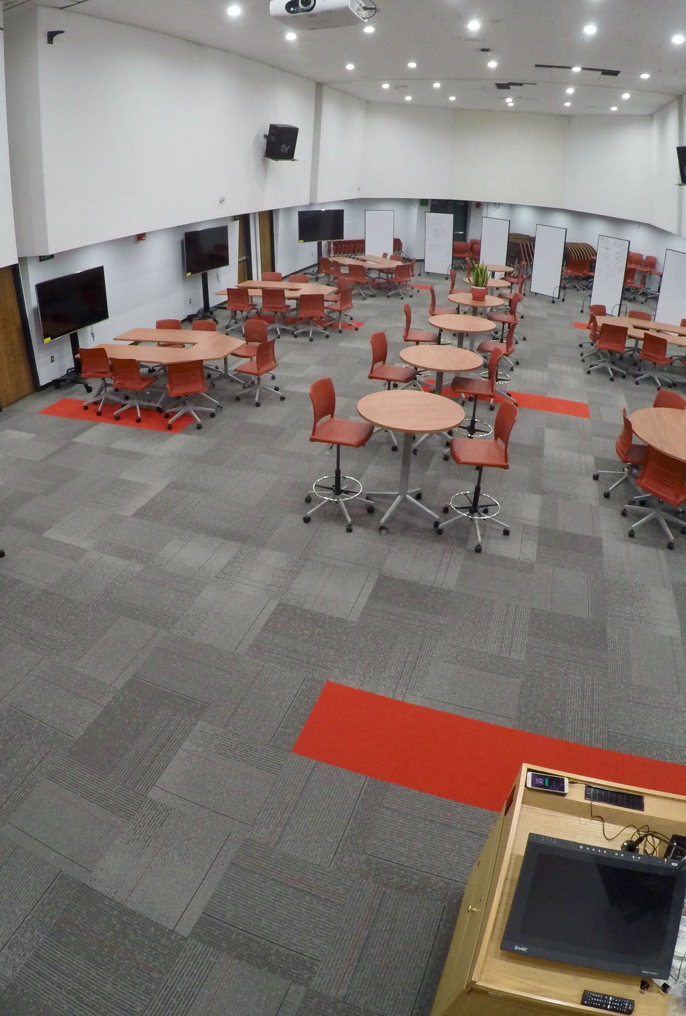
Research Practica
Three research practicum topics will be offered 2-3 times each, during the course of this program as Special Topics seminars.
Trainees are required to enroll in at least two
The three rotating topics are: Bias in Data, Bias in Humans, and Bias in Institutions.
As a trainee, you will learn about current topics related to bias, conduct research with faculty and trainees from other disciplines, engage in collaboration, and present your work.
These are expected to be collaborative and supportive settings, where trainees and faculty alike will have the opportunity to learn from one another.

Slide 12
Eligibility and Funding
Trainees can be non-funded or funded (fellows). Fellows must be US citizens, nationals, or permanent residents to receive NSF funding.
The NSF stipend level is $34K per year.
Students must apply to become trainees first before applying for funding.
Fellows will receive one year of funding and can apply for a second year
Travel funds are available for all trainees (not just fellows).
It’s important that trainees succeed in their primary PhD program as well as in their NRT-related activities.
Trainees will collaborate on interdisciplinary research projects in research practica.
Trainees are expected to remain engaged with NRT program activities, which will include sporadic surveys, until they complete their PhD, even if their dissertation is on a different topic.

Slide 13
Additional Information
The ideal time to become a funded trainee is around the time you advance to candidacy (the year before you advance, or the year just afterward). This is because you need to succeed in your primary PhD program as well as in your NRT-related activities.
Funded trainees in the human-centered sciences will be selected in their 3rd year; those in Computer Science/AMS advance earlier and are expected to become trainees in their 2nd year. Students may apply to become non-funded trainees at any time.
Deadline for funding for the Fall 2022-Spring 2023 school year is May 1st, 2022.
Applications for traineeship and funding can be found on our website under “How to Apply”
You can do an optional data science internship that we will help arrange (this may increase your time to graduation).

Slide 14
To Apply
Speak with your advisor about whether this traineeship is a good match for you and your research. Advisors will be contacted after receiving your application.
A CV and a personal statement are required. The personal statement should be 1-2 pages long and include your current research direction, as well as what interests you about the theme of this traineeship.
Applications are now open, Apply Here!
Questions? Email
BIAS_NRT@stonybrook.edu
Contact us directly:
Kristen.Kalb@stonybrook.edu
Susan.Brennan@stonybrook.edu
Cram@cs.stonybrook.edu
Wei.Zhu@stonybrook.edu

